Slide 1



WS50 powered by Workcloud
The easy way to fully connect your retail frontline workforce
March, 2024

Slide 2

Topics
Challenge and solution
The WS50 mobile computing platform
New wearable mounting accessories designed-for-retail
The software — Zebra Workcloud, Item Lookup and Voice AI Assistant
Mobility DNA — only from Zebra
Service and support

Slide 3

Challenge and Solution

Slide 4

Handheld mobile computers serve 33%* of today’s retail associates with instant access
to whatever they need to deliver a great customer experience.
The ‘unserved’ 66%* don’t carry a fully-featured mobile computer, yet they perform some of the most important tasks in your store — including assisting your customers.
How do all those ‘unserved’ associates impact your store?
* Zebra Business Market Intelligence/Global Statistics

Slide 5

Every associate that is not connected impacts store operations, customer service and the customer experience
Tasks take longer to complete — reducing productivity
Questions take longer to answer — keeping customers waiting and potentially leaving without making a purchase
Some information just isn’t readily available — like item details
The ‘unserved’ do need a real-time connection to store data
and other staff members to increase efficiency…but that
doesn’t require a fully-featured handheld mobile computer
So…what’s the answer?
5

Slide 6
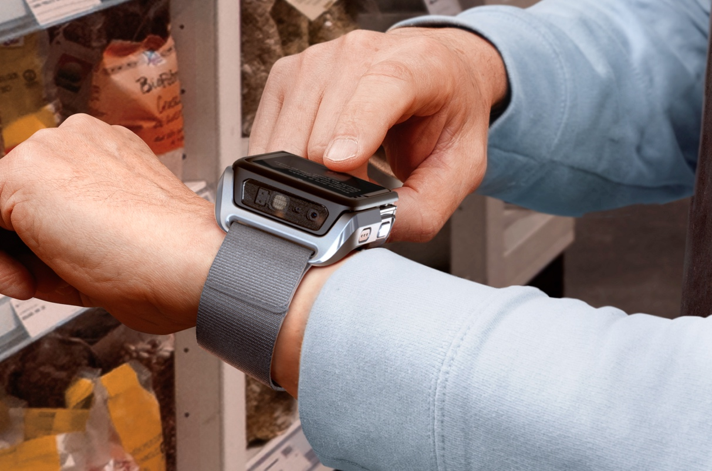
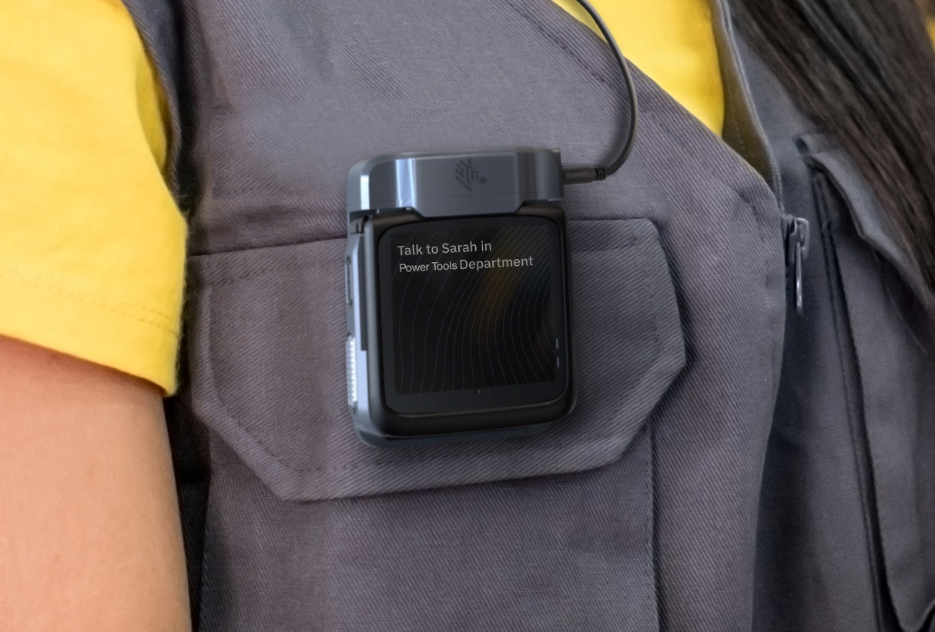
Introducing the
WS50
powered by Workcloud
The industry’s first fully-featured wrist- and clip-wearable enterprise-class Android touch computer, optimized for retail
Fully connect your retail frontline workforce with the right-sized and purpose-built wearable mobile device designed for today’s unserved retail associates
Designed specifically to empower workers that
don’t carry a handheld mobile computer today
with the features they need to complete tasks and
assist customers most efficiently

Slide 7
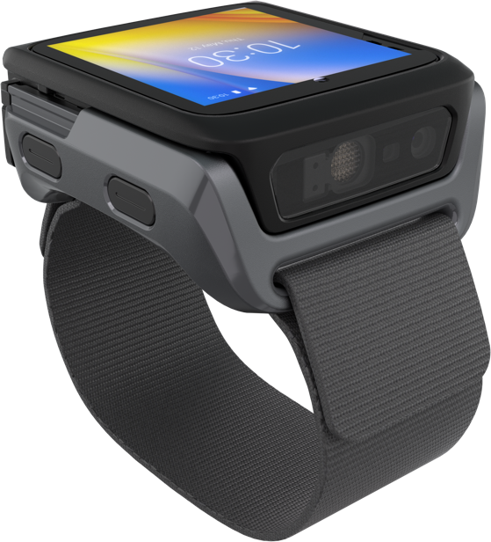


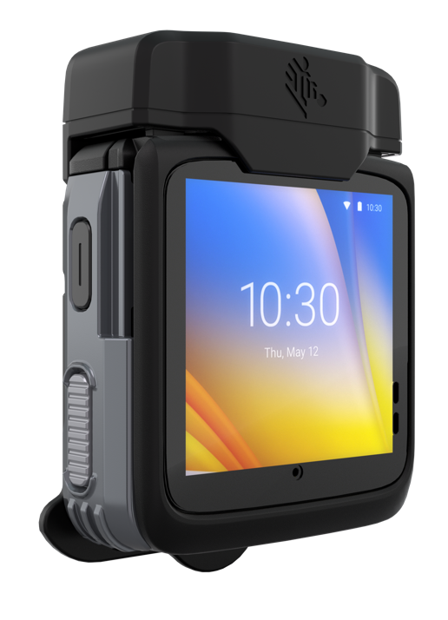

A solution created for today’s unserved workers
The world’s smallest Android wearable enterprise mobile computer
paired with four powerful software applications
Voice AI Assistant
Enables hands-free operation with a powerful true natural language voice AI engine that allows workers to simply ask for what they want in their own words
Workcloud Task Management
Supervisors can quickly and easily assign tasks that workers accept and confirm when complete
Workcloud Communication PTT
Enable instant collaboration
with 1-to-1 and 1-to-group
push-to-talk calls with
co-workers and supervisors
Item Lookup
Integrates with your inventory system to allow workers to scan a barcode and ask the Voice AI Assistant for inventory information
WS50 Android Wearable Computer
Choose from two new mounts specially designed for retail: thin wrist and clip

Slide 8

The WS50
mobile
computing platform
Right-sized for today’s unserved workers

Slide 9

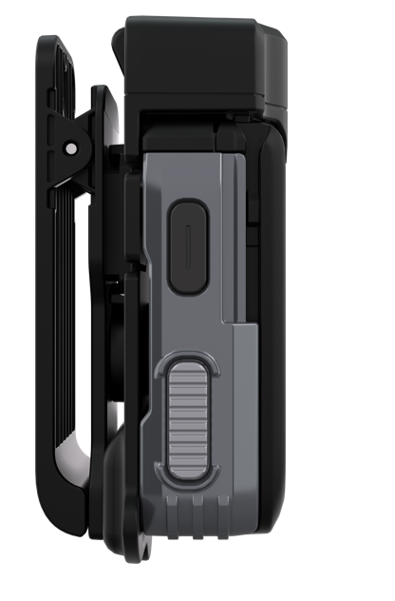
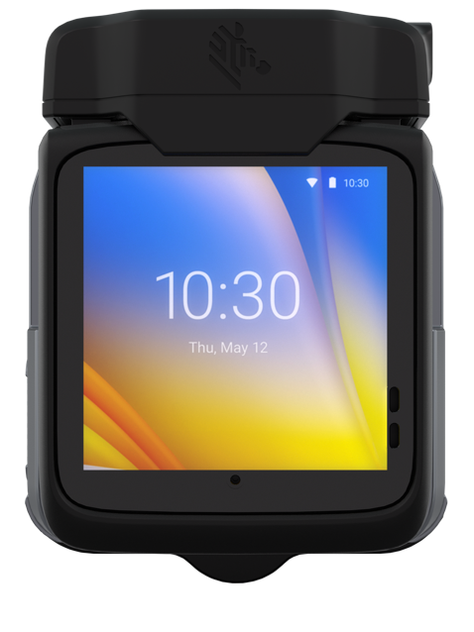
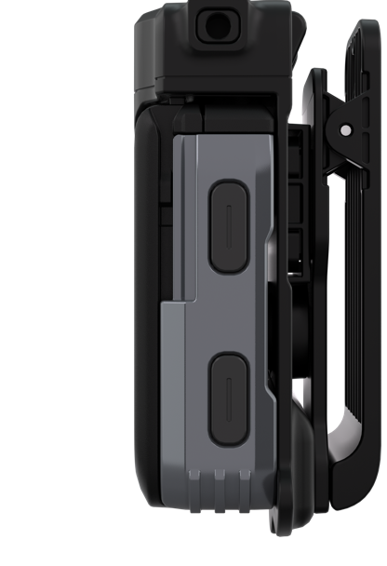
Clip mount: multi-modal operation
Intuitive design needs only minutes of training —
ideal for permanent and seasonal workers
1
Programmable Button
(clip mount only)
Programmable for mute/panic/emergency or
other function
Three modalities for device interaction:
3
1
Buttons
2
Interactive
touchscreen
3
Voice queries
via Voice AI
Assistant
1
Scan
Back
1
2
1
PTT/
Voice AI
Home
1

Slide 10
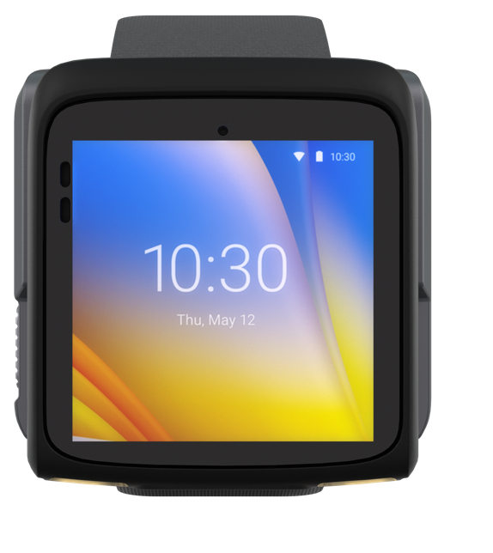
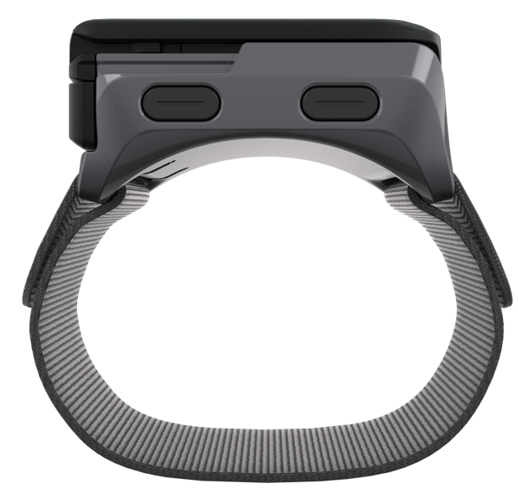
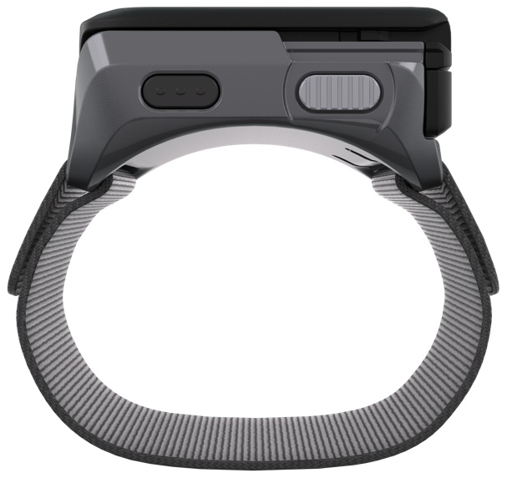
Thin wrist mount: multi-modal operation
Intuitive design needs only minutes of training —
ideal for permanent and seasonal workers
3
Three modalities for device interaction:
1
Buttons
2
2
Interactive
touchscreen
3
Voice queries
via Voice AI
Assistant
Back
Home
Scan
PTT/
Voice AI
1
1
1
1

Slide 11

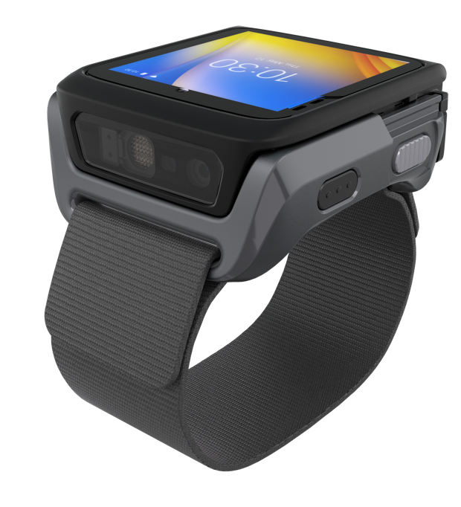



Voice-enabled for easy hands-free operation
Three voice modalities
Bluetooth headset for wireless voice communications
Bluetooth is supported on both clip mount and wrist versions, providing cord-free freedom
Dedicated large textured Voice AI Assistant and PTT button is easy to find
Corded headset
Prefer not to use Bluetooth? The clip mount’s universal 3.5 mm audio jack supports standard headsets
Built-in microphone and speaker
Simply speak in natural language and the WS50’s Voice AI Assistant will take the appropriate action

Slide 12
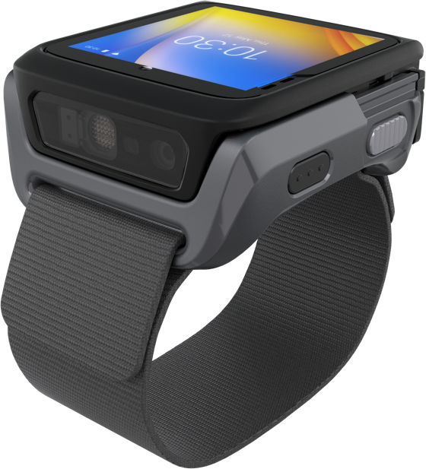
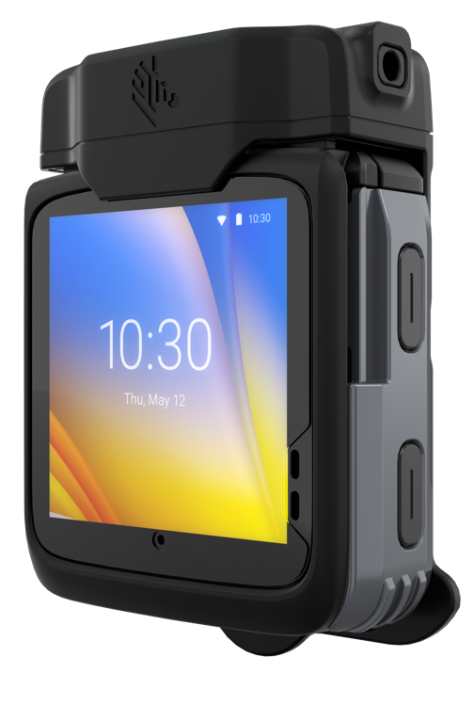
All the right features
Lightweight
High resolution 13MP camera for easy barcode and image capture
Low discrete profile
Mobility DNA Fusion for superior
Wi-Fi performance and reliability
Hot-swappable batteries — no need to take it out of service to charge
Flexible charging options — cradles that charge devices and spare batteries; USB cable for wristband
Easy management via your EMM
Interoperability with other
Zebra mobile devices running Workcloud software
Designed for full-shift comfort
Rugged, designed to last – drop
and tumble tested and IP sealed
2-inch AMOLED advanced color touchscreen display; extraordinarily
bright – no backlight required
Textured buttons that are easy
to find and easy to identify

Slide 13

New wearable mounting accessories designed for retail

Slide 14

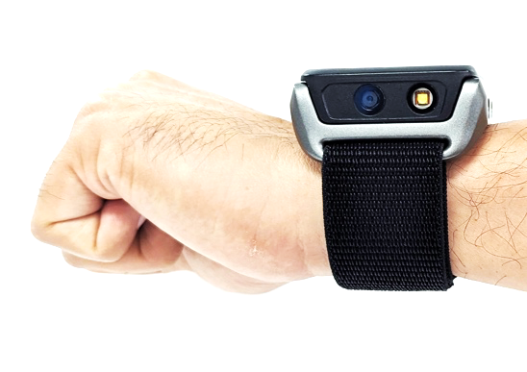
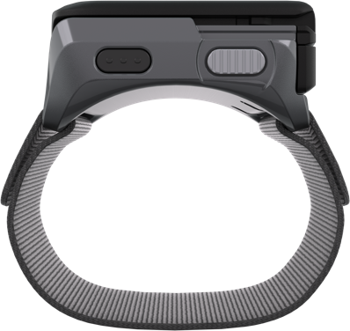
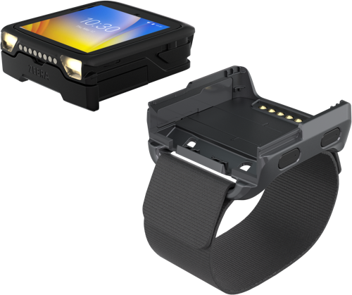
New wrist mount
Thinner materials chosen for comfort, easy to adjust, easy to change wristbands
Low profile
Doesn’t protrude, isn’t bulky, it’s discreet to work seamlessly for the task at-hand
New ultra-thin wristband
Nylon Velcro strap provides all-day wearing comfort, and is adjustable to fit any size wrist
Easy to detach
Just press a button to release the WS50 from the wristband; easily switch to another associate's personal wristband or charge in a cradle

Slide 15
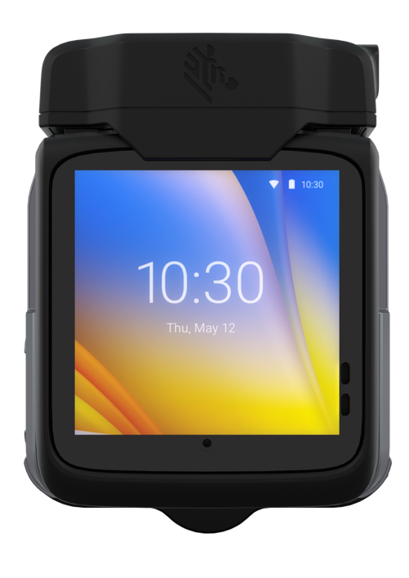
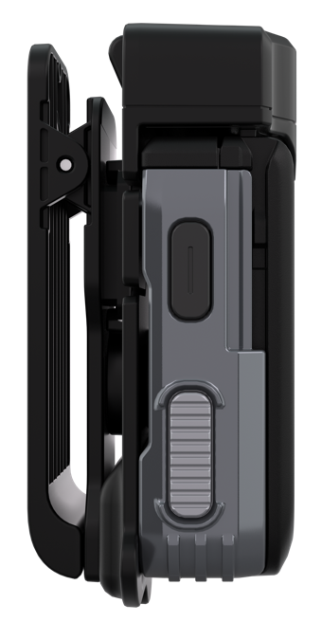
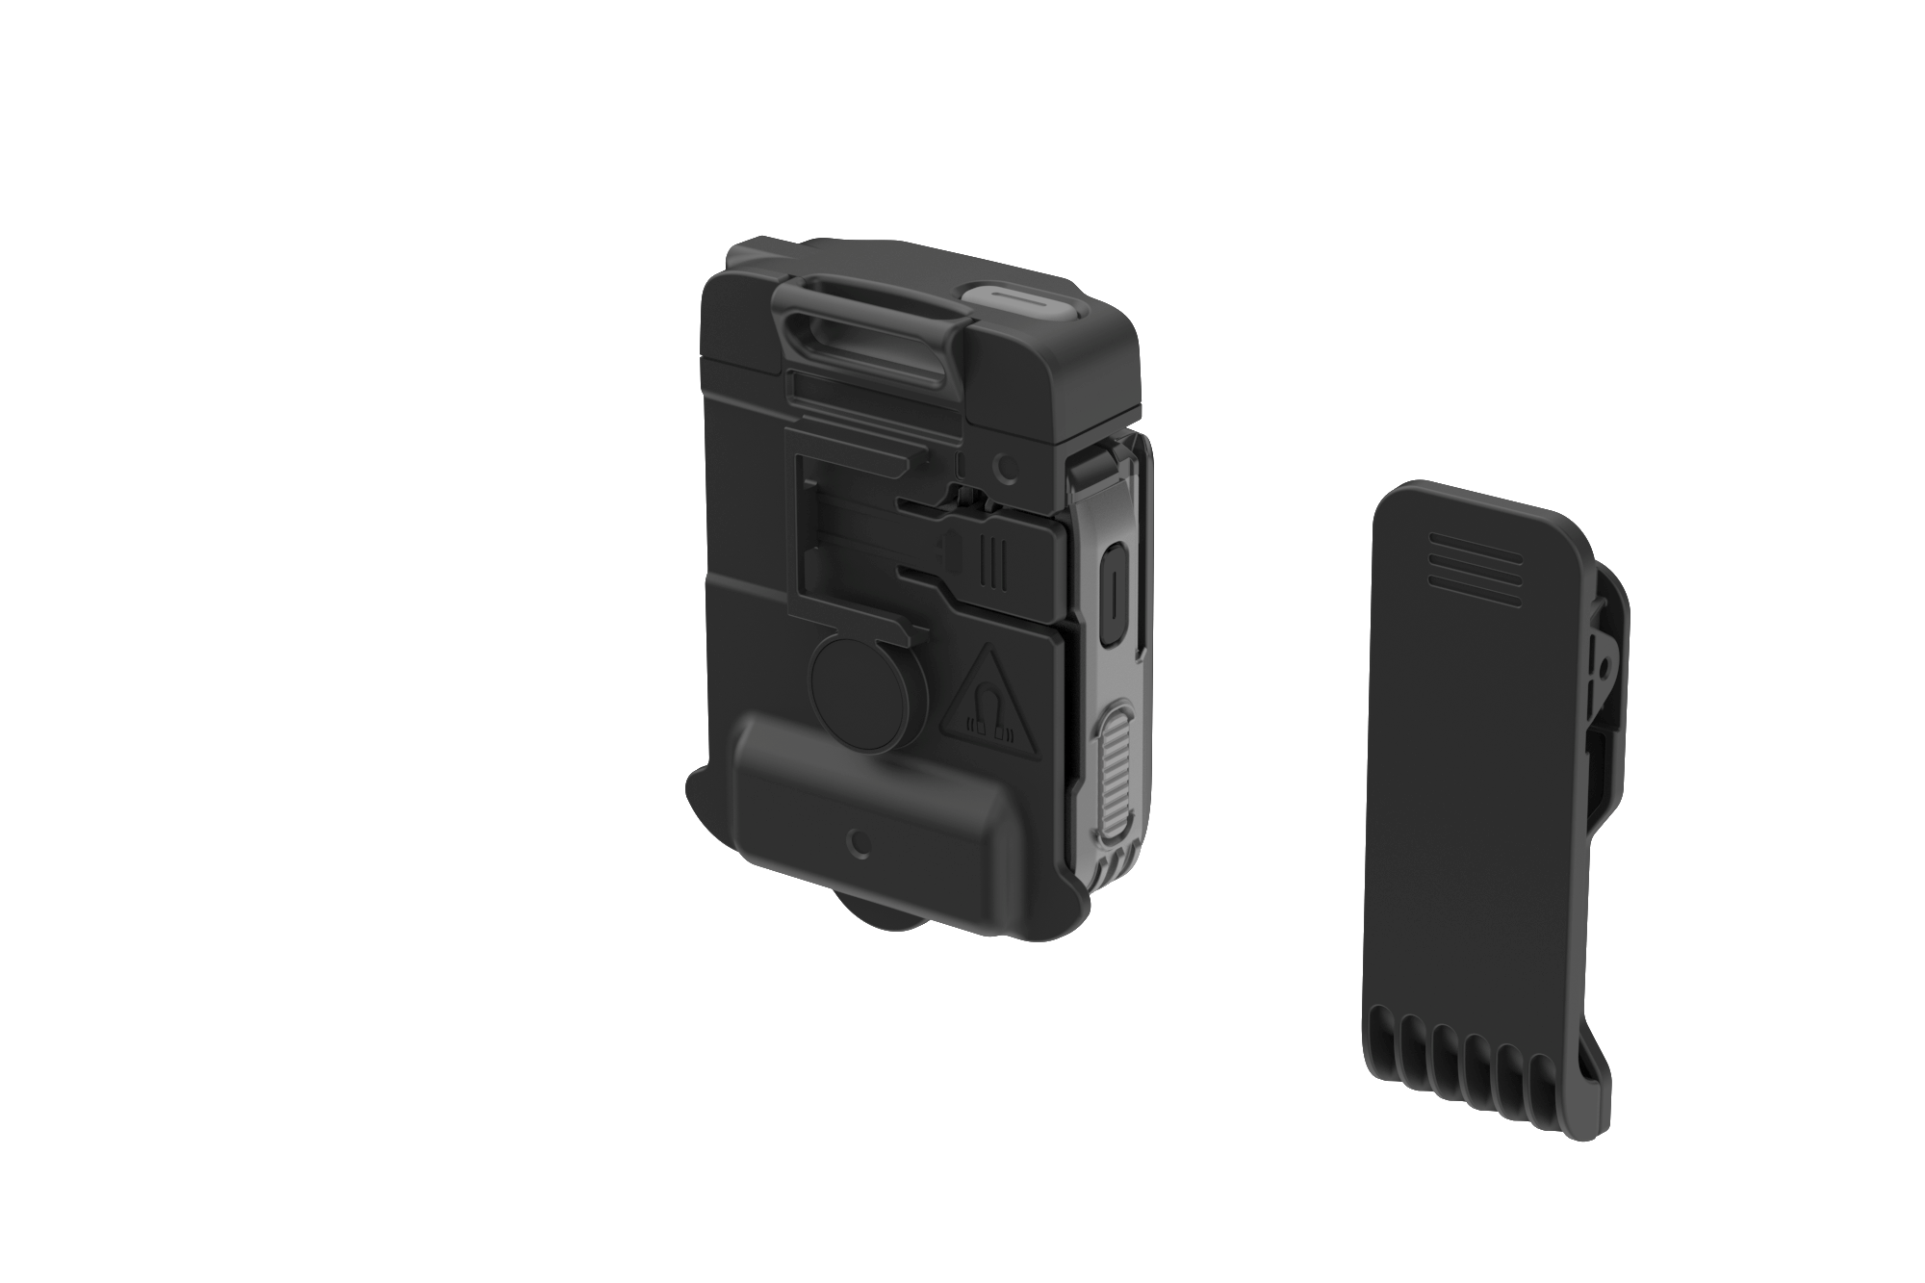
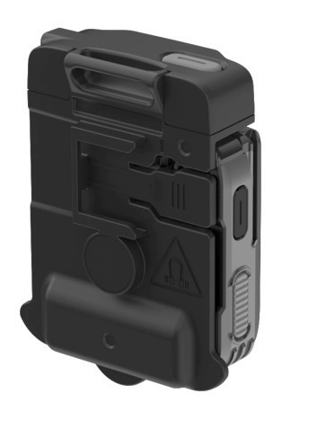
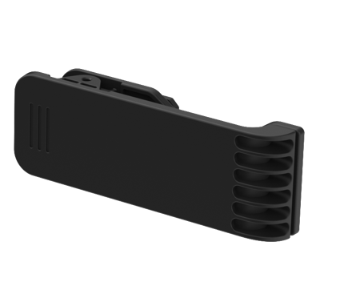
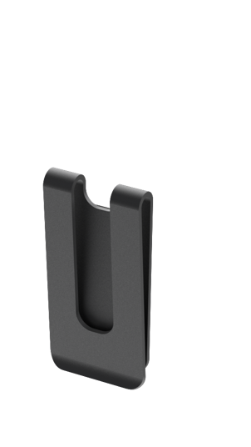
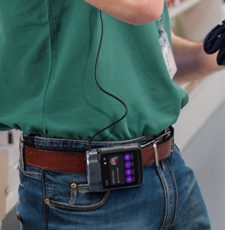

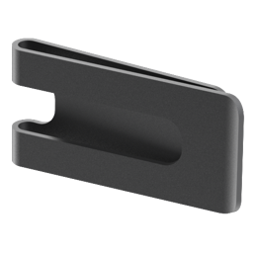
New versatile clip mount
A wearing style for every worker, regardless of what they are wearing
Horizontal clip orientation for belts
Vertical clip orientation
for vests and aprons
Just swivel the clip to change orientation — workers can change as needed to clip on whatever they are wearing

Slide 16

Thoughtfully selected software — including Zebra Workcloud™

Slide 17

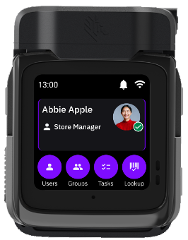
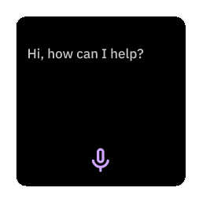
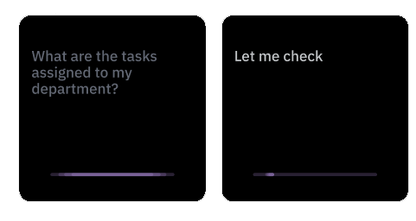
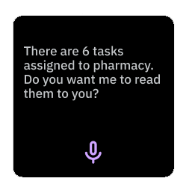
Voice AI Assistant
Turns the WS50 into a hands-free solution
Features
True natural language voice AI engine
Allows workers to speak naturally
Sophisticated algorithm analyzes the natural language spoken words, determines intention and takes the
right action
Supports multiple languages

Slide 18

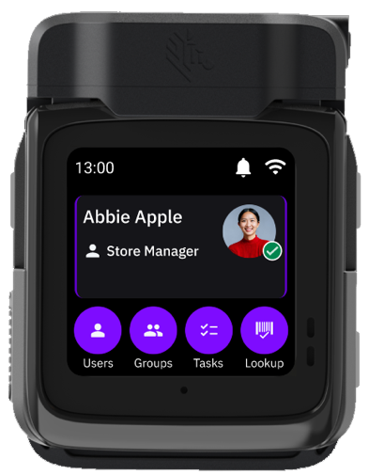
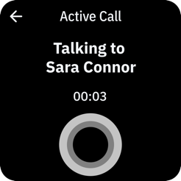
Workcloud Communication PTT
Enable instant push-to-talk calls for superior collaboration
Features
Enables workers to place and receive instant push-to-talk calls with co-workers and supervisors
Both mounts support wireless Bluetooth headsets;
the clip mount also supports wired headsets
Both mounts enable voice via the built-in microphone and speaker — no headset required
1-to-1 and 1-to-group calling
Enterprise grade security on every call
Supports multiple languages
Simple software download

Slide 19

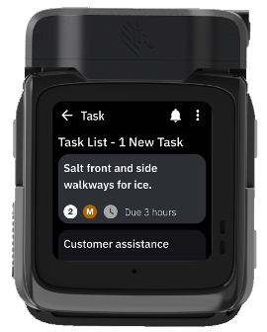
Workcloud Task Management
Enable associates to execute tasks more efficiently
Workcloud Task Management
Easily accept, complete and update the status of tasks from supervisors
Provides managers with real-time visibility into tasks, who is responsible for each task and whether the task has been completed
Workers have clear direction on the tasks they are responsible for
Task management is more efficient

Slide 20

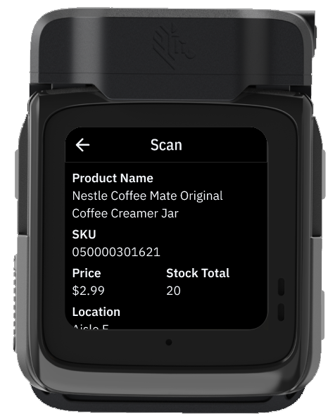
Item Lookup
Enable associates to look up inventory information in seconds
Features
Front end application that integrates with your backend inventory system
Supports web-enabled inventory system access, including SAP and Oracle
After scanning the barcode on an item, workers can simply ask a context-aware question to get more information — such as ‘How many units are in stock?’ or 'Do we have any units in red?
Eliminates the need for workers to navigate through screens to find out about inventory availability, available colors or related and similar items

Slide 21

Mobility DNA — only from Zebra

Slide 22

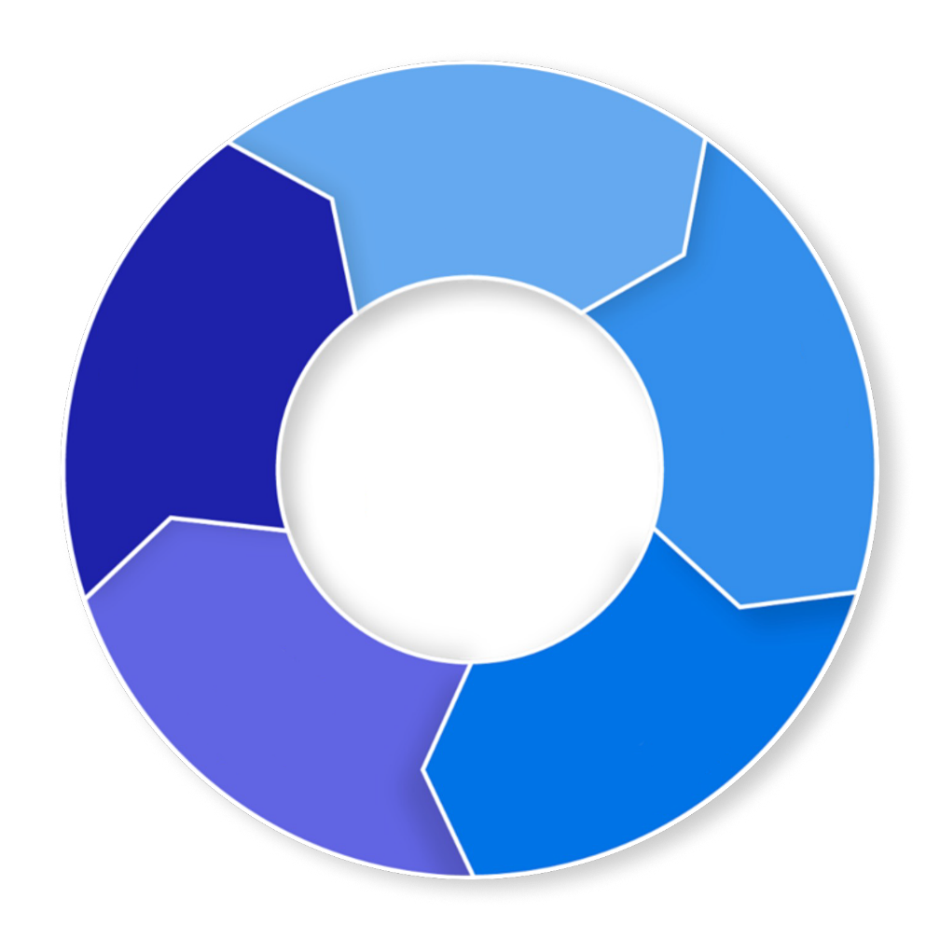





Mobility DNA Software Suite
Intuitive app-based capabilities that simplify every aspect of the device lifecycle
Integrate
Developers can effortlessly create and integrate mobile computer apps in less time with less risk
DataWedge API
Enterprise Browser
Integrate
Enterprise Mobility Management Tool Kit
Optimize
Enable workers to do more by improving the performance and UX of their mobile computers
Optimize
Secure
Maximize IT’s ability to address new and emerging threats
Secure
Device Central
Mobility DNA
Enterprise Home Screen
Enterprise Keyboard
Identity Guardian
LifeGuard™️ for Android™️
Mobility Extensions (Mx)
Manage
Deploy
Manage
Help IT reduce the complexity of managing and maintaining mobile computers
Deploy
Rapidly stage and easily configure small to large batches of mobile computers
Bluetooth Manager
Device Diagnostic Tool
Device Tracker
RxLogger
Wireless Fusion
StageNow
Notes:
Enable workers to contribute more to raise productivity, reduce turnover and achieve greater outcomes by adding simplicity into their routine.
Integrate
Write it once; run it on multiple platforms
Add advanced enterprise features
Leverage Zebra APIs and sample code
Secure
Get <10 years of timely, aggressive updates
Migrate to the new OS at your pace
Monitor the security status of mobile computers in real time
Deploy
Configure with almost no learning curve
Automate staging with a scan or NFC tap
Bundle all settings and remotely stage
Manage
Centrally manage devices in multiple locations
Resolve software and OS issues faster
Assess utilization of mobile computers
Optimize
Ensure reliable and consistent connectivity
Find lost devices even if powered down
Unify teams, communication, and workflows
No other vendor offers such a comprehensive ecosystem of software to support rugged Android devices in the enterprise

Slide 23
Mobility DNA Software Suite
Your mobile device’s built-in advantage
Integrate
Secure
Deploy
Manage
Optimize
DataWedge API
Integrate data capture into enterprise apps without writing any code
Enterprise Browser
Enable customers to create simple custom web applications on the WS50
Enterprise Mobility
Management Tool Kit
Take full advantage of your device’s capabilities
Enterprise Home Screen
Specify apps users can access, disable device features and automatically launch apps
Identity Guardian
Provide convenient and secure user login on Zebra mobile devices while ensuring the utmost protection and privacy of user and corporate data
LifeGuard™️ for Android™️
Extend OS security support for 8 years
Mobility Extensions (Mx)
Add extra layers of features and services crucial to protecting business data and network access
StageNow
Stage thousands of devices with a scan of a barcode or a tap of an
NFC tag
Bluetooth Manager
Controls which Bluetooth devices can pair with a Zebra mobile computer
Device Diagnostic Tool
Test major systems to eliminate unnecessary repair-depot trips
Device Tracker
Easily track and find lost or
missing Zebra mobile devices
RxLogger
Capture system and application
logs to identify problems and avoid sending no-failure-found devices
for repair
Wireless Fusion
Get dependably superior Wi-Fi connections
Device Central
Manage Bluetooth™ accessories
Enterprise Keyboard
Enable simple custom keyboard interfaces on the small WS50 display

Slide 24
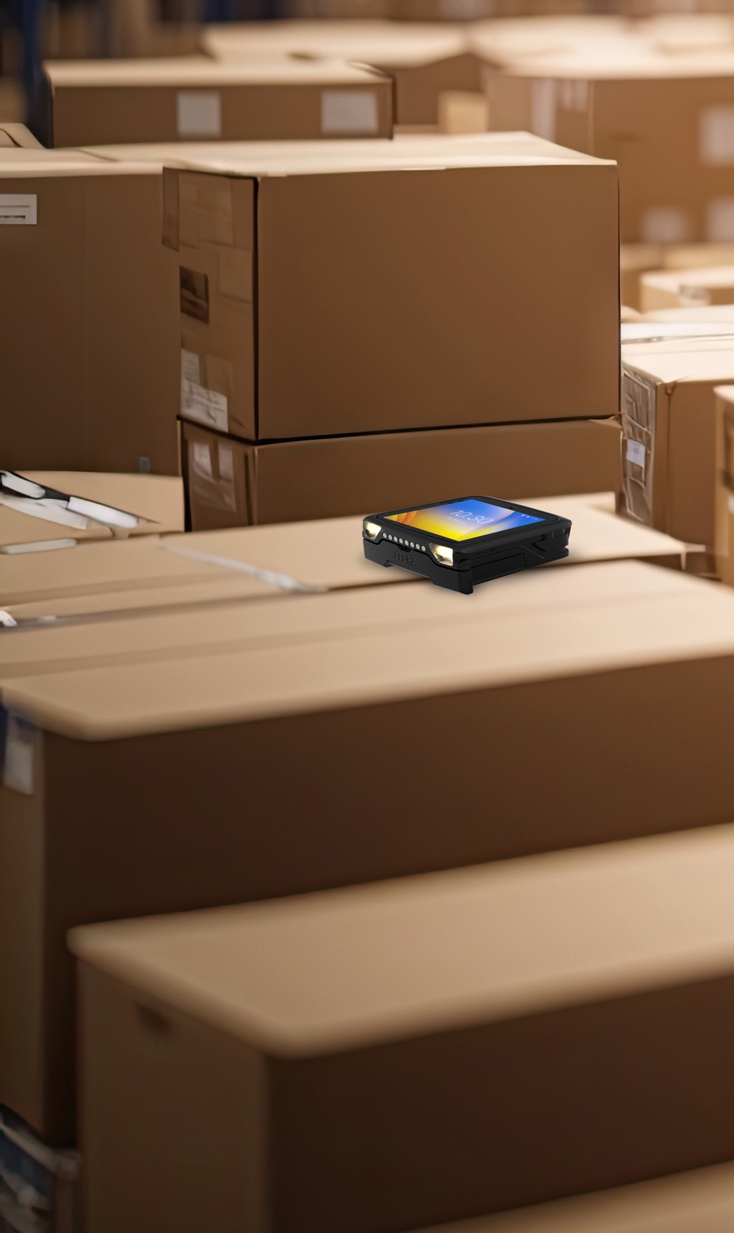
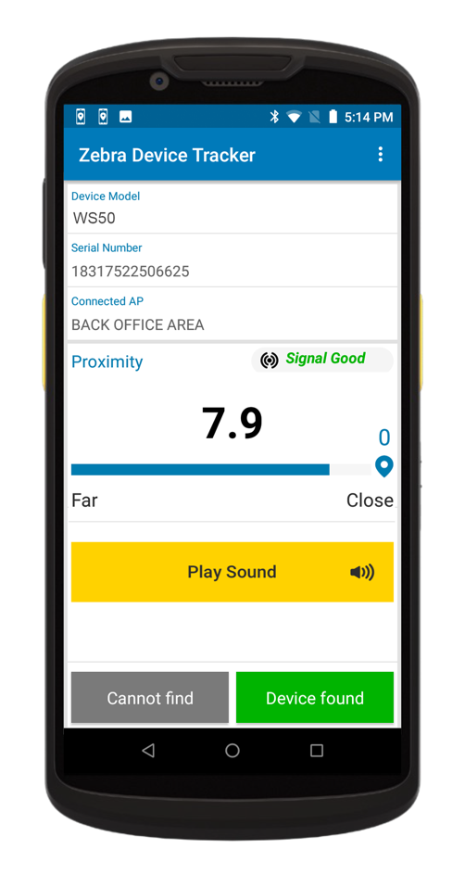
Device Tracker for mobile computers
Track and find your Zebra handheld and wearable computers and tablets —including the WS50 — with the BLE battery and a Device Tracker license
  Advanced tracking technology with BLE Beacon battery
  Easily locate missing devices, even if they are turned off or the battery is dead*
  Geiger-counter style proximity indicator
  Easily guides users to a missing device’s precise location
  Easy-to-deploy
  Cloud-based service — no infrastructure to purchase, deploy and manage
  Grows with your organization
  Supports up to 100,000 devices at up to 5,000 sites
  Improve accountability
  Track who signs out each device, device status and location in your facility
  …maximizing device availability, staff productivity and your return on investment
* The ability to locate a device when the battery is dead requires optional BLE battery
24

Slide 25
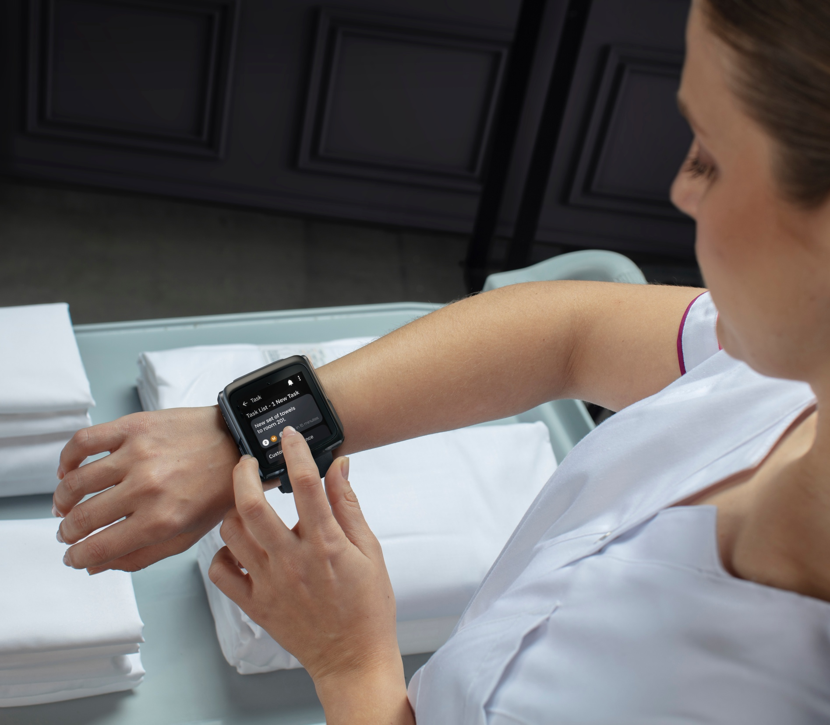
Service
and Support

Slide 26






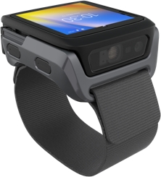
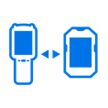








Added value for Zebra’s WS50
with a full portfolio of Services to address your needs
Zebra OneCare Essential
Professional Services
3- or 5-year protection covering device functional failure and normal wear and tear
Gold Build ensures your Mobile Computers (MC) operate at their peak performance​ by successfully designing user profiles
3-day turnaround from the repair center *
Save valuable time in your operation with Zebra Staging by aligning consistency on operating system version, security features and application loading
Priority access to a live-agent, 24x7 access to self-service tools. Software updates and security patches also covered
Let us help you put together the device and accessories and/or printed collateral into individual or site boxes
Access to VisibilityIQ™ OneCare** dashboard to manage your contracts and track the status of your repairs
Optional Battery Maintenance to meet your needs and help you avoid downtime
VisibilityIQ Foresight™
Cloud-based dashboard to view fleet insights and make decisions based on analytics across your entire device fleet
Address potential device issues before they impact your business, and uncover opportunities for cost-cutting, right-sizing inventory and reducing lost or stolen assets
View everything in an easy-to-grasp, color-coded dashboard and get alerts on your fleet of mobile devices
* Ground shipping is covered in North America only. For other regions, please get in touch with your Zebra Account Manager for more details.
**For Mobile Computers and Scanners only. Includes Cloud-based visibility to repair, technical support, contracts, LifeGuard reports, and more.
26
ZEBRA TECHNOLOGIES

Slide 27
Thank you!
For more information, please visit www.zebra.com/ws50-powered-by-workcloud
ZEBRA and the stylized Zebra head are trademarks of Zebra Technologies Corp., registered in many jurisdictions worldwide. Android is a trademark of Google LLC. The Bluetooth® word mark and logos are registered trademarks owned by Bluetooth SIG, Inc. and any use of such marks by Zebra is under license. Wi-Fi™ is a trademark of Wi-Fi Alliance®. All other trademarks are the property of their respective owners. ©2024 Zebra Technologies Corp. and/or its affiliates. 03/04/2024

