Slide 1
How to use this modular deck
This deck is modular, designed to enable as much flexibility as possible to meet the different messaging needs for different regions and customers.
Section 1:
Today’s Challenges
This section starts on slide 4.
Use only slide 5 for a shorter, high-level deck.
If your customer is not overly interested in AI, just delete the text under the green containers that says “…easily addressed in your frontline with AI”
Section 2a:
Zebra AI Frontline Suite
This section starts on slide 10.
There are 3 high level slides in this section that provide an overview of the Zebra AI Frontline Suite.
If your customer wants more details, please see the slides in Appendix A (which starts on slide 62) for more details on all
3 of the Zebra AI Frontline Suite toolsets: Frontline Enablers, Blueprints and Companions
Section 2b:
Device Features
This section starts on slide 14
For a short deck: if you are looking for a shorter presentation, you can use slides 15 through 19 to provide an overview
For a super short deck Eliminate slides 14 through 35 and just show slide 19, which provides a summary of slides 14 through 35 (Sections 2, 3 and 4)
Section 2c:
Data Capture Features
This section starts on slide 26
For a short deck: You can just use slide 27, which is an overview of all the data capture features
The remainder of this section, slides 28 through 35, provide details on all the data capture features. You could choose to show them all or only those that most interest or are of most value to your customers.
Section 3:
Vertical Markets
This section starts on slide 36
There is one slide for each of the 4 verticals
See Appendix B, which starts on slide 67, to see if there are any use case slides that align with your customer’s potential application(s) to add to this section. Note that the product photos on slides 71 through 74 all have videos that show how Zebra AI Frontline Suite can be utilized to quickly, easily and cost-effectively automate those workflows.
1
ZEBRA TECHNOLOGIES

Slide 2
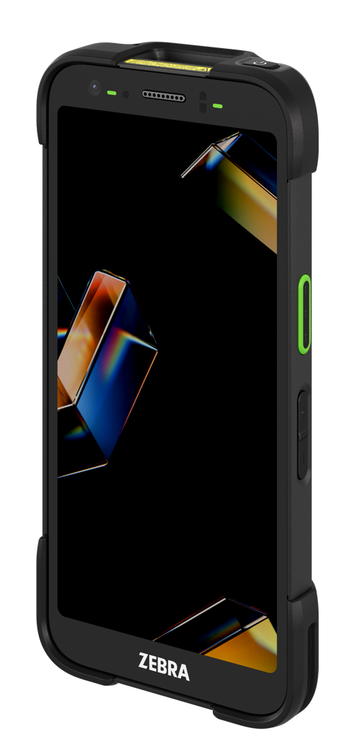
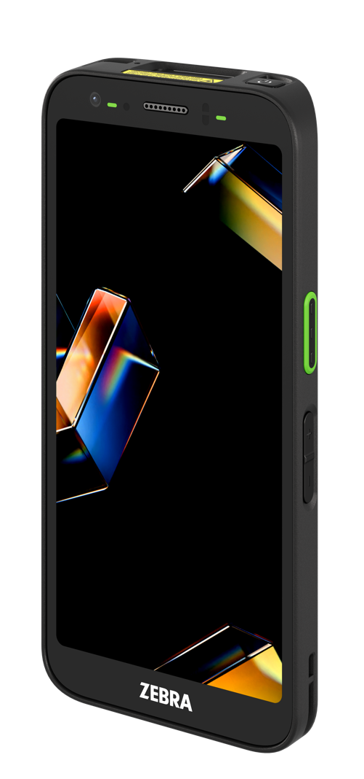


Rugged TC501
Ultra-rugged TC701
Mobile computing reimagined for the AI-powered frontline
February 2026

Slide 3

Agenda
Agenda
Agenda
Today’s Challenges
Zebra AI Frontline Mobile Computer Portfolio
Vertical Markets
and Apps
Enterprise-
class Accessories
Zebra
DNA
Better Together: Zebra
Proven Solutions
Services
Why
Zebra

Slide 4
Today’s Challenges

Slide 5
Today’s top business challenges…
Improve current staff productivity
Continually increasing customer expectations
High turnover and
shortage of labor
Hyper and global competition
Need to get more done in less time, with greater accuracy, with 77% of CEOs surveyed focused
on enhancing productivity.¹
For 85% of customers, experience is as important as your product or service.
Need to minimize ramp up time due to high frontline churn:
87% in QSR
81% in Retail
73% in T&L
Competition is the
5th biggest global business risk, rising from 10th in 2024, with 44% of companies surveyed reporting a loss due to increasing competition.²
…easily addressed in your frontline with AI.
  1. Oliver Wyman Forum; The CEO Agenda 2025; In Black and White;
  2. Global Risk Management Survey (3,000 leaders in 60 countries) Increasing Competition Is Intensifying Risk for Organizations; October 1, 2025; AON
5
ZEBRA TECHNOLOGIES
Notes:
The top business challenges that businesses in all industries face today are easily addressed with AI apps:
#1: Improve current staff productivity
AI apps excel at automating and error proofing tasks, allowing workers to get more done each shift, more accurately
#2 Continually increasing customer expectations
When AI automates tasks, workers have more time to cater to customer needs. And AI can enable richer connections with your customers, improving the customer experience.
#3 High turnover and shortage of labor
AI apps can heavily automate and simplify workflows, making onboarding easier and faster by eliminating task complexities and guiding workers through workflows
#4: Hyper and global competition
These days, what the competition offers is always at the fingertips of your customers—whether they are at home, at work or in the aisles of your store.
AI can help companies better compete by through intelligent automation to:
eliminate time spent on crucial but low-level tasks
allow workers to spend more time on higher-level tasks that have a greater impact on operations and the quality of customer service
improve the customer experience and customer loyalty
reducing the cost of doing business through increased productivity/better utilization of the workforce

Slide 6
Why focus on the frontline?
80%
88%
of the global workforce works in frontline operations. It’s where the work is done.
of today’s companies are using AI regularly in at least one business function.
McKinsey & Company: The State of AI in 2025
ZEBRA TECHNOLOGIES
6
Notes:
Focus on the frontline is key because that’ where the majority of today’s workers are—and chances are your competitors are already in the race to deploy AI apps

Slide 7
Benefits of AI in the frontline:
enable more intelligent and efficient operations
Utilize real-time insights to automate low-level tasks within workflows, enabling workers to do less to get the job done
Simplify and streamline execution of complex tasks to improve frontline productivity
Enable inline workflow assistance based on experience level, including step-by-step instructions for new hires
Provide analysis in the moment to correct errors as they happen
Address language challenges in the moment and on the spot
Provide automation that empowers your workers to get more done, more accurately, in less time
Enable processes to be easily adapted to meet new business needs and continuously improve everyday workflows
7
ZEBRA TECHNOLOGIES
7
ZEBRA TECHNOLOGIES
Notes:
Some of the high-value benefits AI can bring to your operations.

Slide 8
Where can AI make a difference in your organization? In just about any frontline workflow.
Following are just some of the many use cases where AI can magnify the benefits of mobility by reducing more steps in your workflows, increasing workflow accuracy, and reducing the high cost of errors.
Retail
T&L/Post/
Parcel Delivery
Warehouse/
Manufacturing
Field Service
Product/aisle/shelf label compliance
Ticket switching/tag switching
(product recognition)
Top shelf finding
Back of store picking and receiving
Knowledge agent/Sales agent
Translations
Picture proof of delivery
Guided picking (product recognition)
Census/counting stock
Picture proof of delivery
Postal shop picking
Warehouse/distribution
center picking
In-truck packages location
  Visual; RFID + Visual
Knowledge agent
Translations
Receiving
Address label reading
Classifying luggage
Measuring shipments
Detecting damaged packages
Receiving and shipping counting
Warehouse picking
Receiving (data extraction)
Knowledge agent
Translation
Measuring shipments
Detecting damaged packages or items
Receiving/shipping counting
Assembly compliance
PPE compliance
Route optimization
Data extraction with voice notes
Nameplate data reading
Quality validation
Checking inventory
Knowledge agent
Translation
8
ZEBRA TECHNOLOGIES
Notes:
A sampling of some of the typical workflows in different vertical markets where AI can make a difference.

Slide 9

What does it take to implement AI in the frontline?
AI Application development tools
Mobile devices with the power to run AI apps
Mobile devices with rich data capture capabilities
You need tools to develop apps that address your specific workflows and take advantage of all the features of your devices.
It takes a lot of power, memory and more to enable easy-to-use high performance multi-modal AI apps that won’t keep workers waiting…and will maximize the value of your data.
The effectiveness of AI apps and their ability to automate parts of your workflows is dependent on the data you feed it…which is dependent on the data you can capture.
Zebra has what it takes to implement AI in the frontline…today.
9
ZEBRA TECHNOLOGIES
9
ZEBRA TECHNOLOGIES
Notes:
Zebra understands the value that AI can bring to the frontline, and is committed to creating solutions that address the key challenges organizations face when enabling AI on the frontline:
SPEED:
Applications need to return information quickly and never keep workers waiting — a common issue with cloud-based AI solutions since the data makes a longer trip.
SECURITY:
If AI apps and data are in the cloud, both are much more vulnerable to interception, compared to all the processing and data remaining on the device.
COST:
There’s an additional cost for cloud-based computing that is eliminated with on-device processing.

Slide 10

Zebra AI Frontline Mobile Computers
AI app development tools:
the Zebra Frontline
AI Suite
Device features:
built to power
high performance
AI apps
Data capture
capabilities:
fuel your AI apps

Slide 11
The Zebra Frontline AI Suite makes it easy to develop powerful user interfaces for your AI apps that address the unique needs of your Frontline workers, your vertical market workflows—and your strategic business objectives
ZEBRA TECHNOLOGIES
11

Slide 12

Zebra AI Frontline Suite benefits
All the tools you need to put the power of AI in the hands of your workers, quickly, easily and cost effectively
  Save time and cost Develop and deploy AI vision apps in days—instead of months
  Maximize device value Easily leverage the power and value of your Zebra advanced
  AI-enabled hardware
  Streamline workflows Simplify complex workflows with powerful AI applications that automate and reduce workflow steps
  Improve your bottom line Boost operational and workforce efficiency
Easily develop AI-powered apps in days that enable
faster, easier, and smarter work
NOTE: To fully leverage the most advanced, on-device AI models, such as the Zebra Frontline AI Enablers, Zebra recommends systems with enhanced processing power and increased memory capacity.
12
ZEBRA TECHNOLOGIES

Slide 13
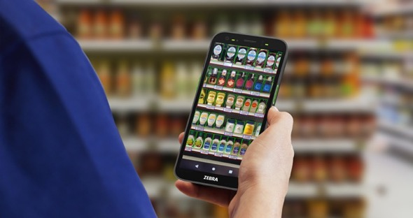


How does Zebra’s Frontline AI Suite simplify enterprise AI app development?
An integrated portfolio of AI enablers, blueprints, and companion agents helps customers digitize their environments, operationalize intelligence, and maximize workflow efficiency for the frontline workforce
Zebra Frontline AI Enablers
(Formerly Mobile Computing AI Suite)
Zebra Frontline AI Blueprints
Zebra Companion
Trained building blocks that can be used as standalone apps or as components in more complex AI apps
Ready-made, adaptable frameworks for building scalable AI workflows that modernize your manual processes
Ready to use AI agents for different types of frontline workers requiring specific types of information
“Zebra’s AI approach is the first enterprise strategy I’ve seen that actually makes operational sense at the store level.”
Greg Buzek, President and Principal Analyst, IHL
ZEBRA TECHNOLOGIES
13

Slide 14
Zebra AI Frontline Mobile Computers
AI app development tools:
the Zebra Frontline
AI Suite
Device features:
built to power
high performance
AI apps
Data capture
capabilities:
fuel your AI apps

Slide 15

Mobile computer requirements to support Frontline AI apps
Multi-modal devices designed to deliver no-wait application performance and seamless application interactions
Processing Power
Memory
Data Capture
Quality and Quantity
AI apps require heavy processing power
AI apps require substantial memory to support processing
Maximum data =
maximum time savings
High-speed processor with
a dedicated NPU (Neural Processing Unit)
Why? NPUs run Frontline AI use cases 60 to 100 times faster than GPUs or CPUs—with less power
Amount of memory matters
Memory speed matters—
the latest versions of memory protocols better support the processor, enabling faster processing and ample storage to support graphics intensive apps
The more data capture options the better
The higher quality the sensors are, the richer the data
You can count on Zebra to deliver it all.
ZEBRA TECHNOLOGIES
15

Slide 16
Introducing the new Zebra TC mobile computer portfolio, purpose built to empower your Frontline with AI
ZEBRA TECHNOLOGIES
16

Slide 17
A new portfolio built to put the power of AI in the hands of your frontline
Count on every device in this portfolio to deliver:
AI and Frontline Performance
Reliability
Security
Everything you need to set a
new standard for AI-Enabled frontline performance…
Next-level reliability and technology innovation designed to address your business challenges…
End-to-end enterprise-class security…
…to turn every worker into your best worker…
…from a market leader you can count on with 50-years of experience…
…with all the ingredients to enable best practice layered security…
…with a portfolio of hardware and software designed for AI from the ground up to offer the right device for workers in different industries and environments with different device and workflow requirements
…trusted by 80% of the Fortune 500 and thousands of small businesses to provide proven solutions that make operations better every day…and well-proven technology used by millions of workers every day, across industries, all around the globe
…with hardware, timely OS updates and Zebra-only software options to keep your data, devices and networks safe, including Mobility Extensions (Mx), offering over a hundred features to infuse consumer Android with enterprise-class features
ZEBRA TECHNOLOGIES
17

Slide 18
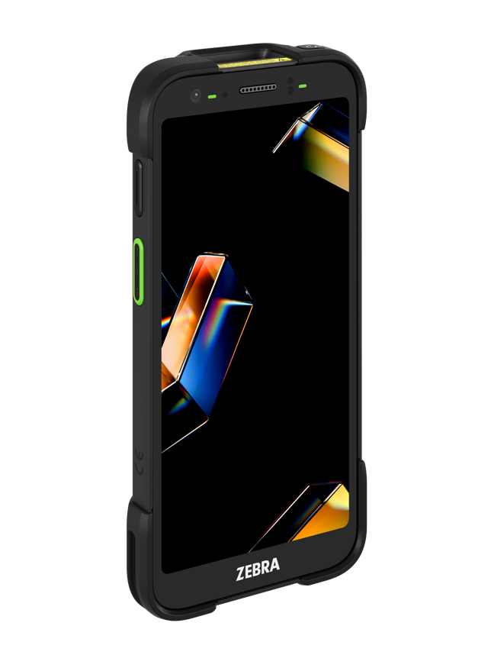
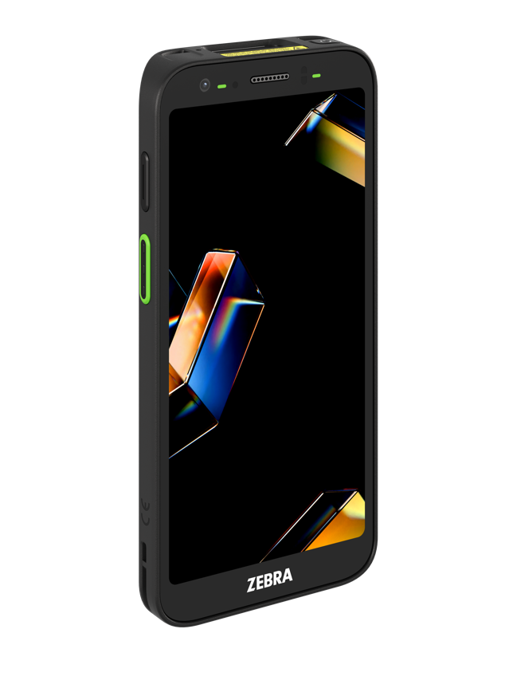
Introducing the first models in the new TC AI Frontline portfolio
TC501 rugged and the TC701 ultra-rugged handheld mobile computers
A new platform reimagined for the AI-powered frontline
The right
hardware features
Built to power the AI apps of today and tomorrow with all the right ‘stuff’, from processor to memory
The right data capture features
Fuel your AI apps with a world of data with the most sensors in any TC device yet
The right AI APP development tools
Develop and deploy AI apps tailored for your workflows in days—instead of months
Extend device capabilities with Zebra-only solutions
Add powerful new capabilities that boost worker productivity, operational efficiency and ROI
The right application development tools
ZEBRA TECHNOLOGIES
18

Slide 19
Features at a glance: TC501/TC701 mobile computers
A new platform to meet the needs of AI enterprise apps
The right
hardware features
The right
data capture features
Extend device capabilities
with Zebra-only solutions
Built to power the AI apps of
today and tomorrow
Advanced Qualcomm Dragonwing™
Q-6690 processor with dedicated NPU
Maximum memory to support AI apps
Advanced 6-inch AMOLED display for a superior user experience
All the fastest wireless networks:
global 5G, Wi-Fi 7, Bluetooth 6
Most rugged TC5 and most ultra-rugged TC7 devices built to date
More powerful batteries with fast charging and hot swap
Multiple layers of security
Fuel your AI apps with a world of data
50 MP rear camera
Optional ultra-wide angle 13 MP camera
AI-driven camera app for first-time every time great photos
Zebra’s most advanced scanner options: AC670, SR560, SR500
Integrated short range UHF RFID
Comprehensive OCR options
Triple band GNSS for more accurate and available GPS information
Optional Time-of-Flight sensor to capture 3D data depth, volume and more
Contactless pay/Apple VAS support
Exceptional AI-enabled audio for voice input and phone calls
Boost device functionality and ROI—turn Zebra devices into 2-way walkie talkies, workstation and more
Zebra DNA for Mobile Computers: easily
set up, secure, manage and optimize Zebra mobile devices
Zebra Guardian suite to manage device access, readiness and availability: Identity Guardian, Device Guardian, Device Guardian Access Management (DGAM) and Guardian Cabinets
Workcloud Sync real-time collaboration: Push-to-talk over Wi-Fi/cellular networks; secure chat; PBX calls; voice/video calls
Workcloud Task Management
Wireless Workstation Connect
…and more
19

Slide 20
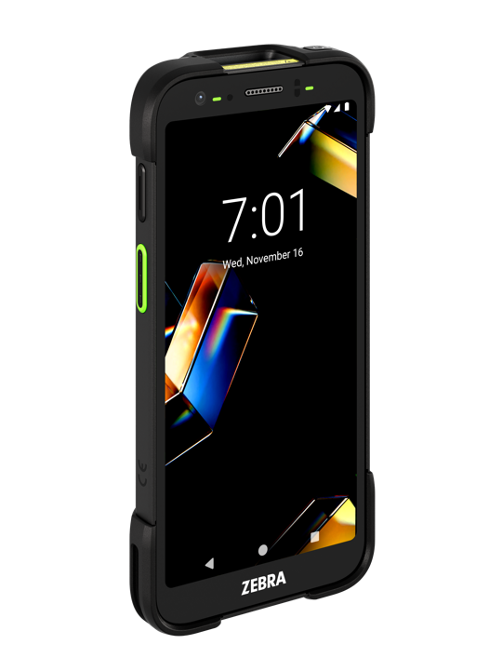

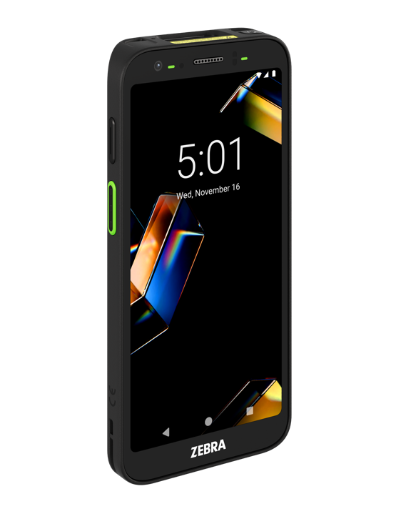

Exceptional power for exceptional AI application performance
Experience unparalleled performance and efficiency with Qualcomm’s innovative Dragonwing™ Q-6690 processor
TC701
Qualcomm’s innovative Dragonwing™ Q-6690 processor
Up to 2.9 GHz
Up to 300% increase in performance
over legacy TC5 and TC7 Series devices *
Dedicated Neural Processing Unit (NPU);
purpose built to enable energy efficient on-device AI
Major leap in processing efficiency to preserve battery power
Advanced memory technology and the most memory in its class
Up to 12 GB LPDDR5 RAM and 256 UFS 3.1 Flash available—
50% more RAM and 2x Flash of the nearest competitor
The next generation LPDDR5 RAM is 1.5x faster with up to 20% power reduction compared to the prior generation LPDDR4X.
UFS (Universal Flash Storage) 3.1 is up to 3x write speeds of the prior generation technology
TC501
* Based on GeekBench 6 Multi-Thread benchmark scores using real-world tests (Note ‘real-world tests’ is how Geekbench refers to GeekBench 6 on their website)
20
ZEBRA TECHNOLOGIES

Slide 21
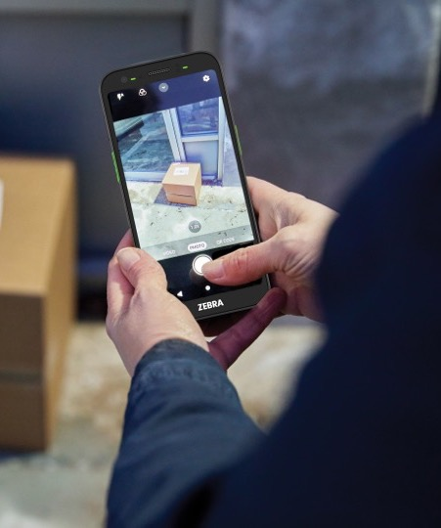
An advanced display designed
for enterprise workers
Easy to read at extreme angles: with a nearly 180-degree viewing range
High resolution: 6-inch AMOLED FHD+ (1080 x 2160)
Exceptional viewing experience: brilliant colors, crisp text, sharp images and up to 1500 NITS of brightness create a display that is easy to read anywhere—indoors or outside, even with sunglasses
Rugged: Corning® Gorilla® Glass Victus®, providing superior scratch-and-shatter proofing
No wait screen draws: variable refresh rate for improved touch response times
More display space: up to 20%+ more screen area to display more information and reduce scrolling*
Power efficient: uses up to 40% less¹ than the typical LCD mobile computer display, extending battery cycle time²
1. Reduction in power varies, dependent on numerous factors and features including the use of Dark Mode, the volume of black pixels (no power required) and the variable refresh rate. 2. Compared to legacy TC5 and TC7 devices.
21
ZEBRA TECHNOLOGIES

Slide 22



All the fastest wireless networks
Work anywhere without delays
Bluetooth v6.0
Unmatched Wi-Fi performance
Wi-Fi 7 delivers 2x the speed and 2x
the bandwidth of Wi-Fi 6, plus multi-band communications
Zebra DNA Wireless Fusion delivers reliable ‘no-drops’ connections
Ready for the Wi-Fi networks of today and tomorrow, with support for more devices and traffic
Backwards compatibility with the last three Wi-Fi generations
Fastest cellular speeds with global 5G 3rd Gen Rel 17
Enables cellular service anywhere
in the world
Supports simultaneous service on two networks, ideal for workers who cover large areas that may be best served by multiple carriers
Private 5G network support including CBRS–ideal for areas where Wi-Fi is too costly to deploy
Better peripheral performance
Highly stable connections, reduced interference and higher security—
all with reduced power consumption
Centimeter-precise positioning
lets peripherals auto-connect or disconnect—making Bluetooth
feel effortless
ZEBRA TECHNOLOGIES
22

Slide 23
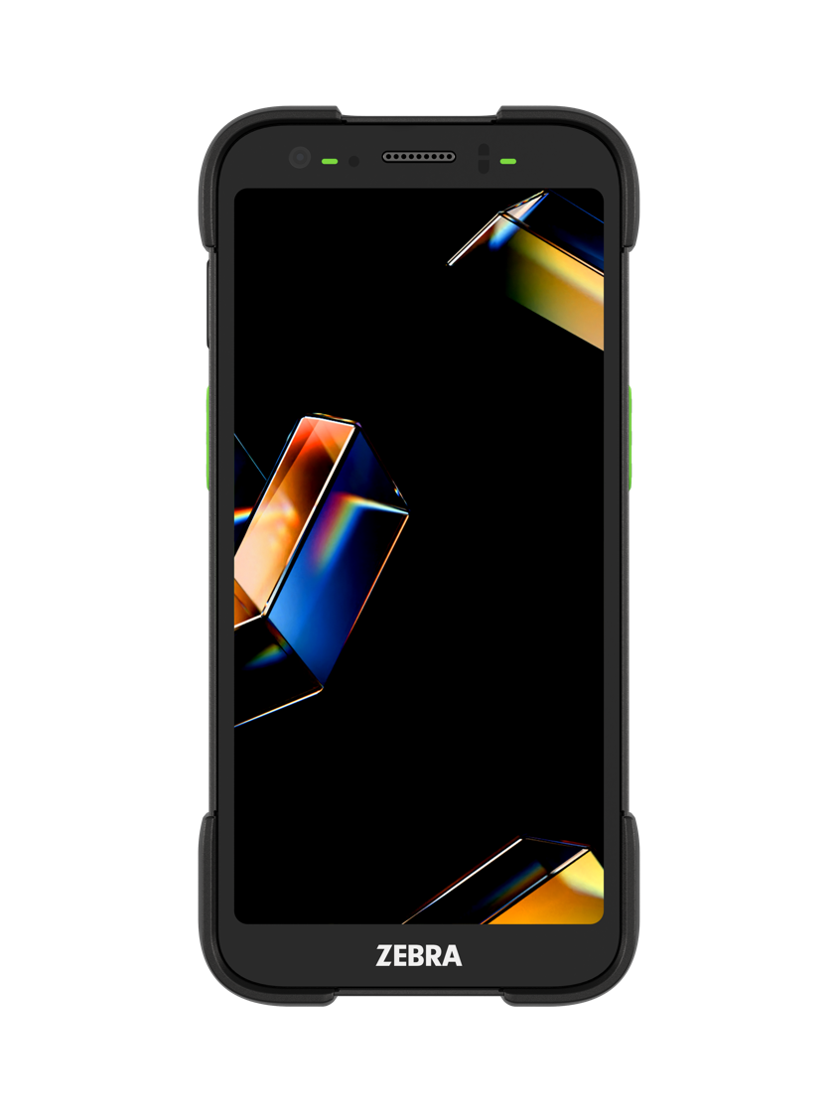
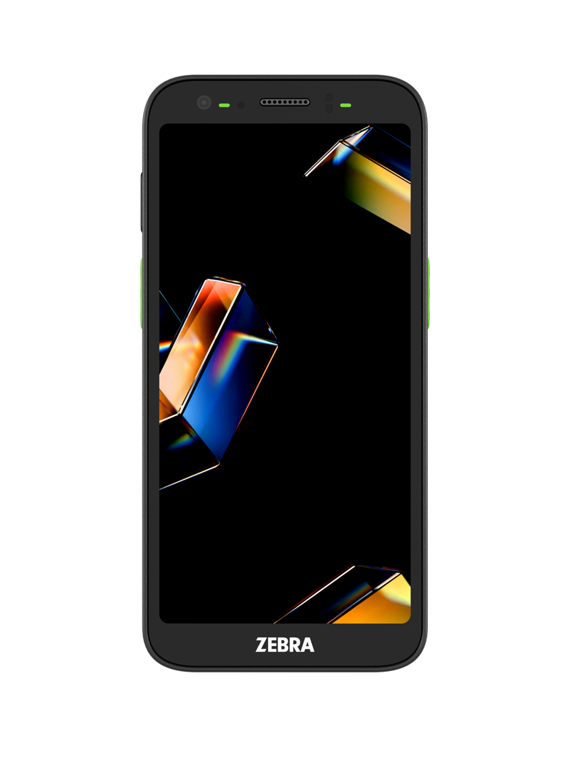
The toughest TC Series devices built to date
Engineered for drops with Zebra’s highest drop testing
Up to 50% higher than legacy TC5 and TC7 models
TC701: Survives 12 ft. (3.66 m)
TC501: Survives 9 ft. (2.74 m) with the optional rugged boot and 8 ft. (2.44 m) (no rugged boot)
Ready for everyday impacts with Zebra’s most aggressive tumble testing
TC701: 3,500 3.3 ft. (1 m) tumbles—a 75% increase over any legacy TC7 model
TC501: 2,000 3.3 ft. (1 m) tumbles with the optional rugged boot;
2,000 1.6 ft. (0.5 m) tumbles (no rugged boot)
Waterproof and dustproof with IP65 and IP68 sealing
Problem-free performance in more environments—use your devices in the rain,
accidentally drop them in a puddle, or spray them down with a hose
Built for extreme temperatures
Thermal shock testing ensures reliable operation, even if workers routinely move between
subzero cold temperatures to sweltering heat
ZEBRA TECHNOLOGIES
23
Notes:
Drop specification specifics related to temperature:
TC701:
Exceeds MIL-STD-810H:
8 ft. (2.44 m) to concrete at -4°F to +122°F (-20°C to +50°C)
12 ft. (3.66 m) to concrete @ room temperature
TC501:
Exceeds MIL-STD-810H:
No rugged boot:
6 ft. (1.83 m) to concrete at -4°F to +122°F (-20°C to +50°C)
8 ft. (2.44 m) to concrete @ room temperature
With rugged boot:
7 ft. (2.13 m) to concrete at -4°F to +122°F (-20°C to +50°C)
9 ft. (2.74 m) to concrete @ room temperature

Slide 24


More powerful batteries—and new battery features
Everything you need to give AI apps non-stop power
Most powerful TC5/TC7 Series batteries
Plenty of power to run power-hungry AI apps full shift+
Standard: 5000 mAh; Extended: 7240 mAh; Wireless charge: 5000 mAh
Hot swappable replaceable batteries
Devices can work all shift long, no downtime for battery changes, and no need for devices to spend time in chargers
Smarter battery management
PowerPrecision+ technology for more battery intelligence; easily identify and remove batteries that have reached end of life
Fast charging
Charge batteries from 0 to 70% in just 45 minutes with the next-generation ShareCradle fast charging system
ZEBRA TECHNOLOGIES
24

Slide 25


Keep devices and data safe with multiple levels of security
Secure Element prevent physical hardware attacks – the best physical security available on a mobile terminal
LifeGuard for Android delivers regular security updates over a device’s lifespan to protect against the latest cyber threats²
Identity Guardian uses facial biometrics and SSO compatibility for simple, convenient and secure device and application access³
Android StrongBox protects sensitive data like passwords
Government grade security
with FIPS 140-3 Validated (ISO 19790) and Common Criteria certified (ISO 15408)
Device Guardian makes it easy
to find and recover lost or misplaced devices³; Supported right out of
the box with integrated secondary
BLE beacon—no BLE battery purchase required
Guardian Cabinets¹ safeguard devices with an authorized-only physical cabinet
Secure Boot and Verified Boot prevent the loading of malware and unauthorized software when devices are booted
1 Availability varies by country
2 Requires a Zebra OneCare contract
3 License required
25
ZEBRA TECHNOLOGIES
25

Slide 26
Zebra AI Frontline Mobile Computers
AI app development tools:
the Zebra Frontline
AI Suite
Device features:
built to power
high performance
AI apps
Data capture
capabilities:
fuel your AI apps

Slide 27
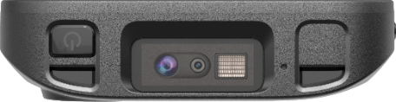
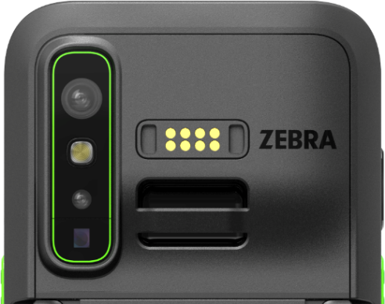
Fuel your AI apps with a wealth of advanced multi-modal sensors
Full spectrum of data capture modalities: barcodes, text, images, video, RFID, BLE, NFC, location, voice
Who, what, where, why, when and how, enables use case driven context-based data capture options
Provides multi-modal data capture for Zebra AI Frontline Suite tooIs: AI Models, Companions and Agents
8MP Front-facing camera
Three new best-in-class scanner options:
  AC670 advanced color range imager
  SR560 with laser illumination and SR500 with LED illumination excel at finding
  2D barcodes in all lighting conditions
50MP Rear-facing camera + HDR
Optional ultra
wide-angle camera
Integrated UHF RFID
Optional Time of
Flight (iToF) sensor
NFC
Wi-Fi 7 for
~3ft location accuracy
Contactless transactions
OCR
eCompass, accelerometer, Gyroscope, pressure sensor, high accuracy GPS
Triple band GNSS high accuracy/high availability locationing data
27
ZEBRA TECHNOLOGIES

Slide 28
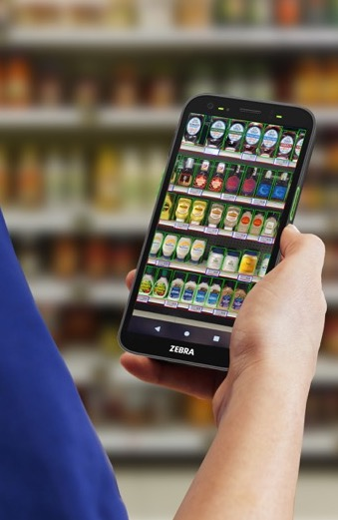
Capture rich photographic details with high resolution cameras
Easily capture finer photographic details
Provides better information and richer input for
AI apps
Ideal for proof of delivery, proof of condition, remote expert technical support for field service and more
50 MP
Rear
Camera
Enables new vision applications that require
a wider view
Retailers can capture entire sections of shelves for merchandising
Car rental agencies can easily document the condition of a whole car
Planogram compliance
13 MP
Ultra-Wide Angle
Camera
ZEBRA TECHNOLOGIES
28

Slide 29
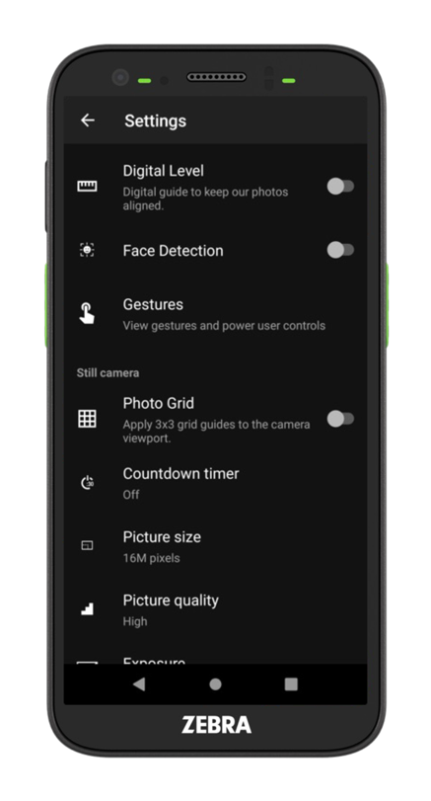
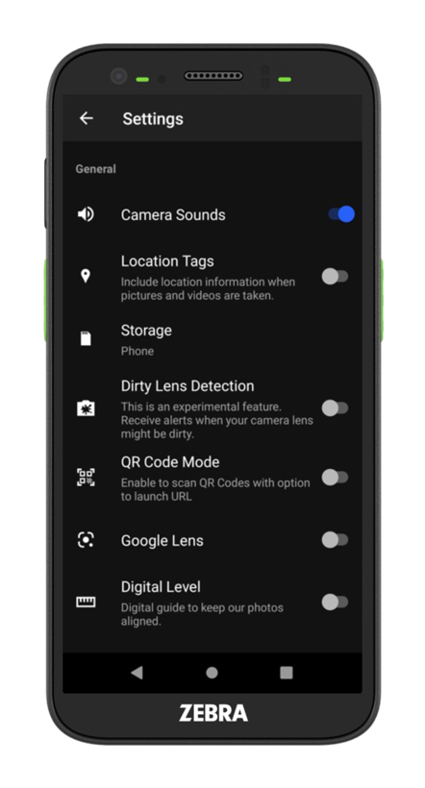
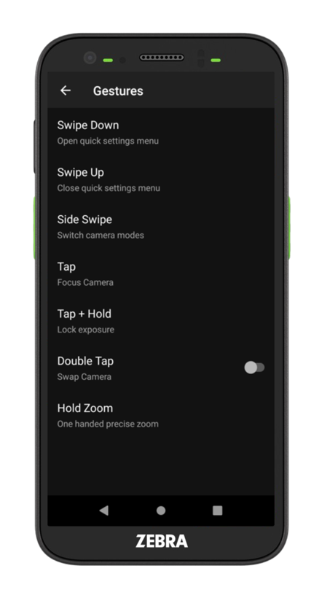
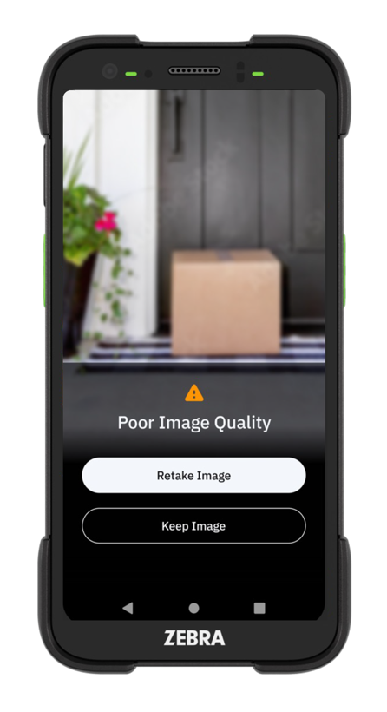
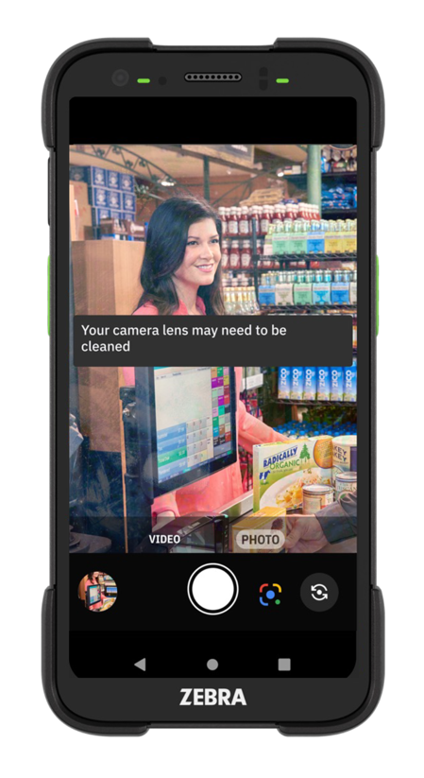
AI-driven camera app for first-time every time great photos
Turn on features like location tags, dirty lens detection, digital level, QR code mode, face detection with auto blur, and location tags; control picture size, picture quality and more—and enable gestures to control camera functions
ZEBRA TECHNOLOGIES
29

Slide 30

Three new best-in-class scanner options for the TC501 and TC701
SR500¹
1D/2D scanner with LED aimer
Yellow LED aimer with red illumination offers enhanced visibility for easier, more accurate aiming
Offers an improved 2D barcode finder for faster and more accurate barcode capture
High motion tolerance makes it easier
to capture barcodes on the move
Captures barcodes in all lighting conditions, including bright sunlight
SR560²
1D/2D scanner with laser aimer
Red cross-hair laser aimer with white illumination offers enhanced visibility, improving user efficiency and reducing errors
Offers an improved 2D barcode finder for faster and more accurate barcode capture
High motion tolerance makes it easier to capture barcodes on the move
Captures barcodes in all lighting conditions, including bright sunlight
AC670
Advanced range scanner with
color image capture
Simultaneously capture barcodes and color photos from near contact to over 100 ft. (30 m) away
Opens up the opportunity for many new use cases
Captured images can be used to train AI models or on-device AI to quickly validate business logic
Delivery drivers can capture a barcode on a package and a high resolution color image of the package for proof of condition
AIMING
AIMING
AIMING
ILLUMINATION
ILLUMINATION
ILLUMINATION
ZEBRA TECHNOLOGIES
1. Equivalent to the SE4720. 2. Equivalent to the SE4770
30

Slide 31








Built-in efficiency with integrated short-range UHF RFID
Eliminate the need for multiple devices
Enables new contactless use cases, from inventory management to asset finding
Integrated, ergonomic solution – no extra accessories, sleds or batteries
Read range up to 6.5 ft (2 m); >200 tags per second*
Where can you put short-range RFID to work?
Inventory
management
Point of sale/
line busting
Track and trace
work orders
Asset management
Ticket
validation
Self-checkout
validation
ZEBRA TECHNOLOGIES
*Depending upon tag type and environment
31

Slide 32
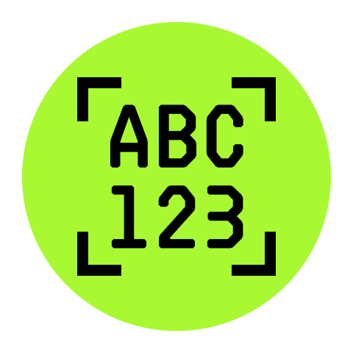



Turn printed text into instant digital data
A complete family of OCR solutions for virtually every industry and workflow
Free-Form OCR
Picklist + OCR
OCR Wedge
OCR-A/OCR-B
Capture multiple lines of text on virtually any label or document
Capture a single word or a single line of text or
barcode on virtually any label or document
Automatically capture, process and send standardized text data right to your apps, all with the press of one button; includes vehicle license plates, identification documents, VINs, TINs, meter readings, and shipping containers IDs
Capture machine readable fonts found on financial documents and government issued documents such as visas and passports
ZEBRA TECHNOLOGIES
32

Slide 33

Exceptional AI-enabled audio performance
Eliminates acoustic echoes and suppresses more background noises to ensure crystal clear voice
Enables accurate input for voice-enabled applications
Ensures call quality with customers, supervisors and co-workers
Smart amplifiers increase and enhance loudness while preventing damage to speakers
Audio headset support via USB-C port or Bluetooth
wireless headset
HD voice (Wideband/WB); Super-wideband (SWB) and Fullband (FB) audio
VoNR and VoLTE for equally high-quality voice over both 4G and 5G networks
ZEBRA TECHNOLOGIES
33

Slide 34



Capture fast and accurate 3D data
Optional integrated Time-of-Flight sensor (iToF)
Collect accurate depth, distance, presence/absence and volume 3D data in any lighting
Enable parcel and pallet* dimensioning to optimize space and capacity in trucks and warehouses with Zebra Dimensioning Mobile Parcel
Capture cuboidal and non-cuboidal irregular items, such as baggage, enabling airlines to maximize space in the cargo hold
Reduces the cost of storage by increasing warehouse space utilization—store more in the same space
Reduces the cost of shipping by increasing truck utilization and minimizing packing material cost
ZEBRA TECHNOLOGIES
* Pallet Dimensioning in Beta testing
34

Slide 35

Always available, highly accurate real-time location data
Improves the performance and availability of location-based applications
Triple band GNSS (Global Navigation Satellite System) provides more connections to more satellites
Improves locationing accuracy, availability and the reliability of real-time navigation and locationing data
Location-based applications are more reliable—especially for workers in remote areas
ZEBRA TECHNOLOGIES
35

Slide 36

Vertical Markets and Applications
Where can you put the TC501 and TC701 to work in your organization?

Slide 37

Retail use cases
Target users
Retail associates, retail managers
Key use cases
Price verification/updates
Store receiving
Online order fulfillment (BOPIS/BOPAC)
Item locator
Assisted selling
Task management
Backroom inventory management
Line busting/Mobile Point of Sale (POS)
Restocking/replenishment
Inventory management (top stock)
Planogram management
Use cases: RFID
Use cases: AI
RFID shopping bag compliance
Inventory management
Price audits/markdowns
Asset management
Customer interaction
Shrink prevention
RFID + Vision finding
Product/aisle/shelf label compliance
Ticket switching/tag switching
(product recognition)
Top shelf finding
Back of store picking and receiving
Knowledge agent/Sales agent
Translations
Picture proof of delivery
Guided picking (product recognition)
Census/counting stock
ZEBRA TECHNOLOGIES
37

Slide 38
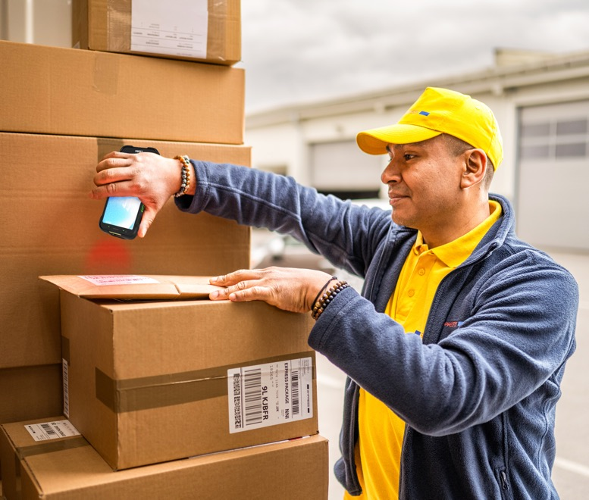
T&L/Parcel Delivery/Post use cases
Key use cases
Parcel delivery
Shipping and receiving
Inventory control
Proof of delivery/condition
Vehicle guidance
Location services
Reverse logistics
Document capture (BOL, Signatures)
Last mile delivery
Route optimization
Payment collection/invoicing
Zebra Dimensioning – Mobile Parcel
Voice communications
Package/pallet track and trace
Electronic driver logging
Target users
Delivery drivers, fleet managers,
postal carriers, courier drivers
Use cases: RFID
Use cases: AI
Reading RFID tags on cages
Asset and container tracking
Parcel routing and validate
truck loading
Proof of delivery
Returnable transport items (RTIs)
Totes (reusable, portable containers or bins) tracking
Finding packages in a truck – RFID + Visual
Picture proof of delivery
Postal shop picking
Warehouse/distribution center picking
In-truck packages location
  Visual; RFID + Visual
Knowledge agent
Translations
Receiving
Address label reading
Classifying luggage
Measuring shipments
Detecting damaged packages
Receiving and shipping counting
ZEBRA TECHNOLOGIES
38

Slide 39

Warehouse & Manufacturing use cases
Key use cases
Picking and put-away
Warehouse management
Asset management
Cross-docking
Shipping and receiving
Inventory control
Reverse logistics
Proof of condition
Document capture (BOL, signatures)
Equipment maintenance
Returns processing
Target users
Warehouse supervisors and personnel,
technicians and maintenance engineers, floor managers, supervisors and cross dock workers
Use cases: RFID/Warehouse
Use cases: AI
Loading/unloading
  Scan package label barcodes with integrated scanner to identify load location and read UHF tags inside the truck to verify the correct package placement
Package sorting
  Workers read UHF tags on boxes and receive on-screen instructions on the proper truck or conveyor for placing packages
Warehouse picking
Receiving (data extraction)
Knowledge agent
Translation
Measuring shipments
Detecting damaged packages or items
Receiving/shipping counting
Assembly compliance
PPE compliance
Use cases: RFID/Manufacturing
Materials validation
  Parts with UHF tags are read by the RFID reader to confirm the contents and quantity of cartons or containers (first article inspection)
Finished goods inspection
  Quality control workers read UHF tags on installed components to confirm the finished goods have been properly assembled
ZEBRA TECHNOLOGIES
39

Slide 40

Field Service use cases
Target users
Field service technicians and
field service trainers
Key use cases
Remote expert
Documentation
Customer sign-off
Asset management
Parts inventory
Invoicing
Mobile Point of Sale (POS)
Scheduling
Real-time directions/route optimization
Location-based services
Field service training
Use cases: RFID
Use cases: AI
Picking and put-away
Shipping and receiving
Inventory control
Reverse logistics
Route optimization
Data extraction with voice notes
Nameplate data reading
Quality validation
Checking inventory
Knowledge agent
Translation
40
ZEBRA TECHNOLOGIES
40
ZEBRA TECHNOLOGIES

Slide 41
Divider Slide
Accessories
A complete family of enterprise-class accessories

Slide 42
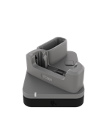
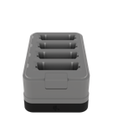
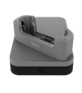
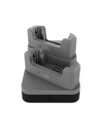






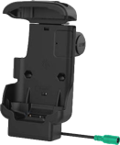
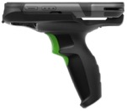




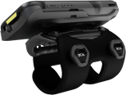


Enterprise-class accessories
1- and 2-slot 2nd generation ShareCradles
5-slot 2nd generation ShareCradles
Batteries/2nd generation ShareCradle charger
Charge one device, two devices or one device and one battery; charge + Ethernet
Charge 5 or 10 devices; charge-only, charge+Ethernet or fast charge; mix and match cups
Charges up to four spare batteries (standard, extended and wireless); use standalone
or mounted on ShareCradle base
Vehicle cradles
Snap-on trigger handle
Protective accessories
Wired and wireless vehicle charging cradle, vehicle holder (non-charging)
Electrical trigger for rapid fire scanning and added comfort for scan-intensive applications
Rugged boot increases drop spec to a new maximum of 9 ft./2.74 m to concrete; screen protectors
Carrying/wearable accessories
Headsets and audio accessories
Shims and cups for legacy ShareCradles
Soft holster, hand strap and wearable arm mounts available for hands-free operation
Rugged wired
USB-C and Bluetooth HD headsets
Just purchase the right shims and cups to continue to use your existing legacy ShareCradles to charge the TC501/TC701—with or without the rugged boot
ZEBRA TECHNOLOGIES
42

Slide 43
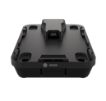
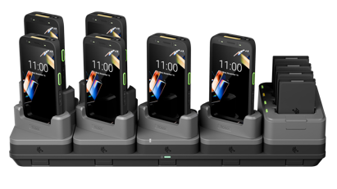

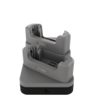

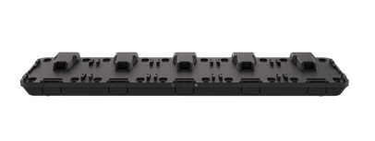
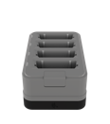
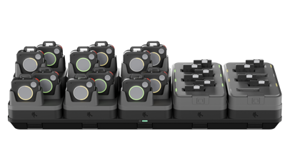
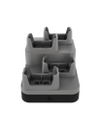
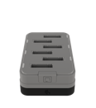
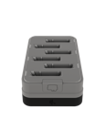
Next-generation ShareCradle
Modular platform lets you add components today—and adapt for tomorrow
1. Choose a base
2. Add cradle cups*
3. Mix and match
Next generation modular future-proof design redefines
adaptable charging
Fast charging: from
0 to 70% in 45 minutes
Smaller footprint to fit
just about anywhere
High density options
to double backroom capacity
Easier to upgrade
More sustainable
FOR HANDHELD MOBILE COMPUTERS
1 Device Fast Charge
1-Slot Base
(Charge + Ethernet)
2 Device Charge
1 Device /
1 Battery Charge
Handheld Mobile Computer ShareCradle
4 Battery Charge
Move incoming shipments from dock to stock faster
5-Slot Base
(Charge Only, Charge + Ethernet, or Fast Charge)
FOR WEARABLE MOBILE COMPUTERS
4 Device Charge
* ADDED FLEXIBILITY:
Individual device and battery cradle cups can be used without a base as standalone chargers, enabling easy charging anywhere in the enterprise.
6 WS101 Battery Charge
Wearable Mobile Computer ShareCradle
6 WS301 Battery Charge
ZEBRA TECHNOLOGIES
43

Slide 44
Zebra DNA
The software suite in every Zebra mobile computer that sets Zebra devices in a class of their own

Slide 45
Empower your workforce.
Drive results.
Intelligence made simple
in every Zebra device.
Zebra DNA spans every stage of your hardware’s lifecycle—from app development to integration, from security to device management and performance optimization.
Note: Many Zebra DNA tools are included at no cost. Depending on configuration, some tools require an additional Zebra DNA for Mobile Computers Enterprise license.
ZEBRA TECHNOLOGIES
45

Slide 46























Zebra DNA for Mobile Computers
Zebra DNA spans every stage of your hardware’s lifetime—from app development to integration,
from security to device management and optimizing performance.
Set Up
Secure and Manage
Optimize
DataWedge: Easily capture data and send to
your host applications without programming
Device Diagnostic Tool:
Instantly test and diagnose hardware operability to
determine system health
Enterprise Home Screen: Control the user interface, including access
to applications and settings
All Touch Terminal Emulation: Drive better productivity by converting legacy green screens to a modern, all touch UI
Enterprise Mobility Development Toolkit (EMDK): Develop powerful customized enterprise applications with less time
and effort
GMS Restricted Mode: Gain data control and enhance security by controlling Google Mobile Services
RxLogger: Capture system and application logs to identify problems and avoid sending no-failure found devices for repair
OCR Wedge: Boost productivity with optical character recognition that works on TIN, VIN, SSN licenses, plates and more
Enterprise Browser: Create cost-effective web-based applications optimized to work on Zebra Android devices
Wireless Analyzer: Comprehensive network diagnostics for rapid identification and resolution of connectivity issues
LifeGuard for Android:
Protect devices from potential threats and access new features with regular updates and patches
Identity Guardian: Simple, secure and personalized access to shared devices with multifactor biometric facial login
StageNow: Stage a handful or thousands
of devices with the scan of a barcode or tap of an NFC tag
Device Central: Simplified pairing, unpairing, locating and troubleshooting with Bluetooth® accessories
Device Guardian: Easily locate and recover missing devices to protect your investment.
OEM Config: Day one support for all device features in Mobility Extensions (Mx) via your EMM
Zebra DNA Cloud: Intuitive unified interface to easily deploy, manage and support your Zebra DNA tools
Mobility Extensions: A layer of enterprise features that are not available in off the shelf Android
Wireless Insights: Real-time visibility of wireless network performance to troubleshoot and optimize connectivity
NG Simulscan: Fast and accurate data capture from multiple barcodes. Capture text, signature, images and documents
Zebra Zero Touch: Helps automate the setup of devices into your third-party management system
Wireless Fusion: Enables seamless connectivity, and enhances the mobile operation and efficiency of Wi-Fi™
Enterprise Keyboard: Customized keys and layouts for specific workflows
ZEBRA TECHNOLOGIES
46

Slide 47

Zebra DNA Cloud—one simple portal to manage all of your Zebra DNA tools
Single interface provides a more cohesive and unified user experience
Simple, intuitive
experience designed
for technical and non-technical
users alike
Standalone fleet
management tool that enables IT personnel to easily administer your Zebra mobile devices
Easily access
Zebra’s exclusive suite of in-device software tools and applications to drive greater efficiencies, and cost savings*
Future release will include coexistence with EMM tools * License required for additional features
The easy way to deploy, administer, and manage all of your Zebra DNA tools

Slide 48
Better together:
Improve Frontline Productivity with Zebra-only Proven Solutions

Slide 49

Know where your devices are and who is using them with Zebra Guardian
Enhance device availability, streamline access control and ensure fully-charged devices
are available at the start of every shift
Identity
Guardian
Easy and secure personalized access
Facial recognition instantly unlocks and automatically provisions the device with the appropriate applications and permissions
Eliminates the risk of compromised credentials
Device
Guardian
Easily find lost or misplaced devices–whether they’re inside
or outside the
four walls
Protect your investment, data and productivity by proactively identifying and addressing potential device loss scenarios
Device Guardian
Access Management
Monitor
your entire
device pool
Real-time visibility into device availability and charge status
Ensure devices are charged
and ready for
the next shift
Guardian
Cabinets
Secure and smart
storage options
Control where your devices
start and end up in the beginning and end of a worker’s shift
ZEBRA TECHNOLOGIES
49

Slide 50
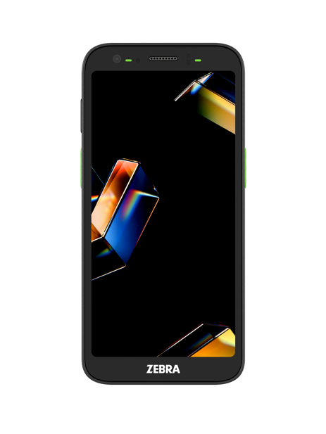
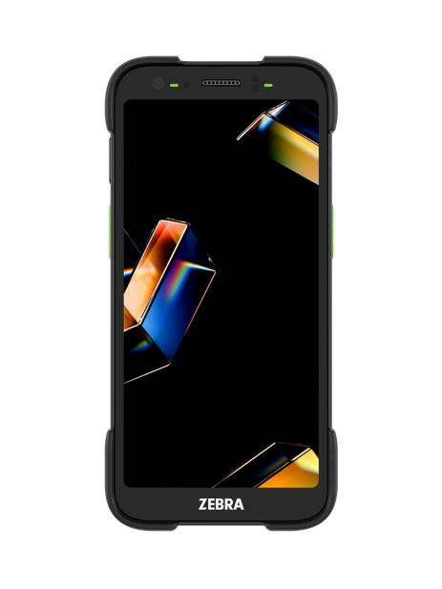
Add 7 new features with Workcloud Sync
Announcements
Deliver Manager on Duty (MOD) and other store-wide communications
Scheduled, prioritized, delivered across site, department, groups or persons
Push to Talk
Instantly connects persons, groups, departments or site members
Speeds up the coordination of priority activities and emergencies
PBX Telephony
Make outbound calls to customers, other sites and more
Direct inbound calls to the right persons, groups, or departments
Voice Calling
Private calls, group calls or company-wide calls
Dynamically assign calls based on department, group, or persons
To-Dos
Review and execute to-dos in real time
Drive real-time collaboration and ensure accountability
Review To-Do instructions, details, & checklists
Voice Commands
Leverage voice to control app features, retrieve information, communicate with colleagues and complete tasks
Ideal for hands-free experience to improve speed,
safety, and productivity
General
Home Page provides central navigation
Contacts provide ability to reach any department, group or persons across a site
Settings enables feature flags and language support
Additional Functionality
Location tracking of workers
Duress Calling
Alerts and notifications
Single sign-on
Presence status
Search
Analytics and reporting
Multi-language support
Central administrative hub
Call for Help
ZEBRA TECHNOLOGIES
50

Slide 51
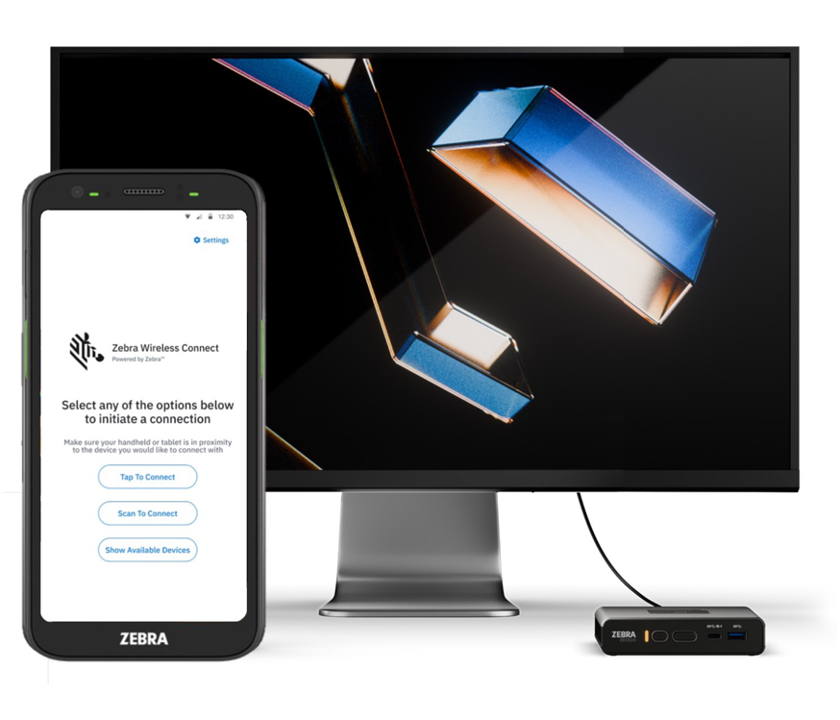
Turn your device into a workstation with Wireless Workstation Connect
No docks. No cables. All flexibility.
Cast the screen of a Zebra mobile device
to an external display connected to a ZEC500
Choose mirroring or a full desktop experience
Share content and work on different apps on mobile device
and external display simultaneously
Interact with apps on the mobile device on a larger display
Use connected peripherals to interact with apps on the big
screen—such as a mouse, keyboard and printer
Seamless transition between mobile and fixed computing
Switch between handheld and desktop modes to meet the
needs of the moment
Mobile device remains fully functional — no missed calls
or alerts
ZEBRA TECHNOLOGIES
51

Slide 52
Zebra Services
The industry standard in enterprise support

Slide 53

Zebra OneCare™: the industry standard in enterprise support
Unexpected failures that interrupt your workflows aren’t an option. Zebra OneCare maintenance plans keep devices running at peak performance and ready for whatever your job demands.
Eliminates unpredictable repair-related costs. With Zebra OneCare, there are no limits—if something is broken, we fix it
End-to-end
coverage
Reduce the cost of battery replacement over a device’s lifespan and ensure workers have a healthy, fully charged battery for every shift
Optional
battery
plans
Included in every plan; your users get support they can count on—fully trained technical professionals are available* to answer questions and address issues
Technical
support
Optional
VisibilityIQ
Foresight™
Cloud-based dashboard to view device insights; address potential issues before they impact your business, uncover opportunities for cost-cutting, right-sizing inventory, and reducing lost assets
ZEBRA TECHNOLOGIES
* Hours of availability are plan dependent
53

Slide 54
TC501/TC701
Zebra OneCare™ Maintenance Plans
Feature | Zebra OneCare Essential | Zebra OneCare Select
Live-agent support | Mon–Fri, 8–5 local time | 24/7
Repair turnaround time | 3-day repair turnaround* | ‘Like-new” replacement device ships for next business day delivery*
Accidental damage coverage
OS software and LifeGuard™ for Android™ security updates
Cloud-based visibility into repair, case reports and more with VisibilityIQ™ OneCare
Battery service enhancement | Option to include Battery Maintenance or Proactive Battery Replacement Services | Option to include Battery Maintenance or Proactive Battery Replacement Services
Spares pool management
Commissioning service enhancement | Option to include Standard or Advanced Commissioning | Standard Commissioning included: option to add Advanced Commissioning
Benefits
Genuine Zebra expertise and parts
to maximize device uptime
LifeGuard for Android—protection from security threats and keeps your devices up-to-date with the latest software and firmware
Years of investment protection—all for less than the cost of a single repair
Cloud-based visibility to repairs and more, with detailed insights into contracts, case and lifecycle reports
True service from the source–no one knows Zebra devices and its software better than Zebra, and Zebra Certified Repair Partners
* Based on when device arrives to repair depot
54
ZEBRA TECHNOLOGIES
54
ZEBRA TECHNOLOGIES

Slide 55
Why Zebra
55

Slide 56
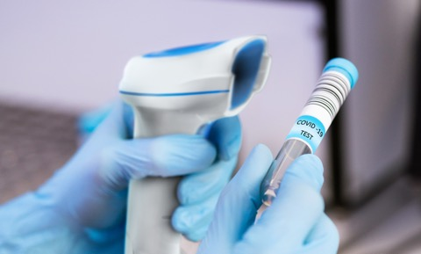



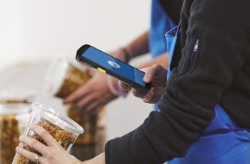
Globally recognized leader in powering the frontline
1
#
BARCODE
SCANNING
RETAIL TASK
MANAGEMENT SOFTWARE
RUGGED MOBILE COMPUTING
THERMAL
PRINTING
RFID
READERS
Sources: VDC Research and Zebra analysis (#1 market share),
56
ZEBRA TECHNOLOGIES

Slide 57
Zebra is leading this transformation with innovative hardware, software, and solutions that digitize and automate business workflows.
55+
years providing solutions to the frontline
We provide solutions to over 80% of Fortune 500 companies
57
ZEBRA TECHNOLOGIES

Slide 58
Why choose Zebra as your AI Partner?
Frontline focus: Zebra builds AI models for our customers with an understanding of their edge needs/requirements
Industry-Specific AI Solutions
Unlike general-purpose AI models, Zebra focuses on solving key industry problems
with tailored AI models, delivering precise and actionable insights for businesses.
Proven Expertise and Continuous Innovation
With over a decade of AI integration, Zebra constantly refines its models to ensure
they remain state-of-the-art, leveraging years of expertise to provide reliable and
cutting-edge solutions.
Optimized On-Device Processing
By prioritizing on-device AI, Zebra ensures enhanced privacy, robust security, reduced dependency on cloud computing, and significantly lower operational costs, all while delivering lightning-fast performance.
Accessible Development Tools
Zebra simplifies AI adoption with user-friendly development tools, empowering developers of all skill levels and reducing the need for costly AI engineering and research investments.
Real-time results using the onboard neural processor
Zebra’s AI Training Database consists of over 24M images
On-device product recognition able to recognize over 200k unique SKUs
58
ZEBRA TECHNOLOGIES

Slide 59

Powering organizations
across the globe
$5.0B
~9,900
80%⁺
in global sales (2024)
employees in 55 countries across 120 offices
of Fortune 500 companies are Zebra customers
10,000⁺
~7,150
~10%
Channel partners in over 190 countries
US & Int’l patents issued and pending
of sales to R&D
59
ZEBRA TECHNOLOGIES

Slide 60

















Our people
make the
difference
Lead through innovation
Deliver excellence with agility
OUR VALUES
Think and act customer first
Succeed
as one
Make a
positive impact
AWARDS
60
ZEBRA TECHNOLOGIES

Slide 61

Thank You!
ZEBRA and the stylized Zebra head are trademarks of Zebra Technologies Corp., registered in many jurisdictions worldwide. All other trademarks are the property of their respective owners. ©2026 Zebra Technologies Corp. and/or its affiliates. 02/17/2026
61

Slide 62
APPENDIX A
Add these detailed slides in the Zebra Frontline AI Suite section for customers who want more detailed information
62

Slide 63
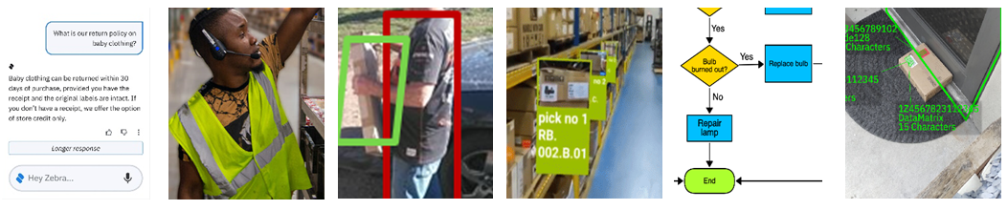
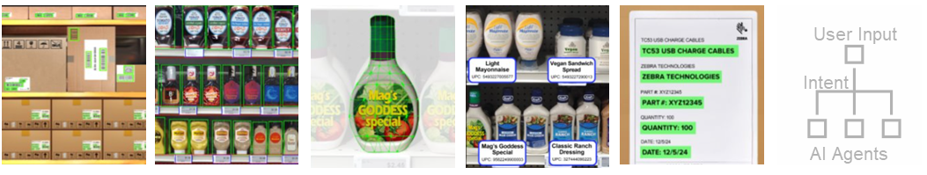
Zebra Frontline AI Enablers
Frontline AI Enablers
Frontline AI Blueprints
Frontline AI Zebra Companions
Shortcut the process to build and deploy AI-powered apps for your frontline with this
ever-growing collection of
pre-trained building blocks to:
Heavily automate your
enterprise workflows
fully leverage the data capture capabilities of Zebra’s AI-empowered mobile computers
Chatbot/
QA
Voice AI
Person Localizer
AR
Workflow Execution
Package Detector
Barcode Localizer
Shelf/Product Localizer
Feature Extractor
Product Recognizer
OCR/Text Recognizer
On-device router
ZEBRA TECHNOLOGIES
63

Slide 64
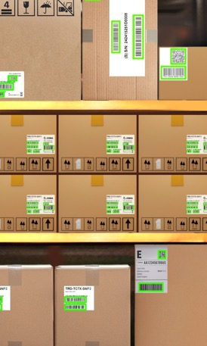
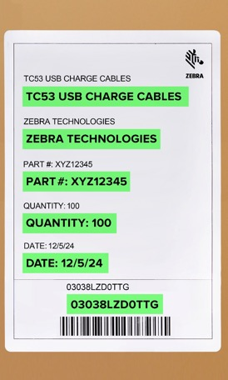
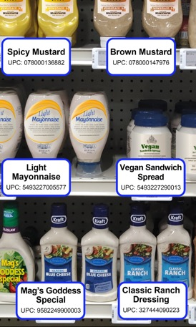
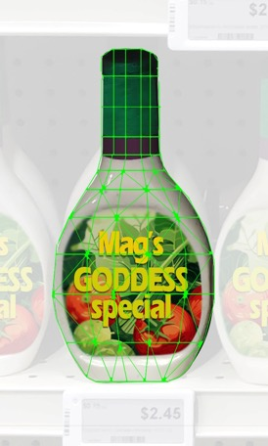
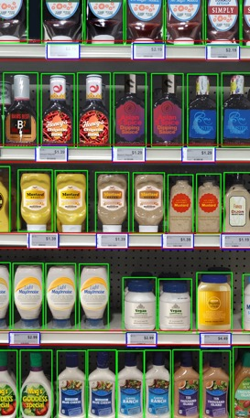
Zebra Frontline AI Enablers
Start capturing volumes of data now with ready-to-use Frontline AI Enablers
Ready-to-use trained Frontline AI Enablers can be used as standalone applications or as components of a more complex application. Either way, your AI apps are up and running quickly, easily and cost-effectively.
Barcode Localizer
Text-OCR Recognizer
Shelf /Product Localizer
Feature Extractor
Product Recognizer
Detects and decodes all barcodes in an image, whether they are on labels on boxes, parcels or shelves
Detects and recognizes any text or characters in an image and decodes the text into words with extreme accuracy. Supports many fonts, font sizes, and text orientation.
Detects all products, shelf and peg labels and shelf facings in an image; variable data capture distances accommodate different aisle widths to support almost any store layout
  Extracts and stores key descriptors of products in a database to enable the Product Recognizer model to identify products in an image.
  Finds and recognizes products on shelves—helps locate an item, determine what items need restocking, or recognize and ring up items at a point of sale (POS), and more
ZEBRA TECHNOLOGIES
64

Slide 65
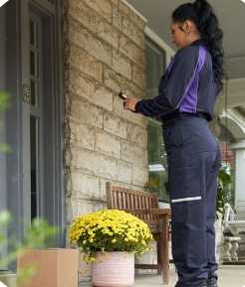
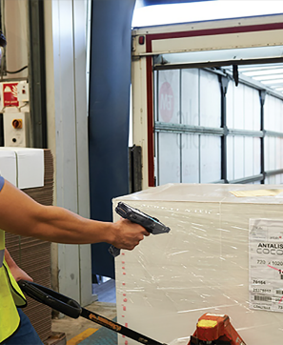

Zebra Frontline AI Blueprints
Infuse AI into your critical workflows with ease using Zebra Frontline AI Enablers
Enablers
Blueprints
Zebra Companion
Ready-made, adaptable frameworks for building scalable enterprise AI workflows that modernize your unique manual processes.
Proof of Delivery
Automated Form Capture
Voice Translation
ZEBRA TECHNOLOGIES
65

Slide 66






Zebra Companion
Trained AI agents that enable specific types of workers to simply ask for what they need
Enablers
Blueprints
Zebra Companion
Connect your workers
to all of your business information to provide instant answers to questions, right on the spot —all on your favorite
Zebra devices.
Knowledge Agent
Sales Agent
Device Agent
Merchandising Agent
  Pre-loaded with your customer’s standard operating procedures and policies
  Pre-loaded with your customer’s product information to help sales associates answer customer questions
  Puts how-to Zebra device information at worker’s fingertips
  Combines advanced image recognition and augmented reality to identify and provide fixes for merchandising related issues
ZEBRA TECHNOLOGIES
66

Slide 67
APPENDIX B
Add this next section to your presentation if there are use case slides that align with your customer’s use cases. Note most of the slides in this section contain powerful videos that show the use case in action.
Note that there is a video embedded into each product photo in slides 71 through 74. To access, simply roll the cursor over the product photo; the video control bar will appear at the bottom of the product photo.
ZEBRA TECHNOLOGIES
67

Slide 68
AI Use Cases In Action
A look at how AI can impact your workflows
ZEBRA TECHNOLOGIES
68

Slide 69


Validate the Address
On-device OCR recognition and processing
Read the address printed or handwritten on the package
Validate with the address
in the system
Speed up the collection of parcels with automated data input
Build on device OCR functionality into your application using Zebra’s Frontline AI Enabler API
69
ZEBRA TECHNOLOGIES

Slide 70


Find the Right Package up to 45% Faster*
Faster finds. Happier customers. More deliveries.
Quickly pan across multiple barcodes to find the right package in the back of the truck
Build in on-device barcode search functionality into your application using the Barcode Localizer Frontline AI Enabler API
Keep delivery schedules on track
Increase productivity without adding staff
Reduce costs due to delivery delays
Boost customer satisfaction and trust
*Estimates are illustrative only, based on controlled simulations and third-party data. They do not represent actual customer results and may differ under real-world conditions
70
ZEBRA TECHNOLOGIES

Slide 71


Barcode Picking: detect, track and decode
Read and take action on many barcodes, simultaneously
Integrates with on-device barcode search
Runs directly on device—no cloud cost
Features and benefits
Detect barcodes on labels, boxes, parcels, or shelves
Rapid scan multiple barcodes to pinpoint correct package
Deliver more packages
Complete routes faster
Boost customer satisfaction
71
ZEBRA TECHNOLOGIES

Slide 72


Text-OCR Recognizer
Fast, complete text recognition
Runs directly on device—no cloud cost
Features and benefits
Read standard text – documents, ID, labels
Read specialized text – handwriting, DPM, Dot peen
Automates data entry
Reduces errors
Streamlines operations
72
ZEBRA TECHNOLOGIES

Slide 73


Product and Shelf Recognizer
Localizes and recognizes products
Pre-trained: no AI training required for typical CPG items
Runs directly on device—no cloud cost
Can be used to create stock or planogram compliance applications
Features and benefits
Detect typical products (boxes, cans, jars, bottles, hanging items)
Detect typical shelves, pegboards and labels
Extracts unique details of products
Creates database of unique products
Demo application enrolls products
Cloud service enrolls thousands of products at a time
ZEBRA TECHNOLOGIES
73

Slide 74




Automated Form Capture and Data Entry
AI-powered capture and pre-population
Packing Slip Capture
Automated Pallet Capture
Pre-trained: no AI training required
Runs directly on device—no cloud cost
Features and benefits
Digitize workflows using vision AI
Avoid manual data entry errors
Improve workflow cycle time
Accelerate task quality
Perfect image capture for audit needs
Improve compliance with various SOPs
ZEBRA TECHNOLOGIES
74

