Slide 1
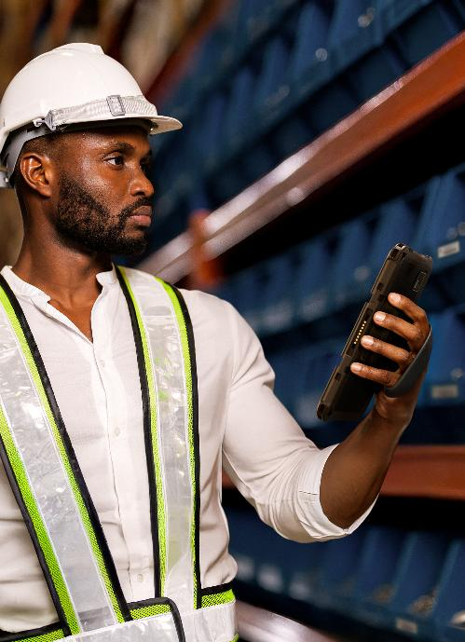

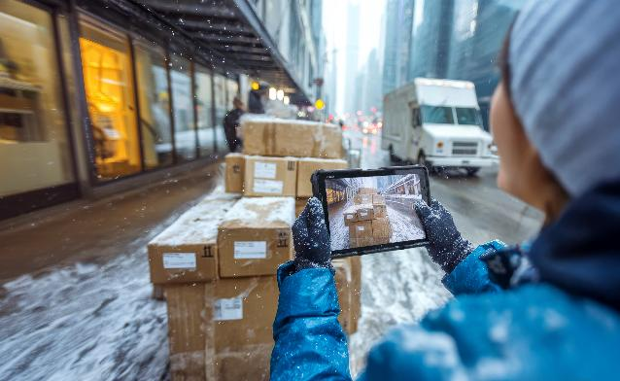
ET401 Enterprise Tablets
Sleek. Rugged. Reliable.

Slide 2

Agenda
Agenda
Challenge and Solution
Markets and Applications
Key
Features
ET401
Product Tour
TCO
Analysis
Zebra
DNA
Zebra
Services
ZEBRA TECHNOLOGIES
2

Slide 3

Challenge and solution
Discover how the ET401 is ready for your business’ biggest demands
ZEBRA TECHNOLOGIES
3

Slide 4

The hidden cost of consumer tablets in the enterprise
The temptation
Low price. Sleek design. Features that seem “good enough”.
The reality
They’re not built for your world—lacking durability, productivity tools, and enterprise-grade support.
The vicious cycle
Device breakage → Downtime → Lost productivity → Costly replacements… with multiple models that lead to complex mixed deployments.
The real cost
What looked affordable at first ends up costing far more over time.
ZEBRA TECHNOLOGIES
4

Slide 5
Consumer tablets are double trouble
…double the cost of lost productivity, double the IT support costs
and 60% higher TCO—every year.¹
Per device
failure
Per battery
failure
Per wireless
connection loss
Per device
trouble ticket
74 min¹ worker productivity lost/incident
54 min² worker
productivity lost/incident
24 min¹ worker
productivity lost/incident
70 min¹
IT time/trouble ticket
More device
trouble tickets
More lost
wireless connections
More frequent
device replacements
Higher
accessory costs
20% more²
device issues
28% more²
wireless connection issues
1 to 2 year lifecycle ¹
More frequent device replacement
Extra costs for
Rugged cases • Scanners • Chargers
2. Enterprise Mobility Total Cost of Ownership; Emily Gove and David Krebs; VDC Research, 2022 1. Enterprise Mobility Total Cost of Ownership; From the Expected to the Unexpected: Uncovering the True Costs of Mobile Solutions for Frontline Mobile Workers; VDC Research, 2021.
Notes:
NOTES ON VDC STATISTICS
Per device failure:
For every device failure incident, workers lose 74 minutes of productivity
Per battery failure:
For every battery failure, mobile workers lose 54 minutes of productivity due to time spent on tasks such as locating a new charged battery and replacing the battery.
Per wireless connection loss:
Every time the Wi-Fi or cellular connection is lost, workers lose 24 minutes of productivity
Per device trouble ticket
Each trouble ticket takes IT support personnel an average of 70 minutes
More device trouble tickets
Consumer devices generate 20% more trouble tickets than enterprise rugged handheld computers
More lost wireless connections
Consumer devices are 28% more likely to have wireless connection issues
More frequent device replacements
Lack of rugged design leads to the need to replace consumer devices more frequently than enterprise rugged devices:
-Failure rates of non-rugged/consumer devices are 3x that of rugged devices.
-Consumer grade devices lack the consistent reliability of rugged devices after their first year of use
Higher accessory costs
Consumer devices may require the purchase and management of rugged cases to survive in the business environment.
Consumer devices typically rely on the camera for barcode scanning and do not have dedicated integrated enterprise-class scanners, requiring the purchase of separate scanners to deliver the on-the-job scanning performance required.
Consumer devices typically do not offer cost-effective multi-device and multi-slot battery chargers, requiring the purchase of a charger for each device.

Slide 6
What’s the solution?
A tablet that won’t make you choose between consumer good looks, price, and enterprise functionality
ZEBRA TECHNOLOGIES
6

Slide 7
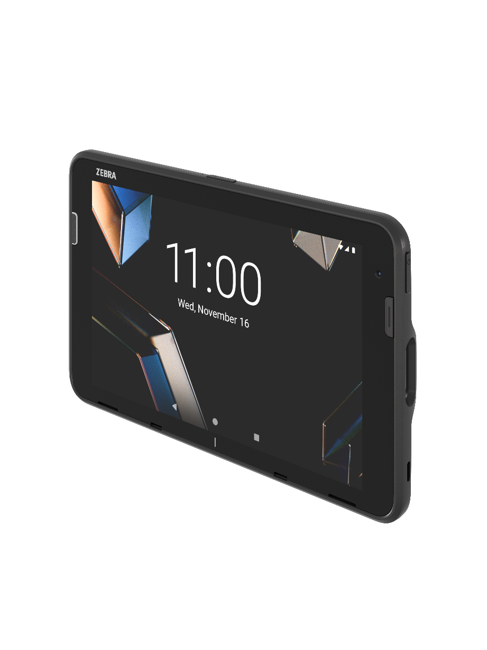
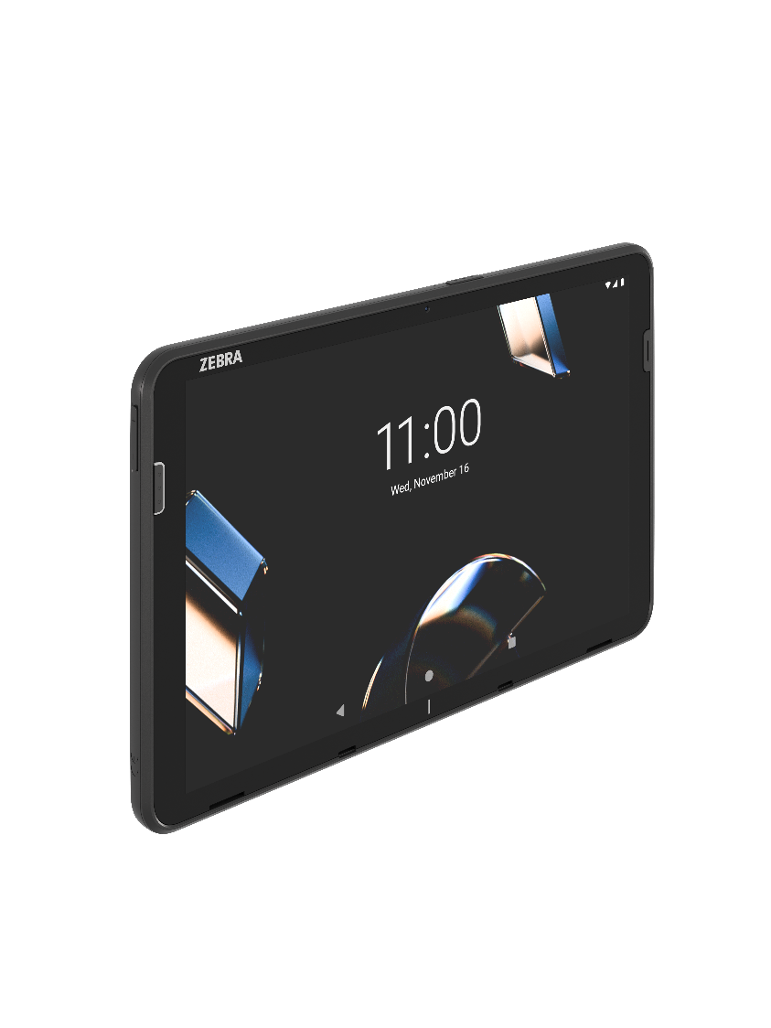






Introducing
ET401 Enterprise Tablets
The sleek design your workers expect, with the power and rugged reliability your enterprise needs
Designed for work
Rugged
built-in
Long lifecycle
Enterprise accessories
On-device AI
ZEBRA TECHNOLOGIES
7

Slide 8

Why is the ET401 the right tablet for your business?
It may look like the personal tablet you have at home—
but it’s built for business inside and out.
Designed for work
Rugged built-in
Long lifecycle
Enterprise accessories
When it comes to feature options, no matter what you need, the ET401 has it, including:
- Integrated RFID
- Integrated scanning
- Ultra-wide angle rear camera
Easy to see in any lighting, including bright sunlight
Select the options you need—you don’t have to pay for technology you won’t use
Built from the ground up to be drop-proof to concrete up to
4 ft. and protected from water and dust
Use it indoors or outdoors
A display with advanced scratch-and-shatter protection
Use it in extreme heat and subzero cold
The ET401 is engineered to last between 4 and 8 years—an extraordinary lifecycle and return on investment
The same model is available
for sale for 4 years, eliminating the complexity of mixed model deployments, keeping your device fleet simple and easy
to manage
Service and support is available for 4 years after end of sale, extending the ET401's lifecycle up to 8 years
Enhance ease of use and portability with expansion backs and carrying accessories
Simplify backroom management with various charge cradles
Increase durability with
rugged boots
Expand versatility with Workstation Connect cradles, payment backs, Point of Sale (POS) hubs, and more
ZEBRA TECHNOLOGIES
8

Slide 9
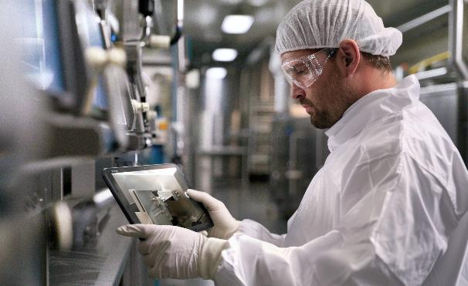
Everything you need to do business right, at the right price
Thin, light, consumer styling
Next-gen Qualcomm
AI-ready processor
AI audio +
AI-enabled touchscreen
Rugged design, complete water and dust protection
Long lifecycle, guaranteed support
New data capture options: RFID + ultra-wide camera
Full accessory family, backward compatible
Expand with payment, workstation and collaboration tools
Fastest wireless: Wi-Fi 7, 5G, BT 6.0
Multi-layer enhanced security
ZEBRA TECHNOLOGIES
9

Slide 10
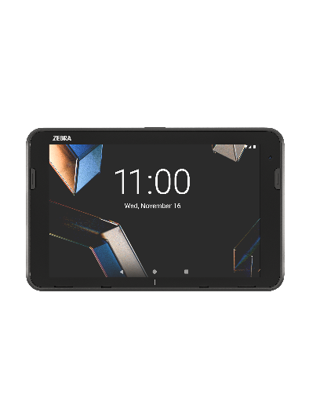

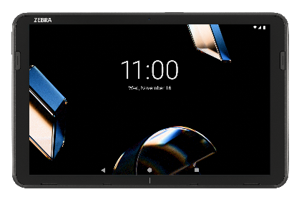
Choose the features you need now…add the features you need tomorrow
Build the perfect-fit solution⎯without paying for features you don’t need
Pick your display size
Choose 8 or 10 inches
Tailor it to your needs with optional features
Add 5G connectivity
Add extra memory
Add integrated short-range UHF RFID
Add an integrated barcode scanner
Add an ultra-wide
angle camera
Add capabilities with Zebra solutions and accessories
Add Workstation Connect*
Add Zebra Pay*
Add Workcloud Sync*
Add a rugged boot
Add a hot-swappable secondary battery
for use with the expansion back
ZEBRA TECHNOLOGIES
* Contact your Zebra sales representative to check availability in your region
10

Slide 11

Markets and applications
Streamline more tasks for different types of work
ZEBRA TECHNOLOGIES
11

Slide 12

Retail and hospitality
Where does the ET401 have
the biggest impact in retail
and hospitality?
Assisted selling
Line busting
Point-of-Sale (POS) – in store, curbside pickup, entertainment,
and events
Inventory management
Staff management and communication
Hotel/restaurant check-in
Food ordering
ZEBRA TECHNOLOGIES
12

Slide 13

ET401 Retail spotlight: the perfect tool for assisted selling
Lisa enjoys a VIP, differentiated in-store digital experience.
Sleek consumer design
AI-enabled WUXGA display
600 nits brightness
David can access information in record time with automated data entry.
RFID
Barcode scanning
Wide angle camera
hybrid/mobile POS with NFC
David stays connected everywhere in the store.
Wi-Fi 7
Bluetooth 6
Optional 5G
NFC
Zebra Fusion
Nothing slows David down—even if he drops the tablet.
4 ft. drop to concrete
IP68 sealing
Gorilla Glass 5 display
8-year product lifecycle
ZEBRA TECHNOLOGIES
13
Notes:
The scene: Lisa is searching for her favorite style of jeans but can’t find her size. She’s about to give up when Joe, a store associate, approaches with an ET401 in hand. In seconds, he checks stock, finds her size in the back, and even shows her a few other styles she might love. David asks if she plans to continue shopping or if she’s ready to purchase the jeans. She confirms that she’s done shopping and is going to check out at a register. David offers to take payment on the spot, so Lisa doesn’t need to wait in the checkout line. David completes payment right on the ET401 and Lisa leaves with her purchase, delighted with the fast personalized customer experience David delivered.

Slide 14

Transportation and Logistics
Where does the ET401 have the biggest impact in Transportation
and Logistics?
Routing and dispatch
Vehicle inspection and maintenance
Quality/safety checks
Inventory management
Staff management and communication
Proof of pickup and delivery
ZEBRA TECHNOLOGIES
14

Slide 15

ET401 T&L spotlight: the perfect tool for proof of delivery
Pam wears gloves to stay warm, but easily interacts with and can clearly see
the screen—even though
it’s snowing.
AI-Enabled Wuxga display
600 nits brightness
Water droplet rejection
Fingerprint resistant
With the press of a button, Pam documents proof of delivery, sends it to the customer and updates her delivery log, all in real time.
Wide angle camera
Barcode scanning
RFID
Pam stays connected, no matter where her delivery routes take her.
5G
Wi-Fi 7
Bluetooth 6.0
Zebra Fusion
Nothing slows Pam down—even if she drops the tablet in the snow or on the sidewalk.
5.1 ft. drop to concrete
with rugged boot
IP68 sealing
Gorilla Glass 5 display
Sub-zero temperature rating
ZEBRA TECHNOLOGIES
15
Notes:
The scene: Pam is out on her delivery route on a snowy, cold winter day. Since Pam has the ET401, the weather doesn’t impact the her tablet—or her ability to get the job done. She leaves her gloves on when she gets out of the truck to make a delivery, and easily navigates through the delivery application on the tablet. The ET401 simply doesn’t care if Pam uses a gloved or bare finger or a stylus for input. And she can change input modes on the fly—without changing settings. These AI-enabled tablets make her job easy. With just the press of a button, Pam can take a photo to document proof of delivery and capture whatever information is required on the box labels, from barcodes to text—and send all that data to the right fields in the delivery application. All of Pam’s wireless connections are solid and reliable, so she stays connected over 5G when she is out in the field and over Wi-Fi 7 when she’s in the office or inside a customer facility. With Bluetooth 6.0, pairing of wireless peripherals couldn’t be easier—and wireless peripheral performance couldn’t be better. With the rugged design, Pam never has to give the weather a second thought—she knows she can count on her tablet. It can rain, sleet or snow and she can still see and interact with the screen. And even if she drops the tablet on the cement, she knows the ET401 will continue to deliver the solid performance she needs to get her job done.

Slide 16

Warehousing and manufacturing
Where does the ET401 have the biggest impact in warehousing
and manufacturing?
Manager’s device
Inventory management
Maintenance repair and overhaul
Quality assurance
Staff management and communication
ZEBRA TECHNOLOGIES
16

Slide 17

ET401 warehouse spotlight: the perfect tool for inventory management
Rick is wearing the protective gloves he needs on the job without impacting his ability to interact with his tablet.
AI-enabled WUXGA display
600 nits brightness
Fingerprint resistant
Rick can easily identify contents on shelves and
in pallets and update his
WMS system in real time.
RFID
Barcode scanning
Wide angle camera
Rick stays connected wherever he goes—in
the warehouse and out
in the yard.
5G
Wi-Fi 7
Zebra Fusion for a superior user experience and ‘no-drop’ wi-fi connections
Nothing slows Rick down—even if he drops the tablet on the concrete warehouse floor or outside in subzero temperatures.
5.1 ft. drop to concrete
with rugged boot
IP68 sealing
Gorilla Glass 5 display
Sub-zero to sweltering heat
ZEBRA TECHNOLOGIES
17
Notes:
The scene: Rick takes inventory in the warehouse to ensure ample stock of parts are on hand to support the manufacturing production line and ample finished goods are on hand to fulfill orders. He can capture virtually any information on any label or on multiple labels with his ET401—RFID tags, barcodes in practically any condition—including poorly printed, smudged, scratched or damaged, multiple labels on a box simultaneously, specific text on a box label and even all the information on all labels on an entire section of a warehouse shelf. The extremely bright screen is always easy to see, whether he is in a dimly lit corner of the warehouse or outside on the delivery dock in the bright sunshine. With the fastest wireless network connections and Zebra’s proprietary Wi-Fi Fusion technology, Rick stays connected and able to access his apps every minute of every shift. Since the ET401 is rugged, Rick can drop it, get it wet, use it in the heat and sub-zero cold and experience no degradation of the tablet’s performance. With the AI-enabled touchscreen, he can enter input easily with the gloves he wears on the job—and he can take off his gloves and use a bare finger or stylus on the fly, without needing to change any settings. And when it comes to carrying his tablet, Rick is always comfortable, thanks to carrying accessories like hand and shoulder straps. With the power of the ET401 in Rick’s hands, he can he can get more done in a day since he has the technology in his hands to work differently, automating more of his workflows than ever before.

Slide 18

Key features
ET401 tablets help your team work smarter and faster

Slide 19

Key Features
Rugged built-in
Longer lifecycle
Designed for
work
Enterprise
accessories
ZEBRA TECHNOLOGIES
19

Slide 20

Consumer looks. Enterprise tough.
More robust water and dust protection (IP68)
Improved IP rating for problem-free performance in more environments—use your tablets in the rain, accidentally drop them in a puddle, or spray them with a hose
Built for extreme temperatures
Thermal shock testing ensures your tablets can perform in subzero cold temperatures
to sweltering heat
Advanced display protection
Gorilla Glass 5 offers advanced scratch-and-shatter protection; fingerprint resistant coating helps keep them looking clean
Engineered to take a fall
4 ft. (1.2 m) multiple drops to concrete, 5.1 ft. (1.5m) multiple drops to concrete with optional rugged boot
ZEBRA TECHNOLOGIES
20

Slide 21
Key Features
Rugged built-in
Longer lifecycle
Designed for
work
Enterprise
accessories
ZEBRA TECHNOLOGIES
21

Slide 22
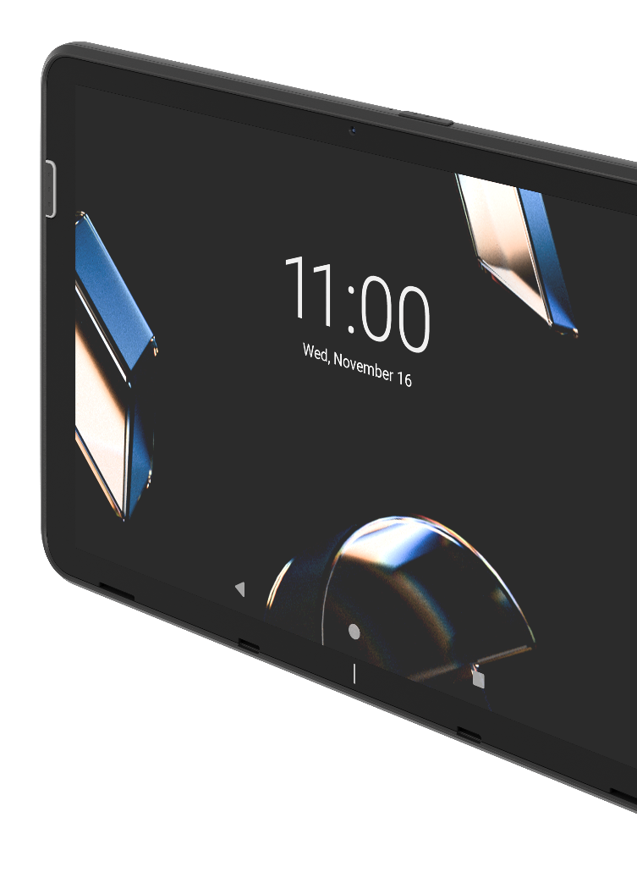
Built-to-last: up to 8 years of service and support
Engineered
for longevity
ET401 tablets are purpose-built for long-term durability
Designed to remain in service—not just for a few years, but for nearly a decade
Simplified lifecycle management
Available for purchase for 4 years
Avoids the cost and hassle of managing multiple device models
Extended support that matches your needs
4 years of service
and support after the first 4 years of sale
Total product lifecycle up to 8 years
ZEBRA TECHNOLOGIES
22

Slide 23
Key Features
Rugged built-in
Longer lifecycle
Designed for
work
Enterprise
accessories
ZEBRA TECHNOLOGIES
23

Slide 24
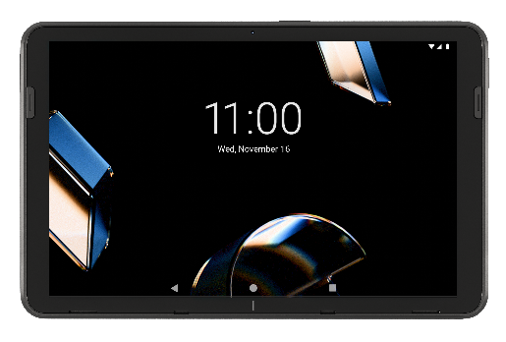







Next generation processing power for a new generation of apps
Experience unparalleled performance and efficiency with Qualcomm’s innovative Dragonwing™ Q-6690 processor
Exponential leap in processing power
Three generations newer than the SM6375 processor in the ET40/ET45, the Q-6690 delivers a huge 42%+ performance boost*
Energy efficiency
An 80% increase in energy efficiency in the high-performance cores means longer run times between battery charges—and longer battery lifecycles
Ready for AI
Able to handle heavy task loads
of modern, cloud-based
AI applications
UHF RFID
World's first enterprise mobile processor with fully integrated UHF RFID capabilities, enabling new use cases in retail inventory intelligence, asset tracking, product authentication and more
Product longevity
Part of Qualcomm’s Product Longevity Program, designed to bring stability to product designs, planned support to 2034**
Premium connectivity
5G, Wi-Fi 7 (including 320 MHz channels and Multi-Link Operation for aggregate throughputs over 30 Gbps), and Bluetooth 6.0
* Based on GeekBench 6 Multi-Thread benchmark scores using real-world tests (Note ‘real-world tests’ is how Geekbench refers to GeekBench 6 on their website)
** Refer to Qualcomm’s product longevity page for details: https://www.qualcomm.com/products/product-longevity-program
24
ZEBRA TECHNOLOGIES

Slide 25


Smarter, with built-in AI intelligence
Cutting edge AI simplifies everyday tasks
AI-enabled touchscreen for unmatched accuracy and speed
Automatically adjusts to bare finger, gloves, or conductive stylus—there’s no need to change settings
Instant, pinpoint touch accuracy and response, even in heavy rain
AI Audio technology takes voice clarity to the next level
Suppresses more background noise than traditional audio technologies
Crystal-clear conversations, even in the loudest environments
Zebra Frontline AI Enablers
Provides the tools you need to build AI apps that streamline workflows and boost efficiency
Ready-to-use trained models capture volumes of data in seconds
Save time and cost—develop and deploy AI vision apps in days instead of months
NOTE: To fully leverage the most advanced, on-device AI models, such as the Zebra Frontline AI Enablers, Zebra recommends systems with enhanced processing power and increased memory capacity.
ZEBRA TECHNOLOGIES
25

Slide 26








Built-in RFID, built for efficiency
Optional integrated RFID empowers workers to quickly complete tasks without juggling multiple devices
Enables new contactless use cases, from inventory management to asset finding
Integrated, ergonomic solution–no extra accessories,
sleds or batteries
Read range up to 4 ft (1.2m); >90 tags per second
Where can you put short-range RFID to work?
Inventory
management
Point of sale/
line busting
Track and trace
work orders
Asset management
Ticket
validation
Self-checkout
validation
ZEBRA TECHNOLOGIES
26

Slide 27

From occasional to all-day scanning, the ET401 has you covered
Three options to match your scanning needs
Optional SR500 for moderate to intense scanning
Yellow LED aimer with red illumination offers enhanced visibility for easier, more accurate aiming
More versatile, longer scanning range
High motion tolerance makes it easier
to capture barcodes on the move
Captures barcodes in all lighting conditions, including bright sunlight
Optional SE4100
for light to moderate scanning
Green LED aimer and white illumination are easy on the eyes
Offers Zebra’s proven scanning performance you can trust
Ideal for indoor scanning applications
Camera-based scanning for
occasional scanning
There’s no need to pay for a scan engine if barcode scanning isn’t important to your workflows
Use the camera for reliable barcode capture when needed
Zebra’s scanning software is included at no extra cost
ZEBRA TECHNOLOGIES
27

Slide 28

Camera options that do it all—wide angle, high-res photos or video calls
New ultra-wide angle camera option
Enables new vision applications that require a wider view
Retailers can capture an entire section of shelves for merchandising
Car rental agencies can easily document the condition of a whole car
High-resolution
16 MP rear camera
Easily capture finer details in photos
Ideal for proof of delivery, proof of condition, and more
Intuitive Enterprise Camera App includes innovative features like dirty lens detection, a digital level and gesture support
High-resolution
8 MP front camera
Enables high quality video calls for better collaboration
Ideal for remote collaboration—give your workers the ability to show remote experts a local problem and get faster issue resolution
ZEBRA TECHNOLOGIES
28

Slide 29

Layers of defense to keep your devices, data and networks safe
Protect your devices and data with multi-layer security that’s always on guard
Secure Element prevents physical hardware attacks–it’s the best physical security available on a mobile terminal
LifeGuard for Android delivers regular security updates over a device’s lifespan to protect against the latest cyber threats²
Android StrongBox protects sensitive data like passwords
Government grade security
with FIPS 140-2 Validated (ISO 19790¹) and Common Criteria certified
(ISO 15408¹)
HID® security chip allows secure card or badge access to the ET401 and protected applications (optional)
1 Available Q1 2026
2 Requires a Zebra OneCare contract
29
ZEBRA TECHNOLOGIES

Slide 30

Know where your devices are and who is using them with Zebra Guardian
Enhance device availability, streamline access control and ensure fully-charged devices
are available at the start of every shift
Identity
Guardian
Easy and secure device access
Facial recognition instantly unlocks and automatically provisions the ET401 with the appropriate applications and permissions
Eliminates the risk of compromised credentials
Device
Guardian
Easily find lost or misplaced devices–whether they’re inside
or outside the
four walls
Protect your investment, data and productivity by proactively identifying and addressing potential device loss scenarios
Device
Guardian
Access
Management
Monitor
your entire
device pool
Real-time visibility into device availability and charge status
Ensure devices are charged
and ready for
the next shift
Guardian
Cabinets
Secure and smart
storage options
Control where your devices
start and end up in the beginning and end of a worker’s shift
ZEBRA TECHNOLOGIES
30

Slide 31



All the fastest wireless networks
Blazing speeds, rock-solid reliability
Unmatched Wi-Fi performance
Wi-Fi 7 delivers 2x the speed and 2x
the bandwidth of Wi-Fi 6, plus multi-band communications
Ready for the Wi-Fi networks of today and tomorrow, with support for more devices and traffic
Fastest cellular speeds
with 5G 2nd Gen Rel 17*
Close out work orders, load database applications and stream video faster than ever with the latest cellular technologies
Private 5G network support–ideal
for areas where Wi-Fi is too costly
to deploy
Better peripheral performance
Highly stable connections, reduced interference and higher security—
all with reduced power consumption
Centimeter-precise positioning lets peripherals auto-connect or disconnect—making Bluetooth feel effortless
Bluetooth v6.0
* Ships with Rel 16, Rel 17 available in Q2 2026 via software update
31
ZEBRA TECHNOLOGIES

Slide 32


Keep working⎯devices are never out of power
You can’t afford to stop your business for a dead battery. With the ET401, it won’t happen.
Full-shift power: 8 inch (6100 mAh/23.46 Wh)
or 10 inch (7600 mAh/29.71 Wh)
Field-replaceable batteries: Replace batteries out in the field at their end of life for continuous power–no need to send the tablet to the repair depot
Smarter battery management: PowerPrecision technology for better tracking and longer battery life
Battery-free operation: Power the ET401 from an external power source in stationery use cases eliminating the need to purchase and maintain batteries
ZEBRA TECHNOLOGIES
32

Slide 33

Put the power of AI in the hands of your workers
With the Zebra Frontline AI Enablers, you get the tools you need to build AI apps that streamline workflows and boost efficiency
  Save time and cost. Develop and deploy AI vision apps in days—instead of months
  Maximize device value. Easily leverage the power and value of your Zebra advanced
  AI-enabled hardware
  Streamline workflows. Simplify complex workflows with powerful AI applications that automate and reduce workflow steps
  Improve your bottom line. Boost operational and workforce efficiency
Faster, easier, smarter work—powered by AI
NOTE: To fully leverage the most advanced, on-device AI models, such as the Zebra Frontline AI Enablers, Zebra recommends systems with enhanced processing power and increased memory capacity.
33
ZEBRA TECHNOLOGIES

Slide 34
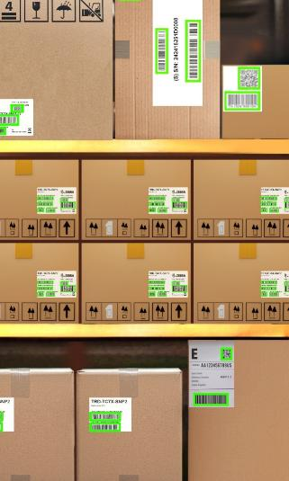
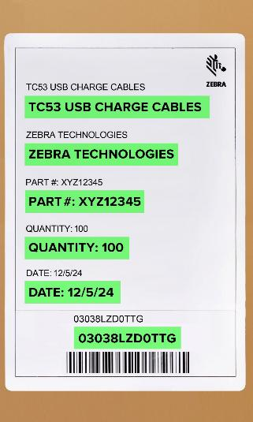
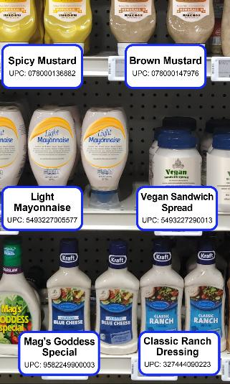
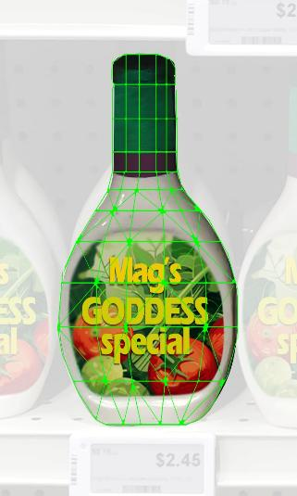
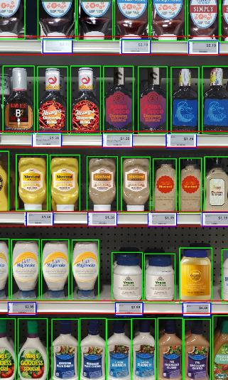
Capture volumes of data in seconds with the power of AI
Ready-to-use trained models fast-track your use cases
Barcode Localizer
Text-OCR Recognizer
Shelf and
Product Localizer
Feature Extractor
Product Recognizer
Detects and decodes all barcodes in an image, whether they are on labels on boxes, parcels or shelves
Detects and recognizes any text or characters in an image and decodes the text into words with extreme accuracy
Detects all products, shelf and peg labels and shelf facings in
an image; variable data capture distances accommodate different aisle widths to support almost any store layout
  Extracts and stores key descriptors of products in a database
  Finds and recognizes products on shelves—helps locate an item, determine what items need restocking, or recognize items at a POS
NOTE: To fully leverage the most advanced, on-device AI models, such as the Zebra Frontline AI Enablers, Zebra recommends systems with enhanced processing power and increased memory capacity.
34
ZEBRA TECHNOLOGIES

Slide 35
Key Features
Rugged built-in
Longer lifecycle
Designed for
work
Enterprise
accessories
ZEBRA TECHNOLOGIES
35

Slide 36
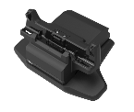
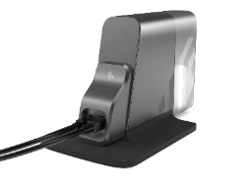
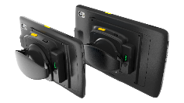
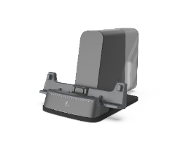

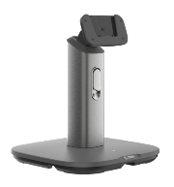
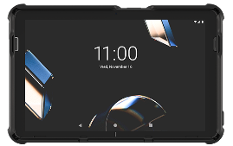
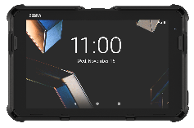
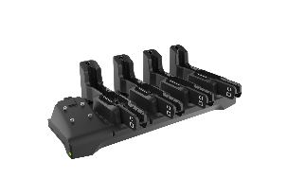
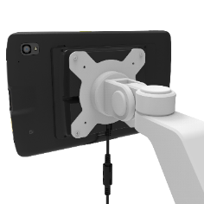
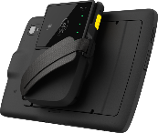
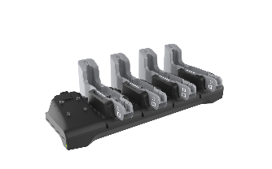
Enterprise-class accessories for every job
A complete accessory family with backwards compatibility
Single-slot
charging cradle
Charges one
tablet; new
ET401
cradle available
Workstation cradle*
Creates an on-demand mobile-driven workstation;
HDMI x 1, RJ45 x 1,
USB-A 5v x 4,
3.5mm audio
Fixed/hybrid Point of Sale
Connects POS peripherals such as scanner, payment terminal, printer, cash drawer for fixed/hybrid checkout
lane applications
Expansion back with secondary battery
Hot-swappable
secondary battery
for constant power;
includes rotating hand strap
Presentation stand
Adjustable stand
for 10 inch tablet;
allows setup on
tabletop for fixed/
hybrid checkout or
kiosk applications
Rugged boots**
Increases drop spec to
5.1 ft (1.5 m) to concrete; available for every model (8 inches/10 inches, with or without scanner)
ET5x adapter rugged
boot (8 inch only)
Increases rugged specifications and enables ET401 to be a
drop-in replacement for ET51/ET56 in vehicle docks
Payment sled (PD20)*
Enable mobile payment with virtually any card
VESA mount adapter
USB data and power connectivity; for use with
third-party VESA accessories: wall, desk and vehicle mounts; available for 10 inch
Multi-slot charge
only cradle
Charges up to four
ET401 tablets
simultaneously; available
for 8 inch and 10 inch
ZEBRA TECHNOLOGIES
* Contact your Zebra sales representative to check availability in your region ** ET401 is not compatible with ET40/ET45 rugged boot
36

Slide 37

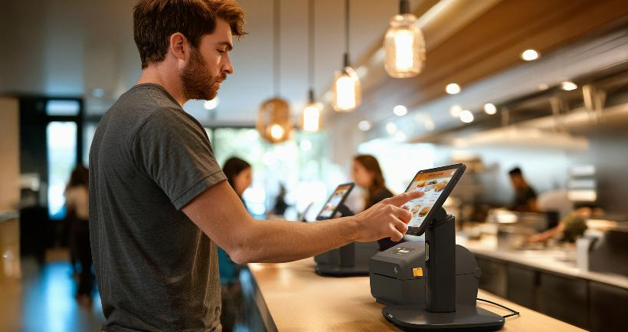
Create a Point-of-Sale (POS) wherever you need it
Mobile and on-demand POS options let you take payment wherever your customers want to pay
Mobile POS
On-demand hybrid POS
Ergonomic expansion backs support the Zebra PD20 payment card reader and third-party readers
Take payment anywhere—from the aisles and the curbside to the doorsteps of homes and businesses
to entertainment events
Instantly create an on-demand complete POS anywhere in your store
Adjustable presentation stand enables ET401 tablets to be used for POS or kiosk applications
ZEBRA TECHNOLOGIES
37

Slide 38
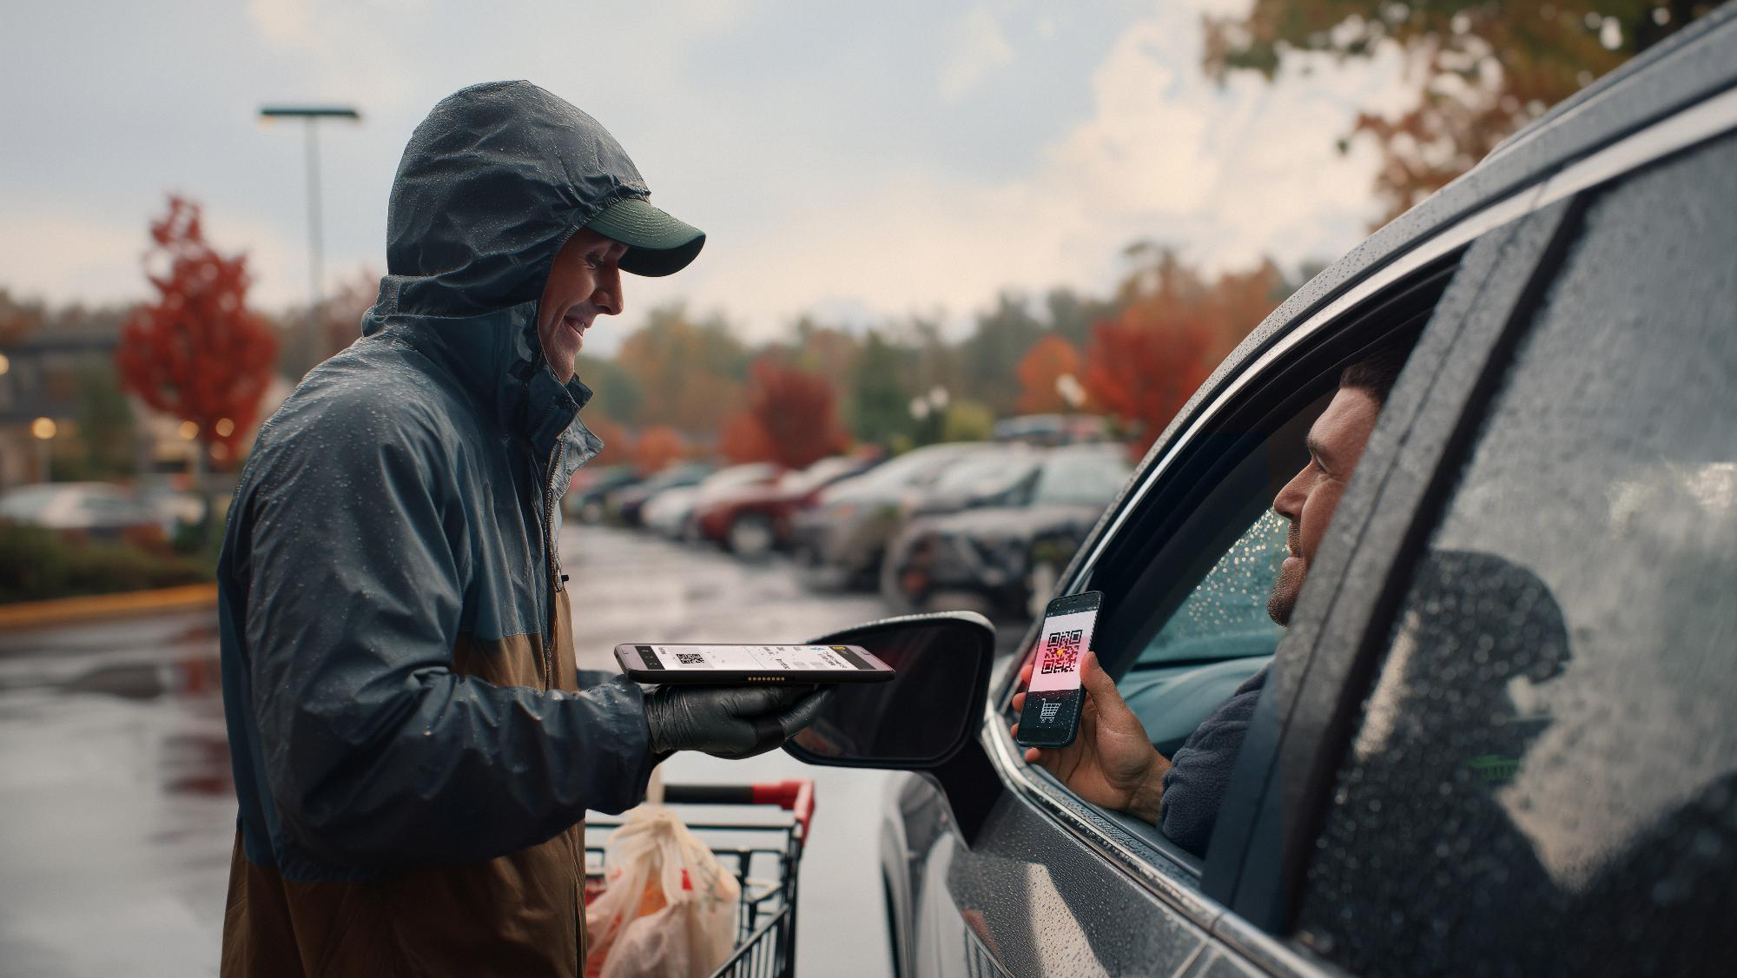
Zebra DNA
Set Up. Secure. Manage. Optimize.
ZEBRA TECHNOLOGIES
38

Slide 39
Empower your workforce.
Drive results.
Intelligence made simple
in every Zebra device.
Zebra DNA spans every stage of your hardware’s lifecycle—from app development to integration, from security to device management and performance optimization.
Note: Many Zebra DNA tools are included at no cost. Depending on configuration, some tools require an additional Zebra DNA for Mobile Computers Enterprise license.
ZEBRA TECHNOLOGIES
39

Slide 40
Zebra DNA Professional
Zebra DNA Enterprise
Complimentary no-cost tools installed on the ET401
Additional advanced tools in the Enterprise License
  DataWedge
  Send barcode data into your apps —no programming required
  GMS Restricted
  Turn off Google Mobile Services you don’t want, such as Gmail, YouTube, and Chrome
  Wireless Fusion
  Delivers unsurpassed Wi-Fi guaranteed with advanced Zebra VoWiFi proprietary features
  Workstation Connect
  Software solution to transform ET401 tablets into fully-featured workstations; requires Connect Cradle accessory
  EMDK
  Everything you need to fully leverage all Zebra device capabilities in your applications, with less time and effort
  StageNow
  Easily stage a handful or thousands of Android devices with a quick scan of a barcode or tap on an NFC tag
  Wireless Analyzer
  Troubleshoot and resolve Wi-Fi issues before worker productivity is impacted
  Picklist OCR
  Capture a single word or a single line of text or barcode on virtually any label or document
  Device Central
  Enables workers to manage
  peripherals while the device is locked down or in kiosk mode
  Mobility Extensions (Mx)
  Choose from over a hundred features to improve the security, manageability and more of the standard Android OS
  OEMConfig (Powered by Mx)
  Allows you to manage all Zebra device features through your EMM, regardless of whether they are supported by your EMM
  RxLogger
  Capture system and application
  logs to identify problems and
  avoid sending no-trouble-found (NTF) devices to the repair depot
  Free-form OCR
  Capture multiple lines of text on virtually any label or document
  Enterprise Keyboard
  Enable faster and easier data entry
  with the optional soft keyboard of
  your choice
  NG SimulScan
  Effortlessly capture up to 100 barcodes in a single scan
  Device Diagnostics
  Get targeted diagnostics to enable faster and easier troubleshooting, diagnosis and resolution of Zebra device issues
  Enterprise Home Screen
  Easily control the applications and device features workers can access
To learn more about Zebra DNA licensing details, click here: https://techdocs.zebra.com/licensing/about
ZEBRA TECHNOLOGIES
40
40

Slide 41

Additional Zebra software solutions available for purchase
Customize your tablet solution with additional software solutions
  Enterprise Browser
  Create feature-rich web apps that take advantage of all Zebra mobile device features
  Zebra Workcloud SyncTM
  Tools to streamline and strengthen collaboration, including:
  Push to Talk. Instantly connects individuals, groups and teams across sites
  Voice calling. Ideal for one-to-one and team calls with key features, such as hold, transfer, add-hoc-callers and more
  Video calling. Enables workers to connect remotely and collaborate visually
  Chat. Send a text with images, audio and video to enrich real time communications with one person or an entire team
  Zebra Zero Touch
  Pre-configure devices out of the box; they’ll provision themselves for faster deployment
  LifeGuard Analytics*
  See available security updates, eligible devices and more
  LifeGuard OTA*
  Update Android on your schedule over
  Wi-Fi or cellular networks—it’s your choice
  OCR Wedge
  Automatically capture standardized data, and overcome its unique challenges, such as a TINs (Tire Identification Numbers) on the black curved surface of a tire
  All Touch Terminal Emulation
  Give legacy green screens an
  all touch, modern UX
ZEBRA TECHNOLOGIES
* Requires a Zebra OneCare Contract
41

Slide 42

Zebra DNA Cloud—one simple portal to manage all of your Zebra DNA tools
Single interface provides a more cohesive and unified user experience
Simple, intuitive
experience designed
for technical and non-technical
users alike
Standalone fleet
management tool that enables IT personnel to easily administer your Zebra mobile devices
Easily access
Zebra’s exclusive suite of in-device software tools and applications to drive greater efficiencies, and cost savings*
Future release will include coexistence with EMM tools * License required for additional features
The easy way to deploy, administer, and manage all of your Zebra DNA tools
ZEBRA TECHNOLOGIES
42

Slide 43

Zebra services
The industry standard in enterprise support
ZEBRA TECHNOLOGIES
43

Slide 44
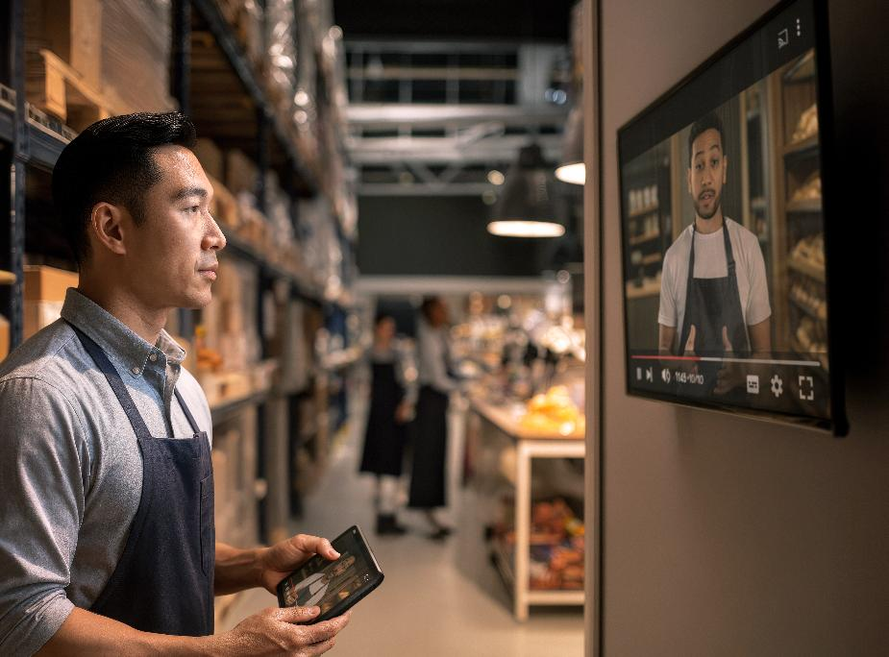
Zebra OneCare™: the industry standard in enterprise support
Unexpected failures that interrupt your workflows aren’t an option. Zebra OneCare maintenance plans keep devices running at peak performance and ready for whatever your job demands.
Eliminates unpredictable repair-related costs. With Zebra OneCare, there are no limits—if something is broken, we fix it
End-to-end
coverage
Reduce the cost of battery replacement over a device’s lifespan and ensure workers have a healthy, fully charged battery for every shift
Optional
battery
plans
Included in every plan; your users get support they can count on—fully trained technical professionals are available* to answer questions and address issues
Technical
support
LifeGuard™
for Android™
Included with every Zebra OneCare contract to
ensure your devices are protected from the latest security threats and are up-to-date with the latest software and firmware
* Hours of availability is plan dependent
ZEBRA TECHNOLOGIES
44

Slide 45
ET401 Zebra OneCare™ Maintenance Plans
Feature | Zebra OneCare Essential | Zebra OneCare Select
Live-agent support | Mon–Fri, 8–5 local time | 24/7
Repair turnaround time | 3-day repair turnaround* | ‘Like-new” replacement device ships for next business day delivery*
Accidental damage coverage
OS software and LifeGuard™ for Android™ security updates
Cloud-based visibility into repair, case reports and more with VisibilityIQ™ OneCare
Battery service enhancement | Option to include Battery Maintenance or Proactive Battery Replacement Services | Option to include Battery Maintenance or Proactive Battery Replacement Services
Spares pool management
Commissioning service enhancement | Option to include Standard or Advanced Commissioning | Standard Commissioning included: option to add Advanced Commissioning
Benefits
Genuine Zebra expertise and parts
to maximize device uptime
LifeGuard for Android—protection from security threats and keeps your devices up-to-date with the latest software and firmware
Years of investment protection—all for less than the cost of a single repair
Cloud-based visibility to repairs and more, with detailed insights into contracts, case and lifecycle reports
True service from the source–no one knows Zebra devices and its software better than Zebra, and Zebra Certified Repair Partners
ZEBRA TECHNOLOGIES
* Based on when device arrives to repair depot
45

Slide 46

Added value for the ET401
VisibilityIQ Foresight™
Professional Services
Proactive device insights and device managed services
Improve operations with proactive insights
Focus on your core business and
let Zebra keep your devices up-to-date and operating the way you need them
Cloud-based dashboard to view device insights and make decisions based on analytics across your entire device inventory
Gold Build ensures your devices operate at their peak performance​ by successfully designing user profiles
Address potential device issues before they impact your business, and uncover opportunities for cost-cutting, right-sizing inventory and reducing lost or stolen assets
Save valuable time in your operation with Zebra Staging by aligning consistency on operating system version, security features and application loading
View everything in an easy-to-understand, color-coded dashboard and get alerts on your inventory of mobile devices
Let us help you put together the
device and accessories and/or printed collateral into individual or site boxes
ZEBRA TECHNOLOGIES
46

Slide 47

Product tour
Get to know the ET401
ZEBRA TECHNOLOGIES
47

Slide 48
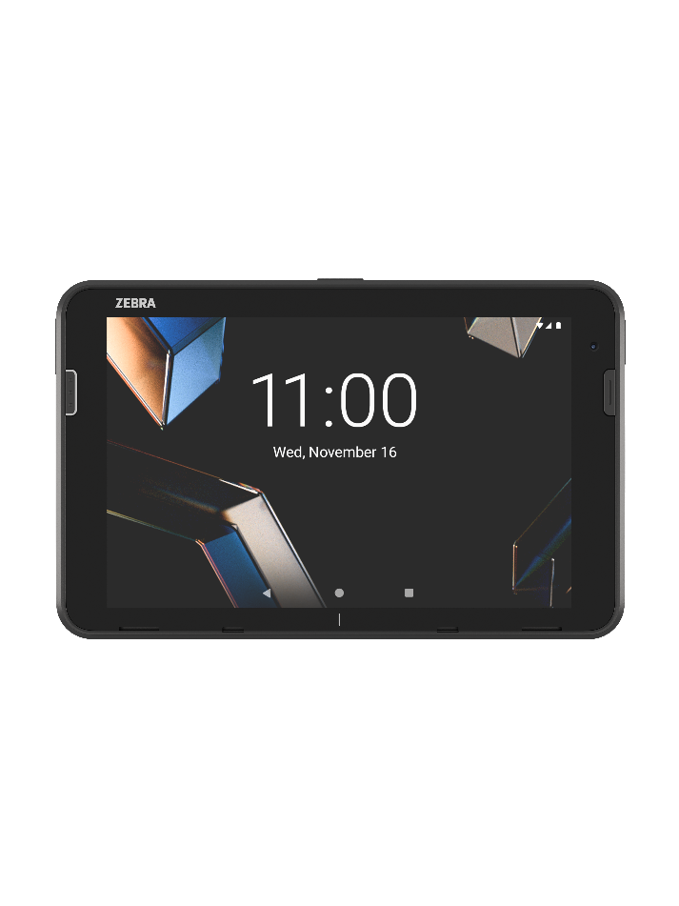
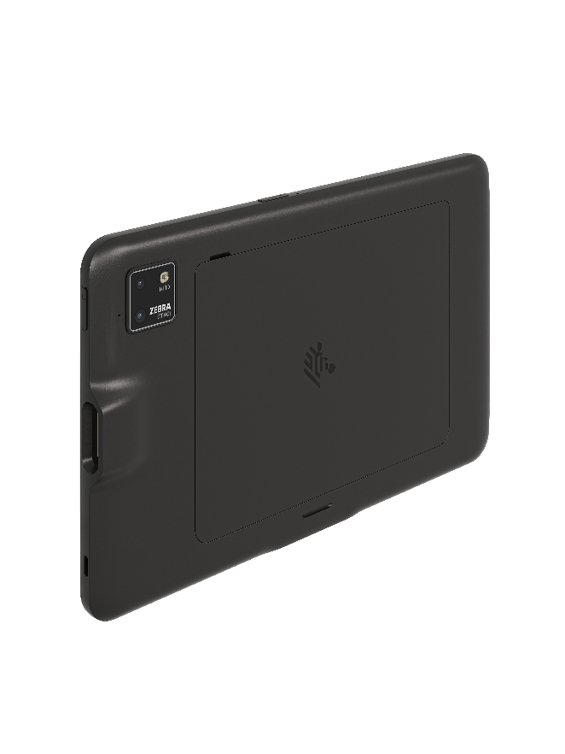
Product Tour
ERGONOMIC Buttons
Dedicated scanning buttons on front left side and top side of the tablet*
All keys are programmable: power, volume, and scanning
WIRELESS CONNECTIVITY
Wi-Fi 7
Optional 5G
Bluetooth 6.0
RUGGED POGO PINS
Fast charging
RUGGED DISPLAY
Gorilla Glass 5
AI-enabled touchscreen
WUXGA
600 nits
Biometrics
Signature sensing
High resolution CAMERAs
16 MP rear camera
8 MP front camera
Optional 13 MP wide-angle rear camera
OPTIONAL INTEGRATED SCANNER
Choice of SR500 or
SE4100 scan engines
FRONT FIRING SPEAKERS
AI-tuned audio experience
OPTIONAL INTEGRATED RFID
Omnidirectional
Up to 4 ft. (1.2 m) away
90 tags/second
REDESIGNED BATTERY DOOR COVER
Field-replaceable batteries
* Dedicated scanning buttons available on models with integrated scanner
48
ZEBRA TECHNOLOGIES

Slide 49
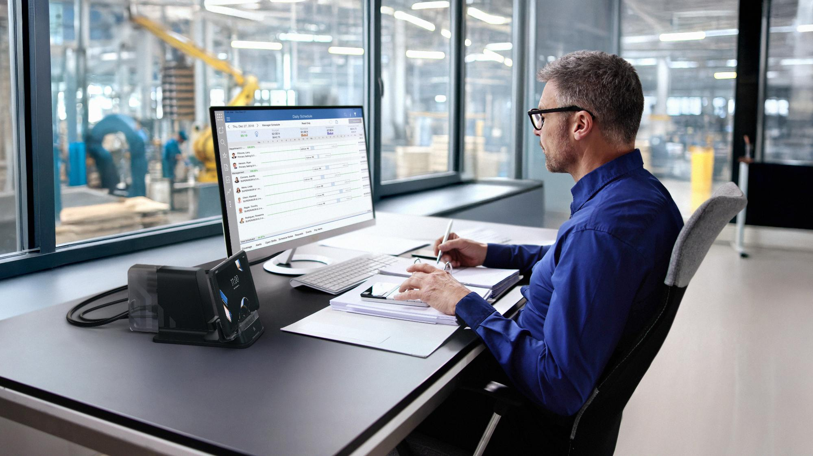

Why Zebra
ZEBRA TECHNOLOGIES
49

Slide 50
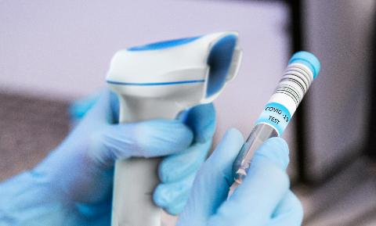



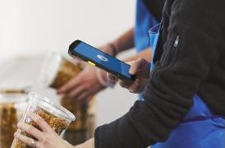
Globally recognized leader in powering the frontline
1
#
BARCODE
SCANNING
RETAIL TASK
MANAGEMENT SOFTWARE
RUGGED MOBILE COMPUTING
THERMAL
PRINTING
RFID
READERS
Sources: VDC Research and Zebra analysis (#1 market share),
ZEBRA TECHNOLOGIES
50
Notes:
Speaking of recognition, don’t just take it from us, Zebra has, once again, been awarded #1 in Gartner’s Magic Quadrant for location services, citing our completeness of vision and ability to execute

Slide 51

Powering organizations across the globe
$5.0B
~9,900
80%⁺
in global sales (2024)
employees in 55 countries across 120 offices
of Fortune 500 companies are Zebra customers
10,000⁺
~7,150
~10%
Channel partners in over 190 countries
US & Int’l patents issued and pending
of sales to R&D
ZEBRA TECHNOLOGIES
51
Notes:
Here we hit on our scale and strength with some datapoints, including our investments in R&D
Speaker notes:
I mentioned our scale, here are some facts and figures to back that up:
$5 billion in sales
Around 10K employees worldwide
We work with 80% of the Fortune 500
We have over 10K channel partners
And speaking of innovation, we own over 7K patents and commit around 10K of our sales back into R&D

Slide 52

















Our people make the difference
Lead through innovation
Deliver excellence with agility
OUR VALUES
Think and act customer first
Succeed
as one
Make a
positive impact
AWARDS
52
Notes:
That Zebra is continually recognized as a great place to work is quite the feather in our cap and, we believe, says a lot about our values and the type of company we want to be for those that work for us and work with us.

Slide 53
Thank you!
ZEBRA and the stylized Zebra head are trademarks of Zebra Technologies Corp., registered in many jurisdictions worldwide. All other trademarks are the property of their respective owners. ©2025 Zebra Technologies Corp. and/or its affiliates. 11/25/2025

