Slide 1
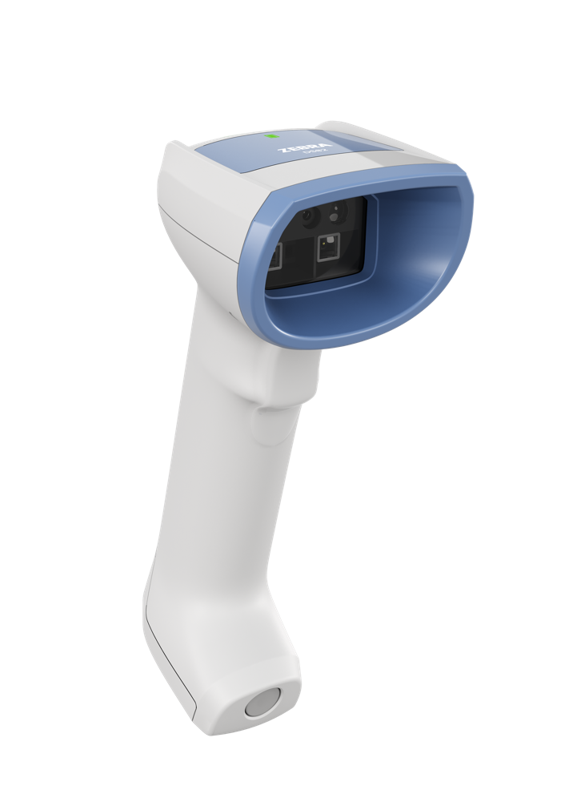

DS82 Series for Healthcare Scanner

Slide 2
Agenda
Agenda
Challenge
and solution
Key
features
Product
tour
Zebra
DNA
Zebra
Services
Why
Zebra
ZEBRA TECHNOLOGIES
2

Slide 3

Challenge and Solution

Slide 4

The Reality of Healthcare Today
Rising complexity. Higher expectations. Zero room for error.
Hospitals and health systems need to drive greater efficiency, accuracy, and patient safety—while easing the strain on overextended clinical teams.
ZEBRA TECHNOLOGIES
4

Slide 5

The pressures reshaping care delivery
Patient safety & care quality
Reduce preventable clinical errors and the spread of infection
Maintain clinician focus on patient care—not workarounds
Clinician workforce challenges
Ongoing labor shortages,
fatigue, and burnout
Technology must simplify workflows and remove friction—not add it
Supply chain & operations
Increase accuracy in supply tracking and inventory management
Minimize delays, waste, and manual processes
Compliance &
infection prevention
Meet evolving regulations
and quality standards
Support rigorous wipedown protocols with healthcare-grade materials
Healthcare demands technology that strengthens safety, streamlines workflows, and lets clinicians focus
on what matters most—
patient care.
ZEBRA TECHNOLOGIES
5

Slide 6
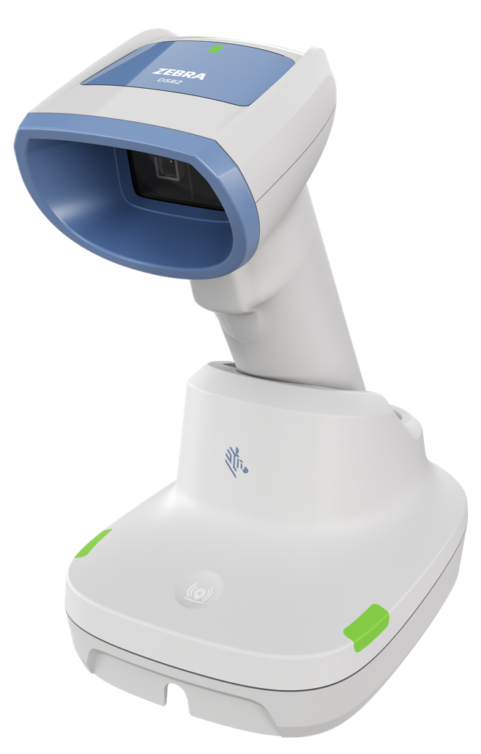
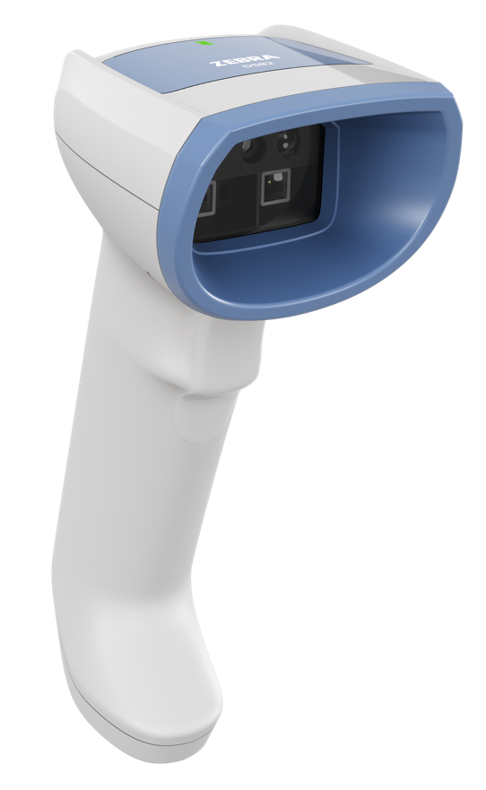
Introducing
the DS82 Series
for Healthcare
Smarter workflows. Unmatched scan performance. Stronger infection control.
Deliver stand-out patient care with a healthcare scanner built to serve
ZEBRA TECHNOLOGIES
6

Slide 7
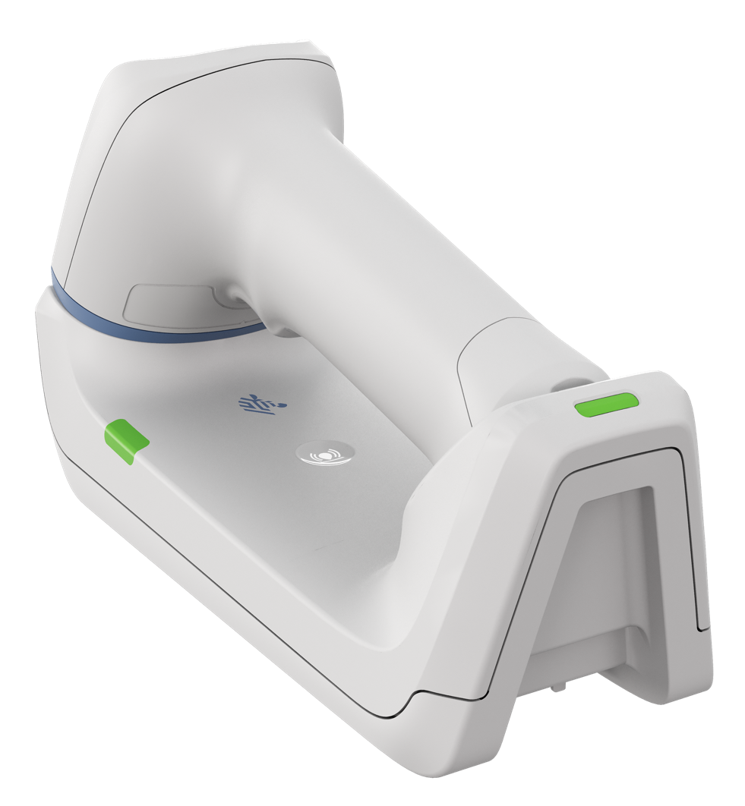






Built for modern clinical workflows
Exclusive 2 MP sensor easily captures even the most challenging barcodes
Programmable multi-function button lets clinicians instantly switch between apps
Industry-leading infection control with sealed inductive trigger
Fast, contactless charging for easier cleaning and less maintenance
Cutting-edge cordless design with swappable battery and supercapacitor
Advanced parsing tools capture more data to boost efficiency in more workflows
ZEBRA TECHNOLOGIES
7

Slide 8


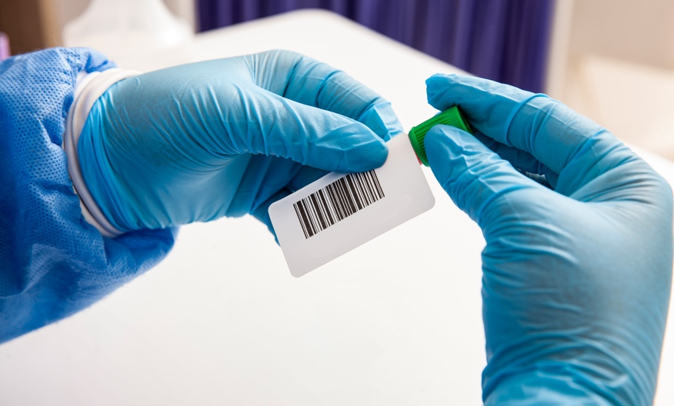
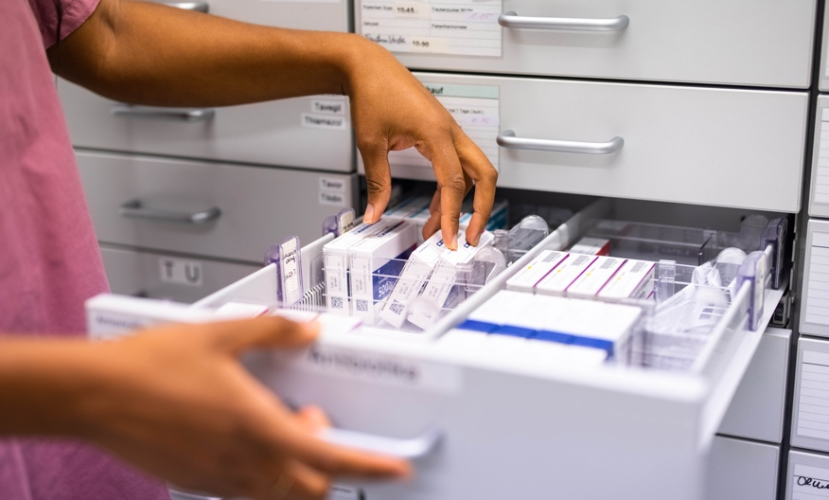

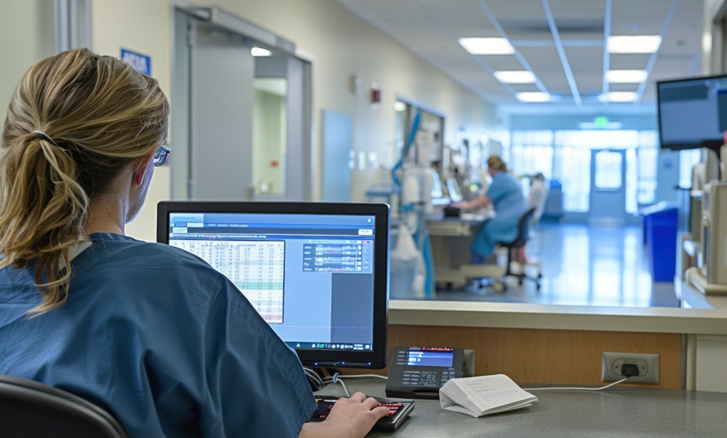
Improve workflows throughout the care journey
POSITIVE PATIENT IDENTIFICATION
MEDICATION ADMINISTRATION
LAB/SPECIMEN COLLECTION
PHARMACY
INVENTORY
SUPPLY
MANAGEMENT
PATIENT
ADMISSIONS
ZEBRA TECHNOLOGIES
8
Notes:
Speaking of recognition, don’t just take it from us, Zebra has, once again, been awarded #1 in Gartner’s Magic Quadrant for location services, citing our completeness of vision and ability to execute

Slide 9

Applications
Positive Patient Identification (PPID)
Medication administration
Hospital Pharmacy: medication intake
and inventory
Hospital Laboratory: specimen track and trace
Caregiver accountability and audit trail
Dietary management
Chain of custody of controlled substances
Operating Room: surgical supply instruments and implants
Patient admission: ER/triage/admissions
Electronic record access
Inventory management
ZEBRA TECHNOLOGIES
9

Slide 10

\
Differentiating
Features

Slide 11
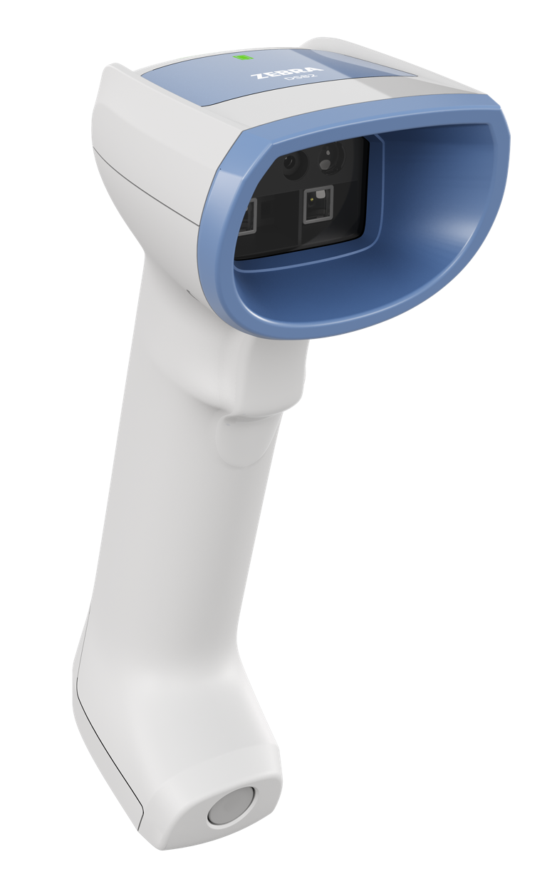
Industry-leading infection control
Every detail designed for safer, easier disinfection—shift after shift
Antimicrobial labels add
an extra layer of protection
Healthcare-grade plastics support cleaning with a wide range of harsh disinfectants
Sealed inductive trigger removes a common area for microbial buildup
Smooth, crevice-free surfaces with concealed seams and screw holes for easier cleaning
Contactless charging
eliminates exposed metal contacts
ZEBRA TECHNOLOGIES
11

Slide 12
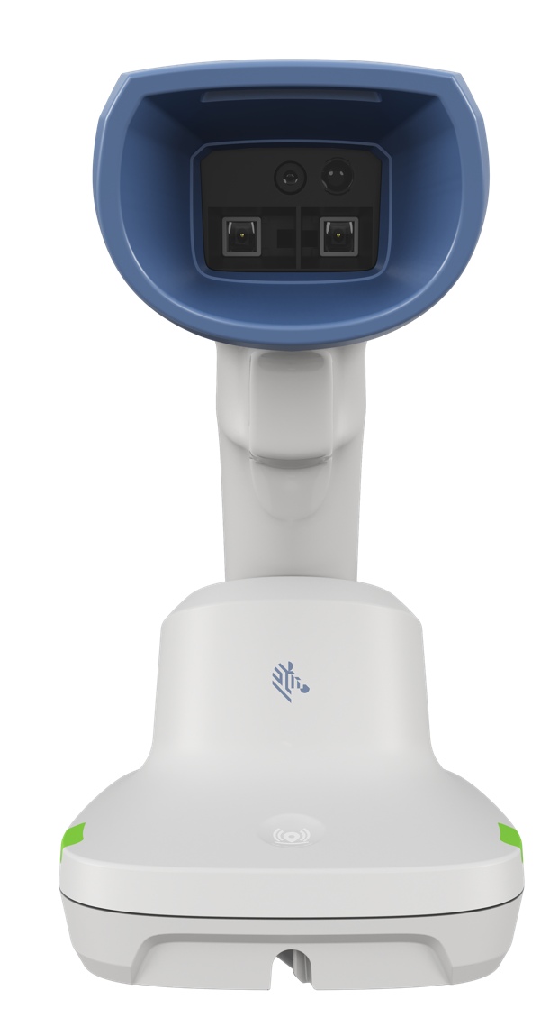

Unmatched scanning performance for clinical care
Uncompromising performance boosts clinical efficiency and keeps clinicians focused on patient care
Faster, easier, more accurate scanning with PRZM Intelligent technology
Instantly capture challenging barcodes
2x
Higher sensor resolution with an exclusive 2 MP optical system
High density focus
Healthcare-friendly
Optimized to capture the tiny
and dense barcodes found in clinical workflows
White illumination and green
LED aim spot can be used throughout the hospital
ZEBRA TECHNOLOGIES
12

Slide 13
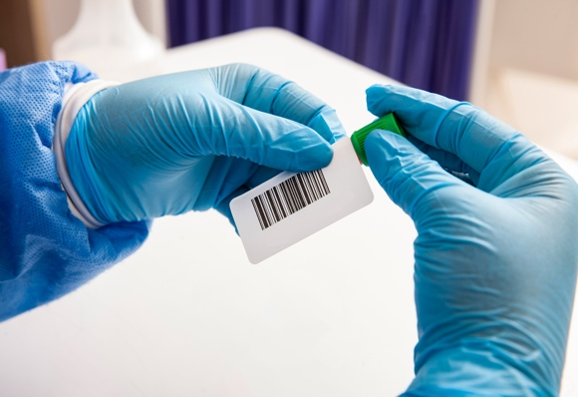
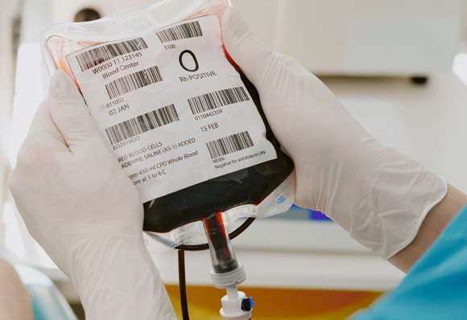

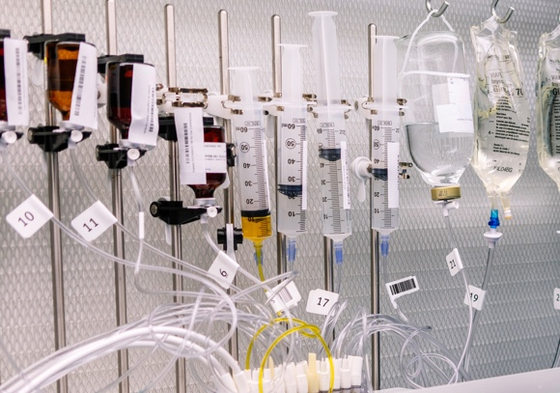
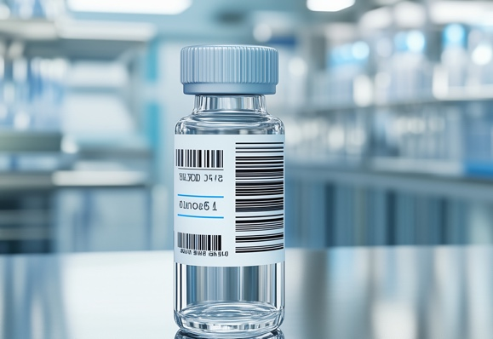

Fewer rescans. Fewer workarounds
Designed to handle the toughest hospital barcodes with consistent, first-pass accuracy
  Captures a wide range of barcodes found across patient care, pharmacy, and lab workflows, such as:
  Curved barcodes on medicine bottles and blood vials
  Barcodes on translucent IV bags
  Barcodes on med-packs and suppositories
  Barcodes on blood bags
  Barcodes on wristbands and ankle bracelets
  Barcodes on specimen trays and biopsy cassettes
  Damaged and poorly printed barcodes
ZEBRA TECHNOLOGIES
13

Slide 14
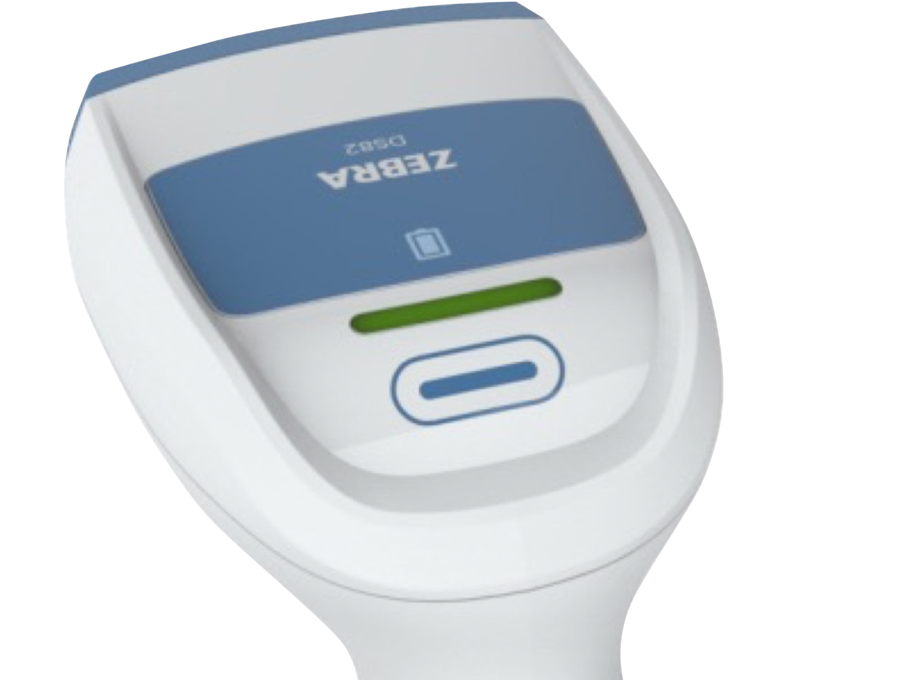
One button. Countless possibilities
Simplify clinical workflows with a programmable multi-function button
Designed for multi-application workflows
A programmable multi-function button lets clinicians move seamlessly between applications (such as EHR, phlebotomy, and specimen labeling), using a single scanner at the workstation.
Speed up daily operations
Use the button as a second trigger to streamline frequent tasks, such as activating Night Mode, locating the cradle, or switching applications—reducing steps during care.
ZEBRA TECHNOLOGIES
14

Slide 15

Engineered for quiet, patient-friendly care
Designed to reduce disturbance while keeping clinical workflows moving
Protect patient rest
Customizable feedback for any environment
Night Mode minimizes noise and light
One-touch access lets clinicians instantly activate Night Mode
Intelligent illumination reduces excess lighting, activates only when scanning
Built-in lamp softly lights the clinician’s workspace—no overhead lights needed
Vibration (haptic) for sound-sensitive environments
Good Decode LED for visual confirmation
Adjustable beep when audio is appropriate
Direct Decode Indicator highlights the barcode
ZEBRA TECHNOLOGIES
15

Slide 16
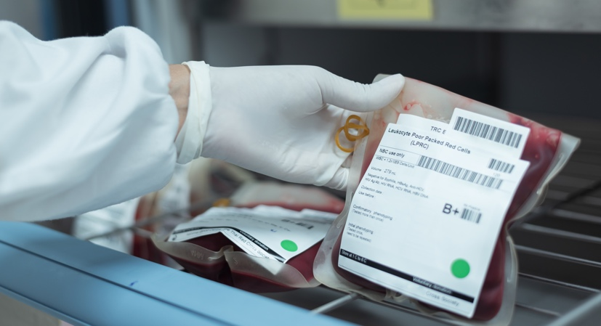
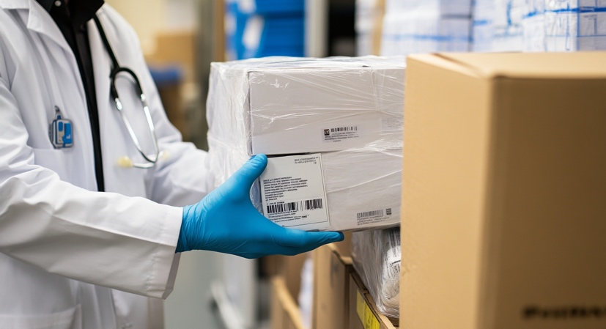

Capture more critical data in a single scan
The DS82-HC Series makes it easy to capture and format complex clinical data accurately—without extra steps or workarounds.
Blood Bag Parse+
UDI Scan+
Preferred Symbol
Capture complete blood bag data with a single scan. Blood type, donation details, and expiration date are automatically extracted and formatted—supporting safer workflows and better traceability.
UDI information is automatically captured, parsed, and formatted from medical device packaging.
The right data is sent to the right application fields, reducing manual entry and data errors.
Capture exactly the barcode
you need—even when multiple barcodes are present. Algorithms isolate and output the preferred symbol without requiring clinicians to cover nearby labels.
ZEBRA TECHNOLOGIES
16
Notes:
While many companies are talking about AI, Zebra is developing and deploying AI tools designed for the front line. Our Frontline AI Suite can enhance your frontline performance by:
Using data-fueled models to digitize your environments
Operationalizing your intelligence with seamlessly connected teams
And optimizing your operations with real-time insights

Slide 17
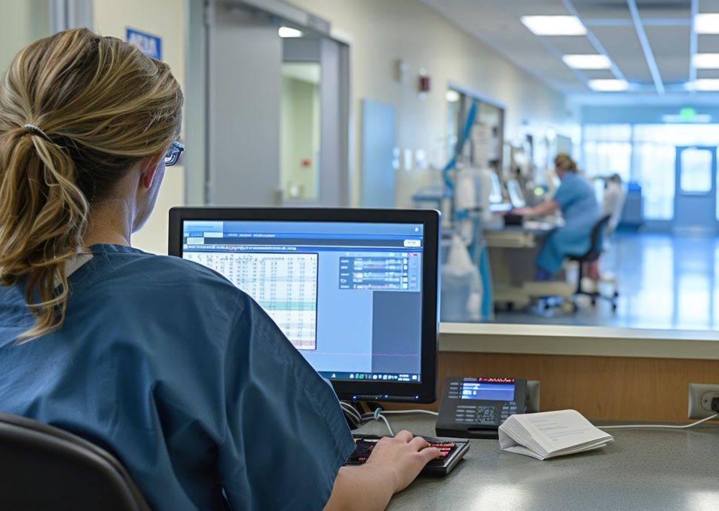
Faster, easier patient processing with built-in image capture
Fewer steps. Fewer devices. Faster flow.
Consistently
clear images every time
Capture high-quality images of patient documents and forms directly at the point of care—no extra equipment required
Automatically extract barcode data from documents, eliminating manual entry and rework
2 MP sensor delivers sharp, readable images
of patient documents
Zebra’s Intelligent Document Capture (IDC) automatically enhances images, compensates
for uneven lighting, and straightens documents
for optimal clarity
Move patients through intake and discharge more efficiently
ZEBRA TECHNOLOGIES
17

Slide 18


Unleash productivity with better cordless technology
Cutting-edge features make it easier to use and manage cordless scanners
Easy to clean, contactless charging. Wirelessly charge your scanners
with inductive technology, making them easier to clean, reducing wear and tear, and extending the lifespan of both the device
and cradle.
100,000
Scans on a single charge with the PowerPrecision+ battery–25% more than closest competitor
3x
Larger supercapacitor than previous generation; 6,000 scans on a single charge
ZEBRA TECHNOLOGIES
18

Slide 19
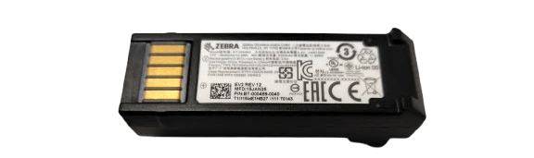

Swappable power sources
Two interchangeable power options make it easy to choose the right power solution for your workflows – and switch any time your needs change
PowerPrecision+ battery
Over four full days of 24x7 scanning (100,000 scans)
Up to 25% longer battery life than the closest competitor
A wealth of battery metrics for better management ⎯ and optional battery maintenance services
Gives users the flexibility to be away from a charging cradle
for extended periods
PowerCap™ supercapacitor
Greener alternative; designed for longevity as there
are no batteries to manage or dispose of
Up to 6,000 scans per charge
Ultra-fast charging minimizes downtime: ready for
100 scans in just 35 seconds
Capable of holding a charge for several hours
ZEBRA TECHNOLOGIES
19

Slide 20
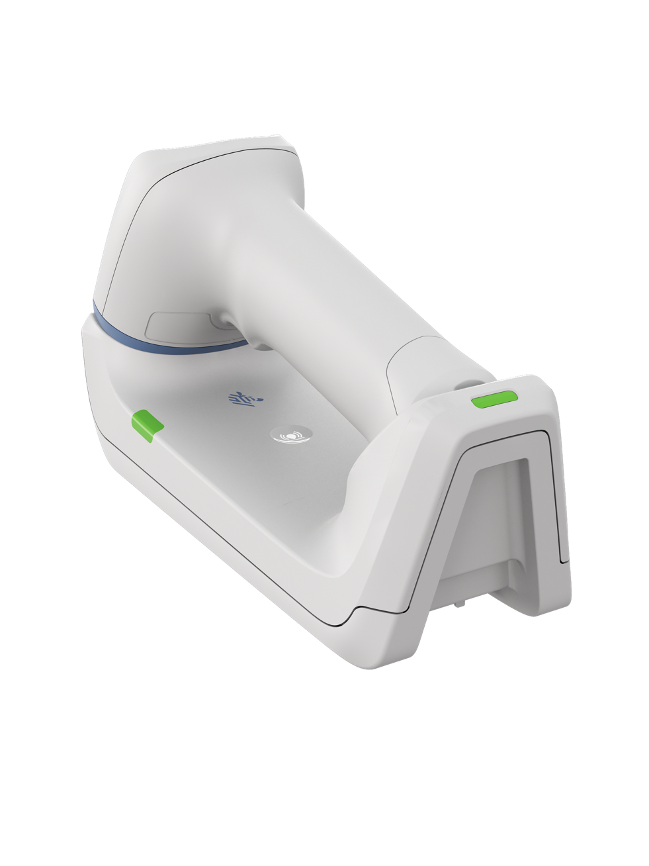
Smarter cordless by design ⎯ down to the details
Optimized for the realities of clinical care
Dedicated power gauge
See at-a-glance if the battery or
PowerCap supercapacitor are
sufficiently charged
Choice of cradles
Presentation cradle for hands-free scanning and over monitor mounting; Standard cradle lays on a desktop, mobile cart or can be wall mounted
Contactless charging
Available for both the battery and
PowerCap supercapacitor
Wi-Fi Friendly mode
Bluetooth scanners won’t interfere with
your Wi-Fi network
Bluetooth radio
Adjustable radio power and
Bluetooth beaconing
Virtual Tether
Keep cordless scanners where they belong; alerts
if a scanner is taken out of range or left out of
the cradle too long
FIPS security
Government-grade security safeguards sensitive patient data
Paging button
Missing a scanner? Press the cradle’s paging button to instantly locate it
ZEBRA TECHNOLOGIES
20

Slide 21
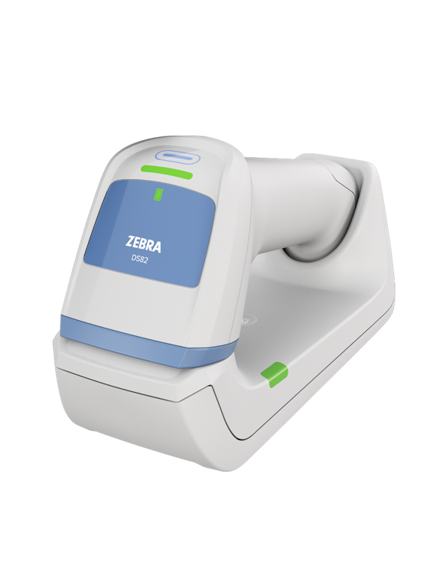
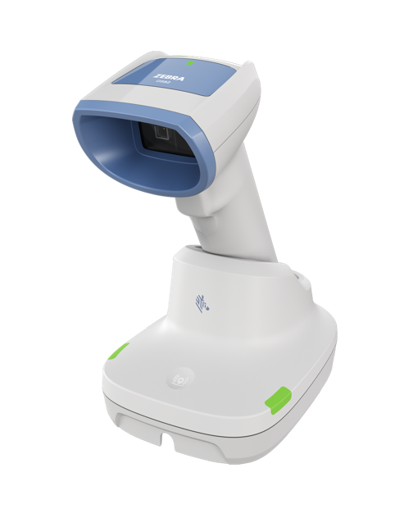
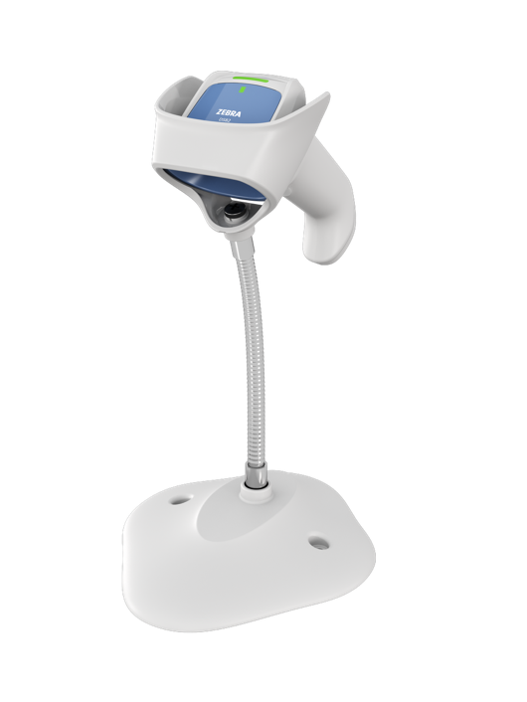
Flexible cradle and stand options
Designed to fit any mobile or in-room workstation
Presentation cradle (cordless)
Ideal for workstation-on-wheels environments. Enables quick transitions between hands-free and handheld scanning—supporting fast-paced
clinical workflows
Compact standard cradle (cordless)
Mounts easily on a wall, mechanical arm, or mobile workstation; integrated magnet helps keep the scanner securely in place when mounted
Intellistand (corded)
Automatically switches between hands-free and handheld scanning when the scanner is placed in or lifted from the stand—no settings or workflow
changes required
ZEBRA TECHNOLOGIES
21

Slide 22
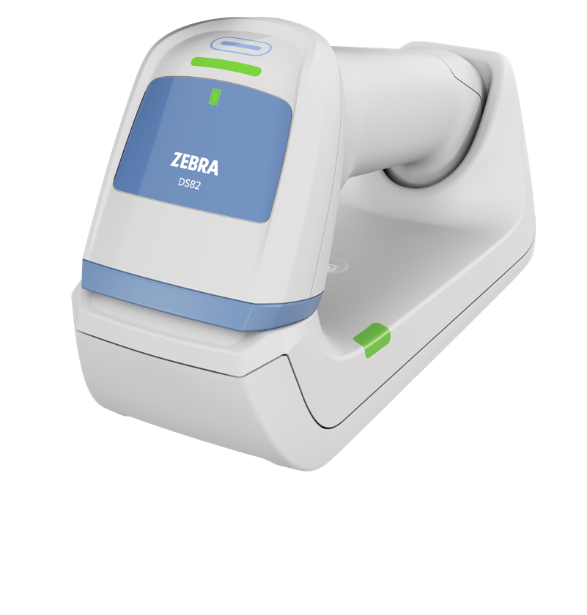

Keep cordless scanners in range, charged, and ready
Virtual Tether alerts staff when a scanner moves out of range or is left off the charger too long—
preventing device loss and ensuring scanners are charged and ready when clinicians need them.
Real-time alerts keep scanners from going missing—and keep workflows moving
Scanner and cradle
alerts—fully customizable
Scanner alerts
Flashing LEDs
Haptic (vibration)
Speaker
Scanner illumination
Cradle alerts
Flashing LEDs
Speaker
Real-time alerts
Flexible, IT-friendly configuration
Uses Bluetooth radio connection
or Bluetooth beacons
Adjustable range via radio
power settings
Works with Battery Preservation Mode to help devices stay charged
Alerts can be paused or disabled
via trigger or cradle button
Integrates with Zebra SW tools
Alerts are compatible with Night Mode to avoid disturbing patients
ZEBRA TECHNOLOGIES
22

Slide 23
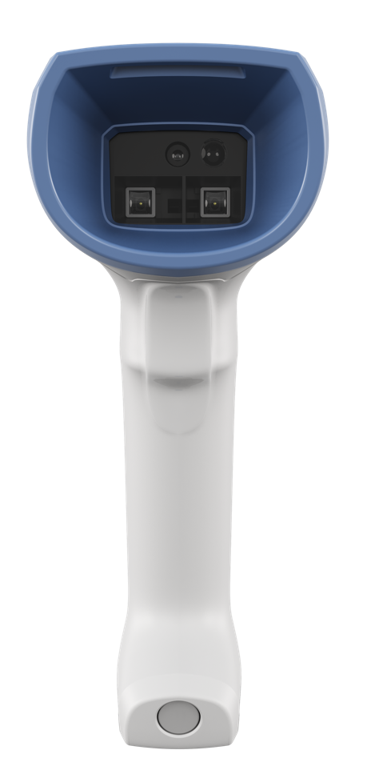
Designed to withstand
real-world clinical demands
Sealed against dust and spills
IP52 sealing protects against spills and dust
Disinfectant-ready plastics
Safe wipedowns with the widest selection of harsh disinfectants
Built tough to survive accidental drops
Survives multiple 6 ft. (1.8 m) drops to concrete – plus 10 ft (3 m)
MIL drop spec (corded) and 8 ft (2.4 m) MIL drop spec (cordless)
Subjected to a punishing tumble test
Survives 2,000 tumbles in a 0.5 m tumbler that emulates
everyday bumps and knocks
Hardened glass scan window
Protects against scratches which can degrade scan performance
Less downtime. Fewer replacements. Lower total
cost of ownership.
ZEBRA TECHNOLOGIES
23

Slide 24

Product Tour
Get to know the DS8208-HC and DS8288-HC
ZEBRA TECHNOLOGIES

Slide 25
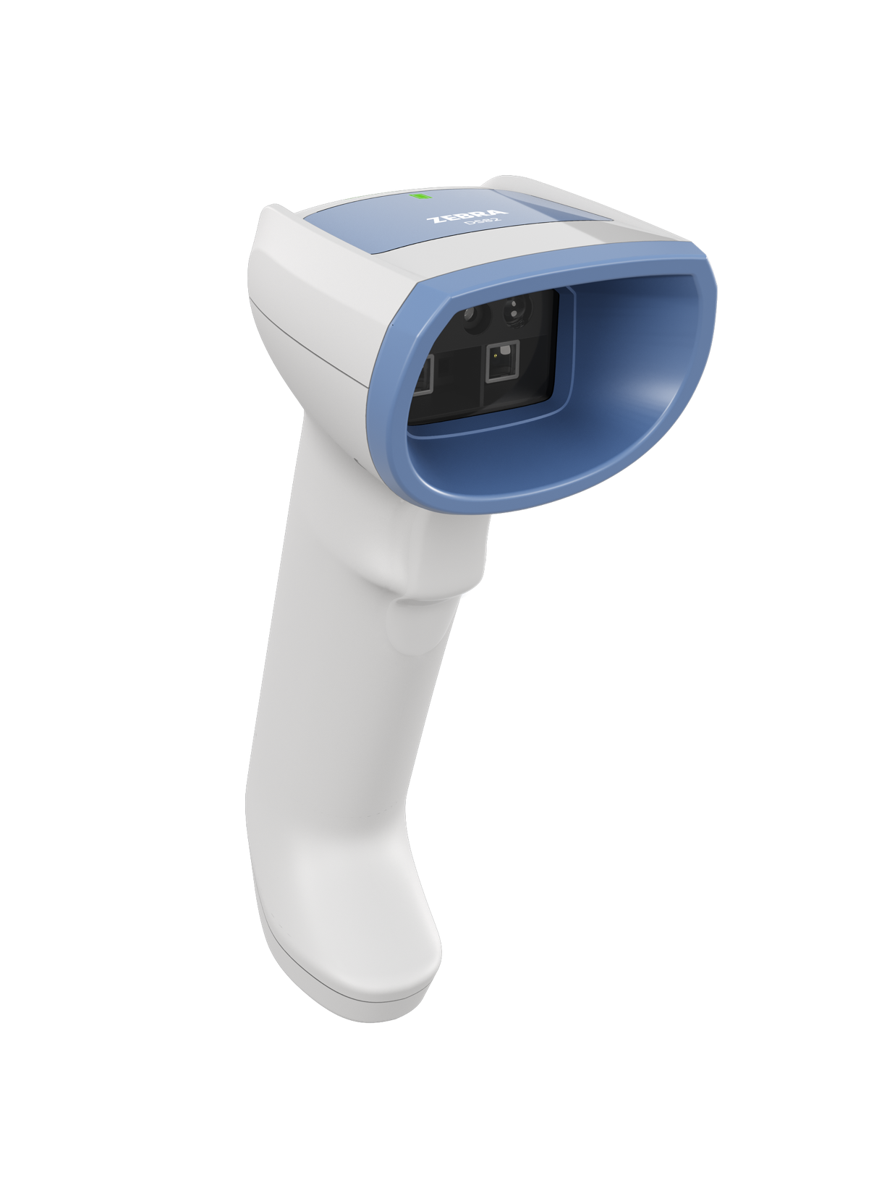
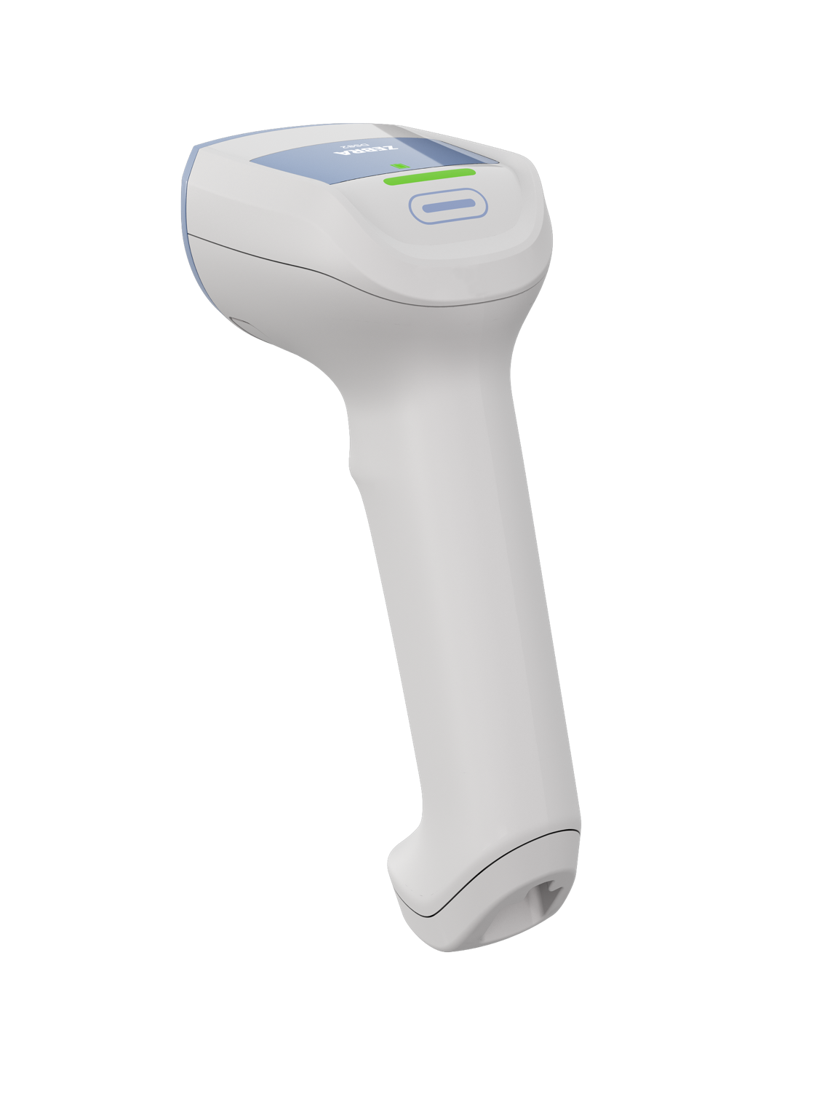
DS8208-HC Corded
2 MP SENSOR
Enhanced scan performance
MULTI-FUNCTION KEY
Programmable, use it as a second trigger, interface with a different host app
DEEPLY RECESSED SCAN WINDOW
Protects against scratches and other damage
ANTIMICROBIAL LABELS
Adds another layer of
infection control
SEALED INDUCTIVE TRIGGER
Seamless design, removes a common point of microbial buildup
MEDICAL GRADE PPSU MATERIAL
Withstands aggressive cleaning
HAPTIC FEEDBACK
Ideal for night shifts and sound sensitive environments
ZEBRA TECHNOLOGIES
25

Slide 26

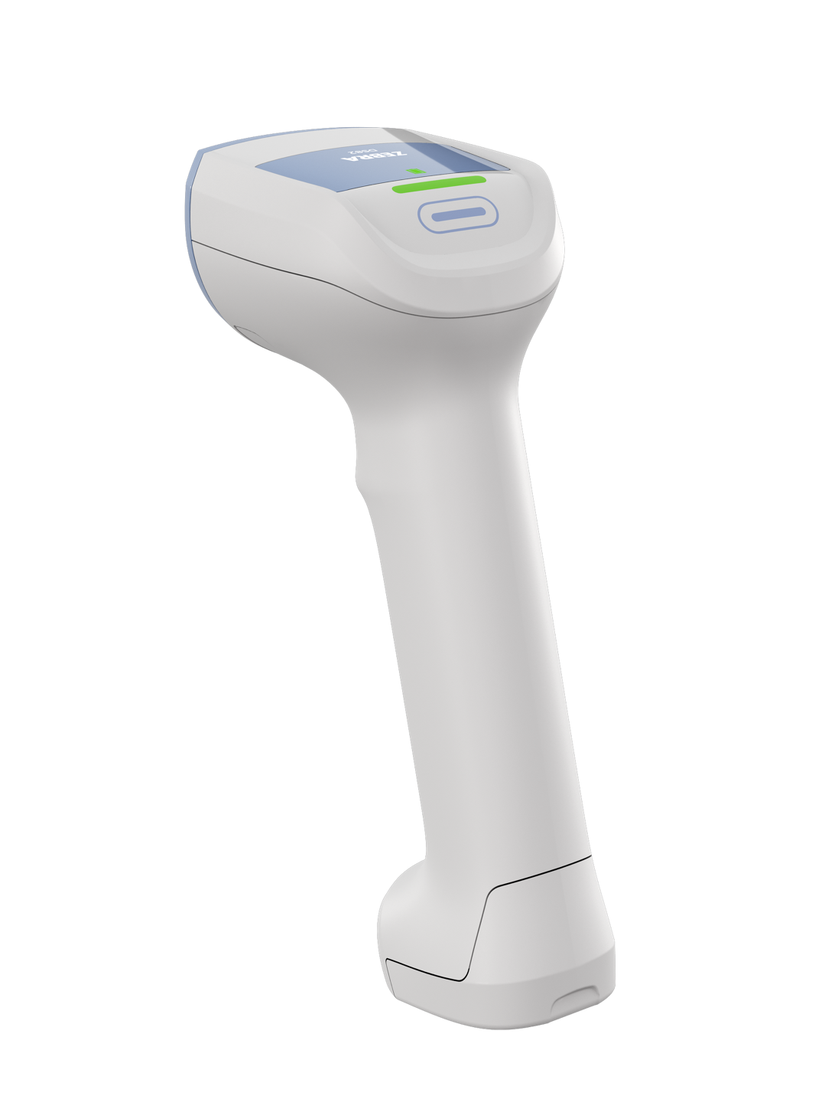
DS8288-HC Cordless
2 MP SENSOR
Enhanced scan performance
MULTI-FUNCTION KEY
Programmable, use it as a second trigger, interface with a different host app
DEEPLY RECESSED SCAN WINDOW
Protects against scratches and other damage
ANTIMICROBIAL LABELS
Adds another layer of
infection control
SEALED INDUCTIVE TRIGGER
Seamless design, removes a common point of microbial buildup
MEDICAL GRADE PPSU MATERIAL
Withstands aggressive cleaning
HAPTIC FEEDBACK
Ideal for night shifts and sound sensitive environments
INTERCHANGEABLE
POWER OPTIONS
3500 mAh smart Li-Ion battery
or 1000F supercapacitor
CAPPED SCREW DESIGN
Easier to clean
ZEBRA TECHNOLOGIES
26

Slide 27
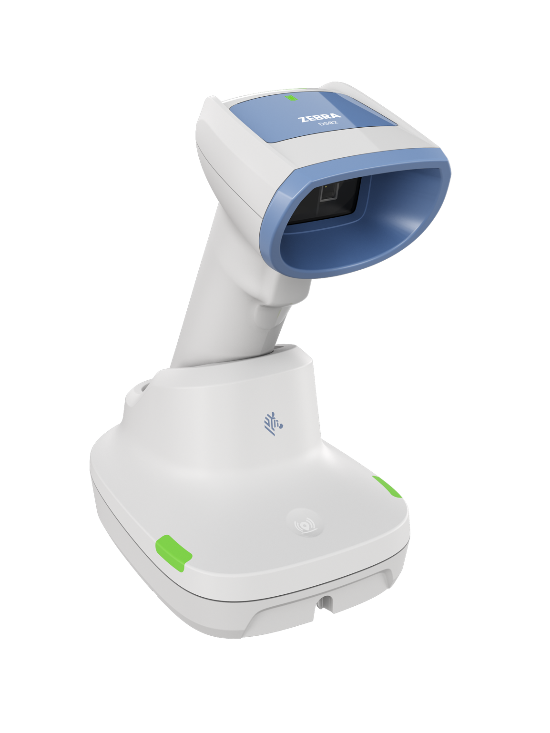
Presentation Cradle
IR SENSOR
Wakes up illumination only when an object is present to reduce excess lighting and lower energy costs
SCULPTED DESIGN
Enables easier cleaning and seamless aesthetics with scanner
HANDLE SCOOP
Provides additional stability
COMPACT FOOTPRINT
75mm x 125mm x 94mm
PAGER BUTTON
Track down a misplaced scanner
DUAL-SIDED LEDs
Easy to see
CABLE MANAGEMENT
1 front cable exit, 2 rear cable exits
ZEBRA TECHNOLOGIES
27

Slide 28
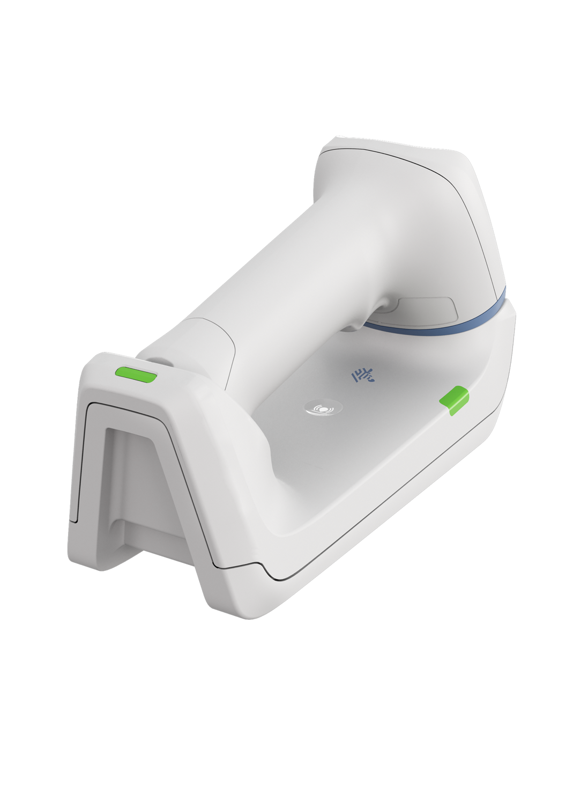
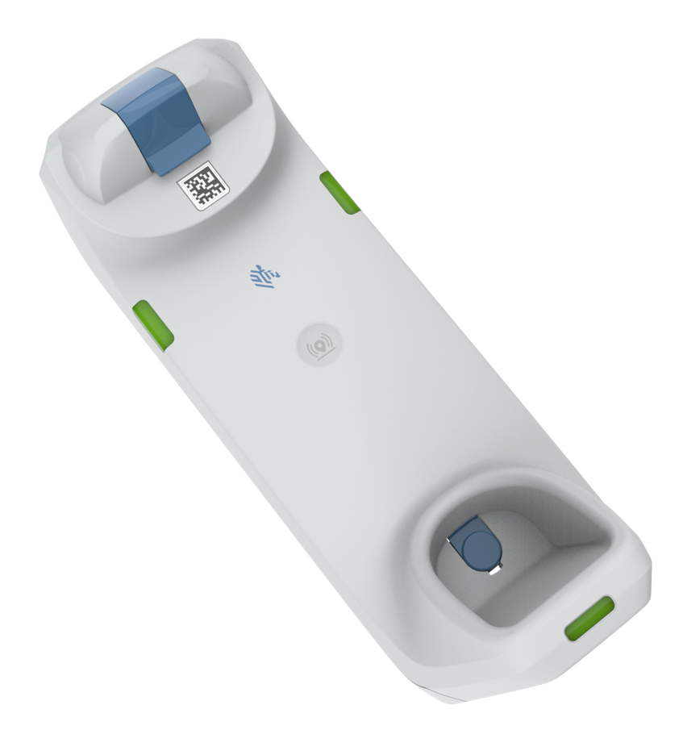
Standard Cradle
ADJUSTABLE SEAMLESS LATCH
Can be adjusted for mounting
or tabletop use
ADDITIONAL LED
Easy viewing inside a cubby
DUAL-SIDED LEDs
Easy to see
CONTACTLESS CHARGING
Easy to clean, reduces wear and tear and maintenance
MAGNET FOR WOW CART
Keeps the scanner securely in place when mounted
PAGER BUTTON
Track down a
misplaced scanner
SECURE FOOT POCKET
Taller foot pocket holds the foot in place more securely
28
ZEBRA TECHNOLOGIES
28

Slide 29

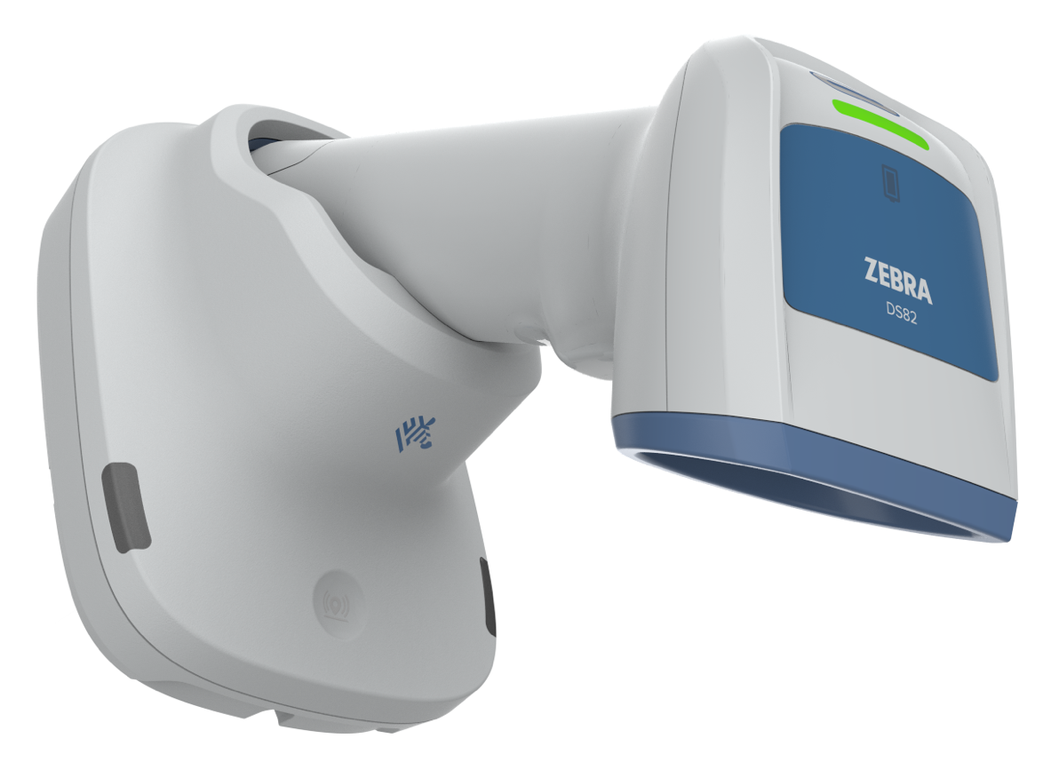
Over the Monitor/Lamp Mode
MAGNET & LATCH
Magnet placed in cradle to enable
OTM / Lamp mode
LATCH SYSTEM
- Retractable latch grips foot
- Magnet holds battery door
Lamp Mode
ZEBRA TECHNOLOGIES
29

Slide 30

Zebra DNA
Setup. Secure. Manage. Optimize.

Slide 31
Empower your workforce.
Drive results.
Intelligence made simple
in every Zebra device.
ZEBRA TECHNOLOGIES
31

Slide 32

Zebra DNA for Scanners
Simplify your scanning journey
UDI Scan+
Capture and parse UDI data in the right order to the right fields, in one trigger pull. No manual data entry is required, boosting efficiency and accuracy.
Blood Bag Parse+
One scan captures all the data you need: blood type, donation date, expiration date, and more; data is automatically parsed for your clinic or lab system.
DataWedge for Scanners
Seamlessly handle multiple workflows in real time, automatically formatting captured data for the designated screen and host application.
Virtual Tether
Receive alerts when a scanner is taken beyond its Bluetooth range or left off
the charger for a predefined length
of time.
IoT Connector
Collect enterprise data and route to your preferred
IoT endpoint to analyze and act to make data-driven decisions in
real time.
.
Zebra DNA empowers your
scanners with unmatched
visibility, uptime, and adaptability.
ZEBRA TECHNOLOGIES
32

Slide 33



















Zebra DNA for Scanners
Make the most of every stage of your scanning journey from deployment to optimization. Zebra DNA lets you keep devices current and adapt them to your business needs for a stronger ROI across the full lifecycle
Set Up
Secure and Manage
Optimize
DataWedge: Easily capture data and send to
your host applications without programming
IoT Connector: Collect enterprise data and route to your preferred IoT endpoint to analyze and act to make data-driven decisions in real time..
PowerPrecision+: Gain easy access to fleetwide metrics and get visual feedback of charge status and battery state of health.
Virtual Tether: Keep track of your cordless scanners
and prevent workflow interruptions caused by a misplaced device.
123Scan: Configure your scanner using a wizard to program electronically or via a printed 2D barcode. Simultaneously stage up to 10 scanners locally.
Remote Diagnostics: Troubleshoot without traveling to sites and resolve issues faster.​
Remotely access asset information, health and statistics, configuration settings and barcode data.
Remote Management: Configure scanners remotely with two options: Scanner Management Service (SMS) or Windows Management Instrumentation (WMI).
PRZM Intelligent Imaging: Farther, faster, smarter imaging that can heighten productivity.
Multi-Code Data Formatting: Scan multiple barcodes with a single trigger pull.
Advanced Data Formatting: Automate workflow decisions for front-line workers
to improve productivity and data accuracy.
Scanner Control Application: Control Zebra cordless scanners from a phone or tablet.​
Intelligent Document Capture: Capture an image and automatically optimize its appearance.​
Preferred Symbol: Prioritize
one barcode while excluding others without having to
cover unwanted barcodes.
Scan-to-Connect: Rapidly connect scanners to a Bluetooth-enabled phone, tablet or PC in one step.
DataWedge for Scanners: One scanner seamlessly works with multiple applications.
Label Parse+: Instantly capture all the barcodes
on a GS1 label.
Wi-Fi Friendly Mode: Ensure Bluetooth scanners don’t interfere with your Wi-Fi network.
UDI Scan+: Capture and parse UDI data in the right order to the right fields, in one trigger pull.
Scanner Software Development Kit (SDK):
Easily create fully featured applications for Windows, Linux, Android, iOS and Chrome.
Blood Bag Parse+: With one trigger pull, instantly capture, parse and transmit data to your app.
ZEBRA TECHNOLOGIES
33

Slide 34

Zebra Services

Slide 35

Zebra OneCare™: the industry standard in enterprise support
Unexpected failures that interrupt your workflows aren’t an option. Zebra OneCare maintenance plans
keep devices running at peak performance and ready for whatever your job demands
Eliminates unpredictable repair-related costs. With Zebra OneCare, there are no limits—if something is broken, we fix it
End-to-end
coverage
Reduce the cost of battery replacement over a device’s lifespan and ensure workers have a healthy, fully charged battery for every shift
Optional
battery
plans*
Included in every plan; your users get support they can count on—fully trained technical professionals are available** to answer questions and address issues
Technical
support
Optional
VisibilityIQ
Foresight™
Cloud-based dashboard to view device insights; address potential issues before they impact your business, uncover opportunities for cost-cutting, right-sizing inventory, and reducing lost assets
* Available for batteries only **Hours of availability is plan dependent
ZEBRA TECHNOLOGIES
35

Slide 36
Zebra OneCare™ Maintenance Plans
Feature | Zebra OneCare Essential | Zebra OneCare Select
Live-agent support | Mon–Fri, 8–5 local time | 24/7
Repair turnaround time | 3-day repair turnaround* | ‘Like-new” replacement device ships for next business day delivery
Accidental damage coverage
Automatic application of engineering changes
Cloud-based visibility into repair, case reports and more with VisibilityIQ™ OneCare
Battery service enhancement | Option to include Battery Maintenance
Commissioning service enhancement | Option to include Standard Commissioning | Standard Commissioning
Benefits
Genuine Zebra expertise and parts to maximize device uptime
Years of investment protection—all for less than the cost of a single repair
Cloud-based visibility to repairs and more, with detailed insights into contracts, case and lifecycle reports
True service from the source–no one knows Zebra devices and its software better than Zebra, and Zebra Certified Repair Partners
ZEBRA TECHNOLOGIES
* Based on when device arrives to repair depot
36

Slide 37

Why Zebra

Slide 38
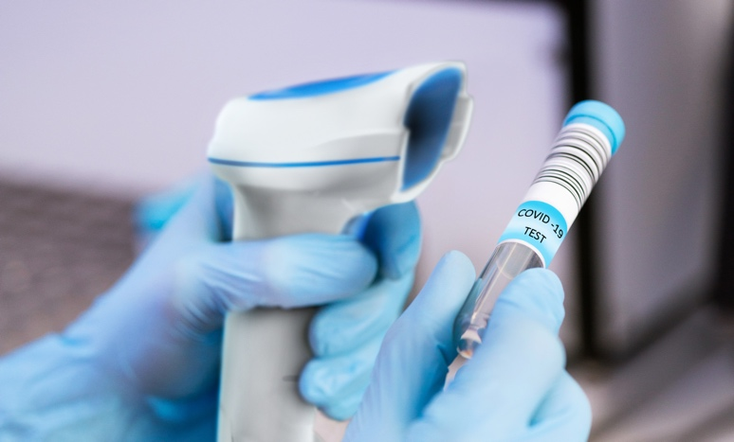



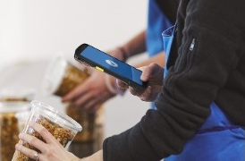
Globally recognized leader in powering the frontline
1
#
RETAIL TASK
MANAGEMENT SOFTWARE
BARCODE
SCANNING
RUGGED MOBILE COMPUTING
THERMAL
PRINTING
RFID
READERS
ZEBRA TECHNOLOGIES
38
Sources: VDC Research and Zebra analysis (#1 market share),

Slide 39

Powering organizations across the globe
$5.0B
~9,900
80%⁺
in global sales (2024)
employees in 55 countries across 120 offices
of Fortune 500 companies are Zebra customers
10,000⁺
~7,150
~10%
Channel partners in over 190 countries
US & Int’l patents issued and pending
of sales to R&D
ZEBRA TECHNOLOGIES
39

Slide 40
Thank You!
ZEBRA and the stylized Zebra head are trademarks of Zebra Technologies Corp., registered in many jurisdictions worldwide. All other trademarks are the property of their respective owners. ©2026 Zebra Technologies Corp. and/or its affiliates. 03/05/2026

