Slide 1
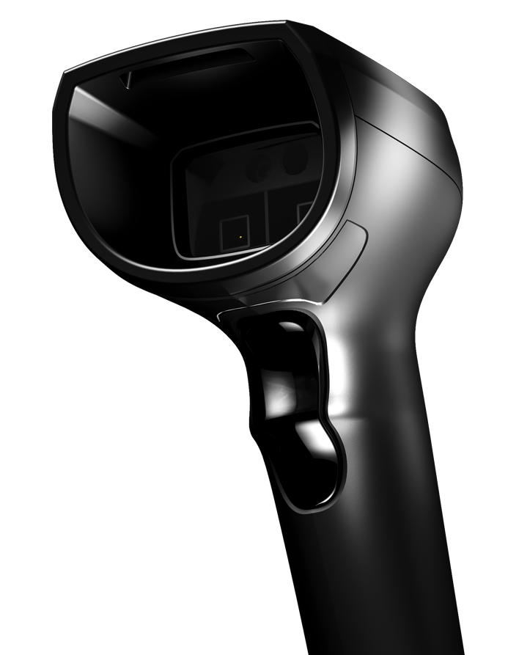
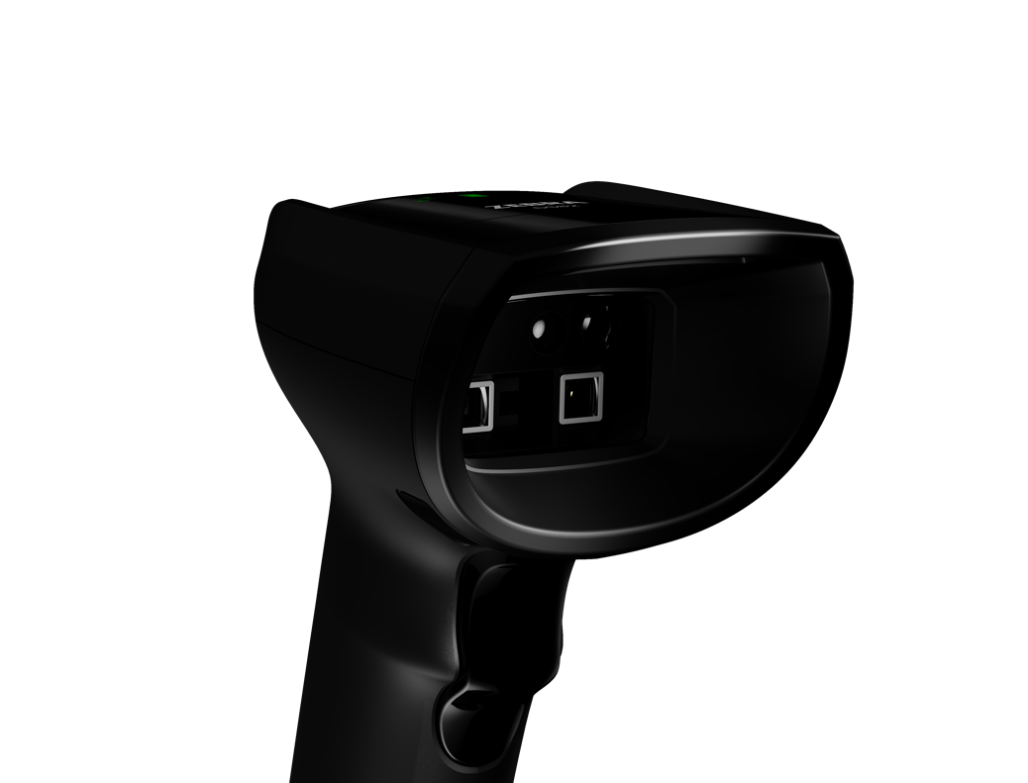

DS82 Series
Exceptional scanning. Unmatched innovation.
Ready for what’s ahead…

Slide 2

Agenda
Agenda
Challenge and solution
Markets and applications
Key
features
Product
tour
Zebra
DNA
Zebra
Services
Why
Zebra
ZEBRA TECHNOLOGIES
2

Slide 3
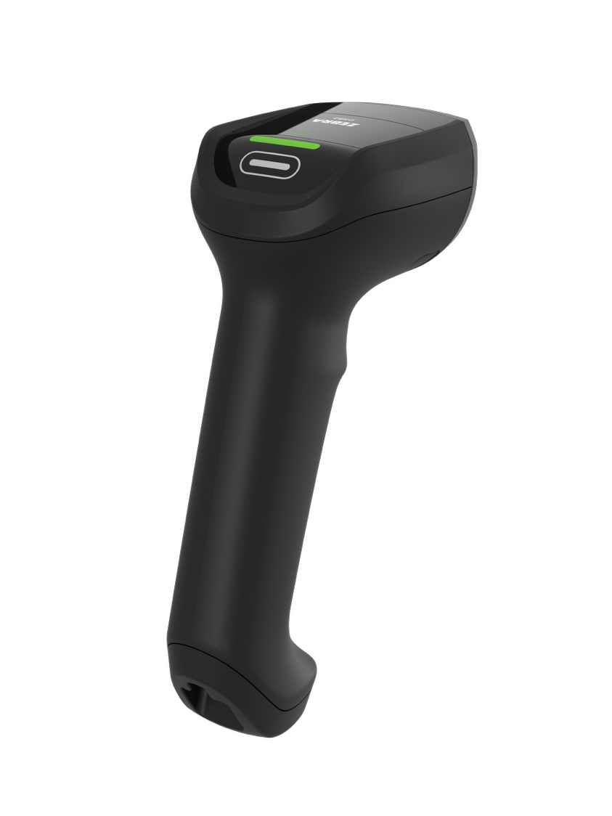
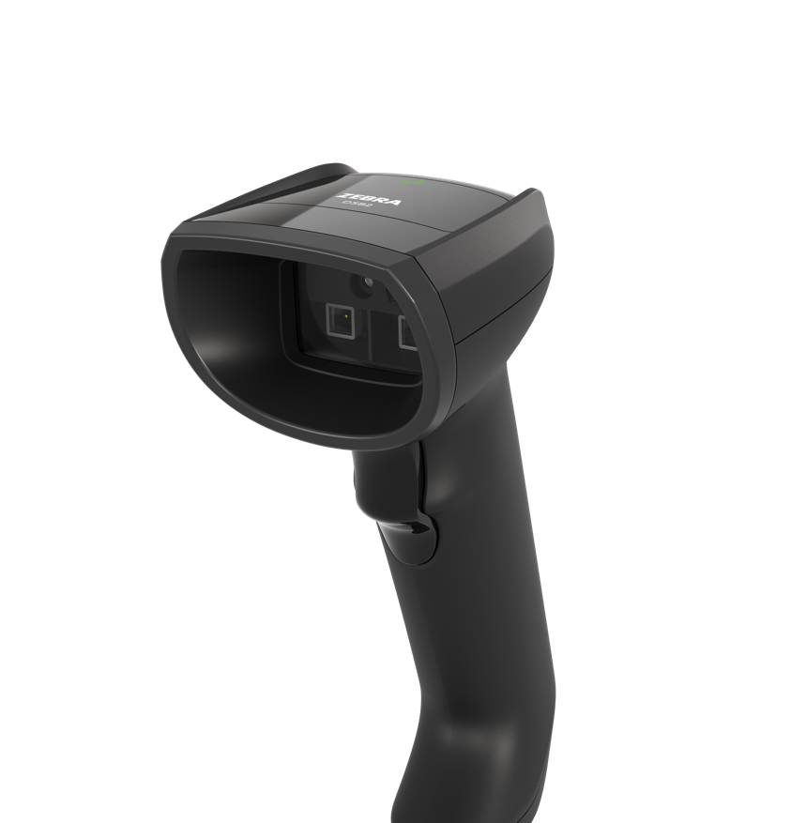

Challenge and solution

Slide 4

Today’s retail landscape: what you’re facing
In-stock is always
expected
57% of shoppers left stores without everything they wanted. The #1 reason? Items were out of stock¹
Lines hurt businesses
80% of consumers avoid businesses with lines, and nearly 40% abandon their purchase entirely²
57%
80%
Pressure to curb losses
83% of retailers say shrink is one of their most pressing inventory issues¹
Inflation drains buying power
11% decrease of average American purchasing power from January 2021 to August 2024³
83%
11%
1. Zebra, 17th Annual Global Shopper Survey. 2. Waitwhile, The State of Waiting 2024. 3. City-County Observer
ZEBRA TECHNOLOGIES
4

Slide 5
The challenges are clear. Now it’s time to act.
Retail’s pain points demand smarter solutions.
ZEBRA TECHNOLOGIES
5

Slide 6
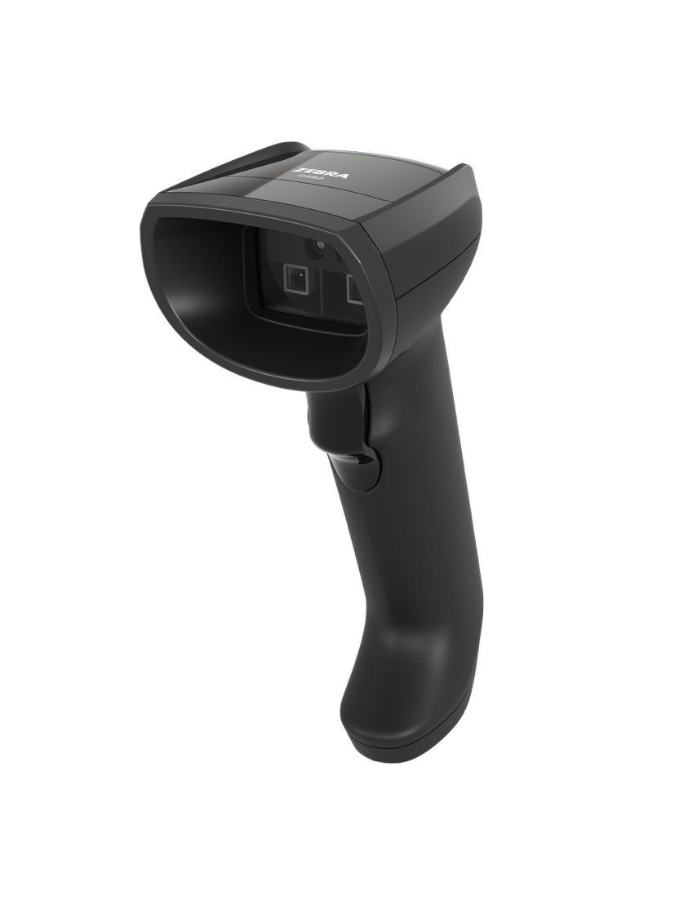
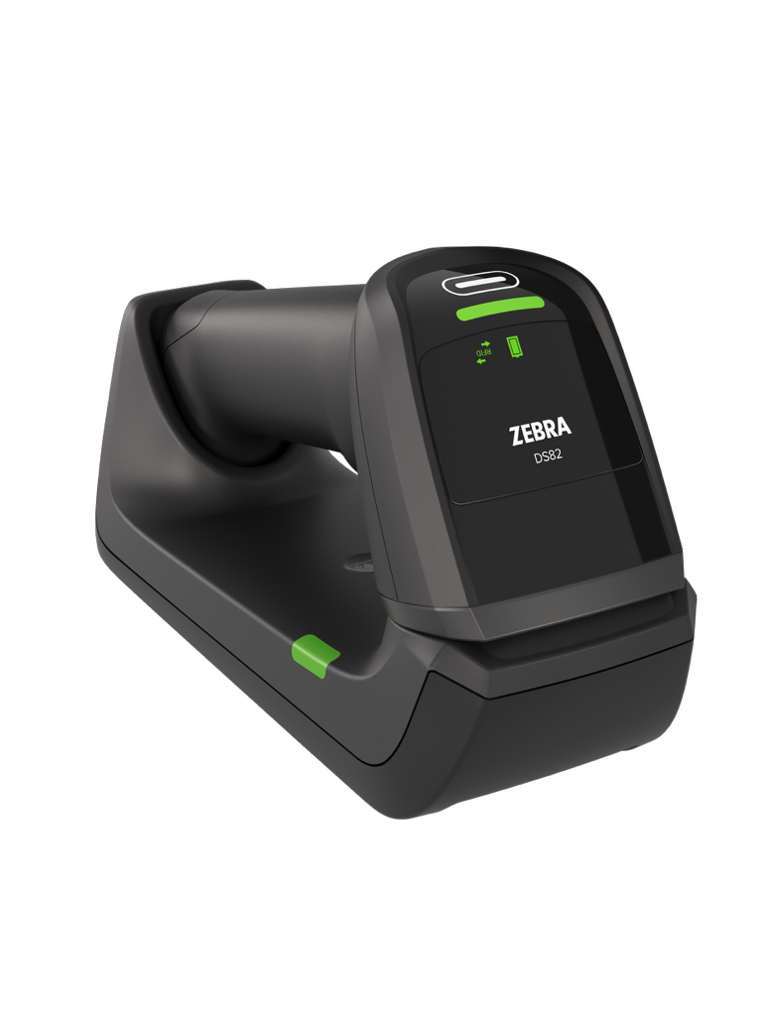
Introducing
DS82 Series
Handheld Scanners
The next evolution in premium handheld scanning, built to enhance operational efficiency across every area of the store
A new standard in scanning performance
Smarter operations
with RFID
Future ready to adapt with
your business
Cutting edge cordless technology
6
ZEBRA TECHNOLOGIES
6

Slide 7
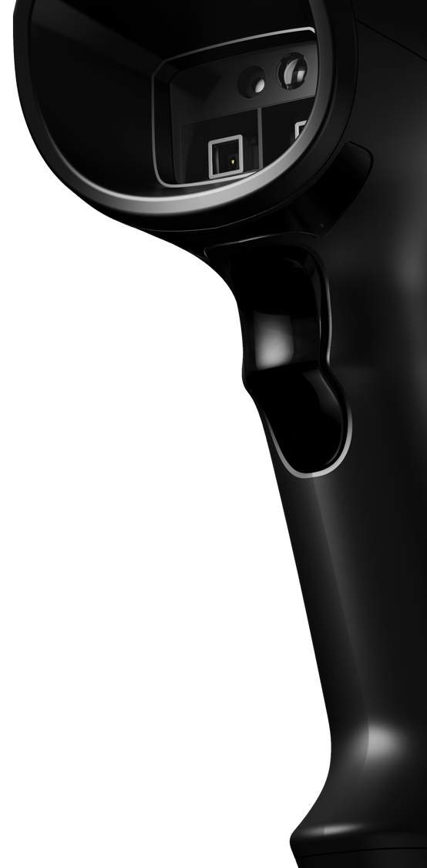
What sets the DS82 Series apart from the rest?
BOOST PRODUCTIVITY
EASIER MANAGEMENT
ITEM-LEVEL VISIBILITY
Enhanced performance, captures more barcodes
faster and with less effort
Up to 25% longer battery life and optional supercapacitor for ultra fast charging
Integrated RFID
model for smarter
retail operations
LOWER TCO
UNLOCK NEW EFFICIENCY
FUTURE-READY
Fast contactless charging for better uptime and less
maintenance
Programmable multi-function button can support different workflows
Exclusive 2 MP sensor
is ready for third-party vision applications
ZEBRA TECHNOLOGIES
7

Slide 8
Markets and applications

Slide 9

Retail
Point-of-Sale (POS)
Self-checkout
Buy Online Pickup In Store (BOPIS)
Buy Online Pickup At Curb (BOPAC)
Loyalty applications
Electronic coupon redemption
Backroom receiving
Real-time item-level inventory
Loss detection/prevention
ZEBRA TECHNOLOGIES
9

Slide 10

Transportation & Logistics
Shipping and receiving
Picking
Product tracking
Ticketing (airports, train,
and bus terminals)
Postal
ZEBRA TECHNOLOGIES
10

Slide 11

Light/Clean Manufacturing
Product and component tracking
Work-in-Process (WIP)
Process control
ZEBRA TECHNOLOGIES
11

Slide 12

Hospitality
Check-in
Ticketing: concerts, sporting events, and more
Loyalty applications
ZEBRA TECHNOLOGIES
12

Slide 13

Government
Asset tracking
Document management
ZEBRA TECHNOLOGIES
13

Slide 14
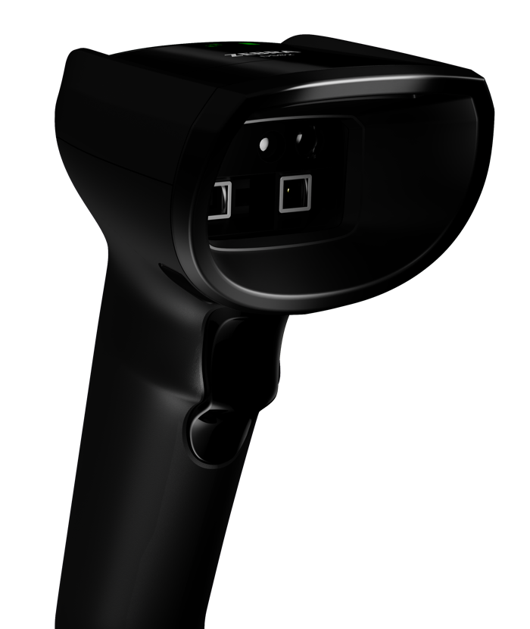
Differentiating features

Slide 15
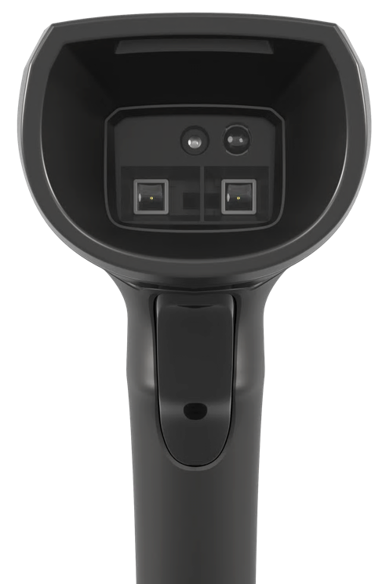

Next-level premium scanning
DS82 Series resets the bar for handheld scanning
Faster, easier, more accurate scanning with PRZM Intelligent technology
Instantly capture dirty, damaged, poorly printed, shrink-wrapped, and other challenging barcodes
Easily reach barcodes on items at the bottom of a shopping cart: 28 inches
(71 cm) for UPC codes and 20 inches (50 cm) for 2D QR codes
2x
Higher sensor resolution with an advanced 2 MP optical system
Enhanced scan performance
Capture more barcodes in a single trigger pull to boost productivity
ZEBRA TECHNOLOGIES
15

Slide 16
Get ready for GS1 Digital Link
The Industry is Evolving
GS1’s Sunrise 2027 initiative marks the shift from traditional
1D UPC barcodes to smarter, data-rich 2D barcodes
Introducing GS1 Digital Link
Adds a web-enabled layer to 2D barcodes, connecting retailers and consumers to real-time data like:
Allergens and product details
Recalls and expiration alerts
Supply chain traceability
Authentication and fraud prevention
The Impact for Retailers
Improve efficiency, ensure product safety, and enable smarter decisions with access to richer product data at checkout
With the DS82 Series, the future is already built-in
Fully compatible with GS1 Digital Link
Large scan zone easily captures both 1D and 2D codes on the same product
Use 123Scan to configure your scanners for GS1 Digital Link in less than a minute!
Support minimal disruption or full adoption—your choice
Developed in collaboration with GS1 standards experts
ZEBRA TECHNOLOGIES
16

Slide 17





Capture it all
Cashiers and self-checkout customers can scan virtually any barcode the first time, every time to keep lines moving and customers happy
Poorly printed and hard-to-read barcodes
Damaged and dirty barcodes
Heavy and bulky items in a shopping cart
Mobile coupons, gift cards and loyalty cards
Picklists with multiple codes
Documents
GS1 Digimarc®
GS1 Digital Link
Driver’s license information
Wide barcodes on boxes and cartons
Dot Code and Dotted DataMatrix under cellophane
ZEBRA TECHNOLOGIES
17

Slide 18
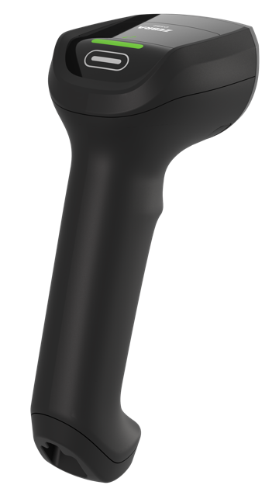

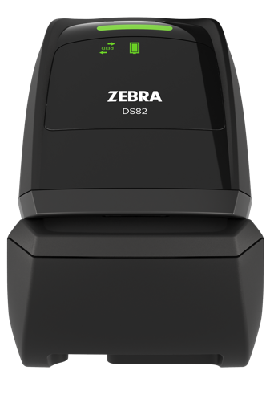

Sleek, integrated RFID
Seamlessly integrated antenna
User
familiarity
Take advantage of capturing unique item details from RFID tags without impacting the high-performance scanning you expect from a premium handheld scanner
RFID reading is invisible and doesn’t impact the checkout experience
  RFID matches barcode scanning modes; no change to user operation
Customizable RFID read range
Programmable RFID trigger
  Minimizes false reads from other checkout lanes and nearby aisles
  Use the multi-function button as an RFID trigger for directed RFID reading (returns or item counting)
ZEBRA TECHNOLOGIES
18

Slide 19
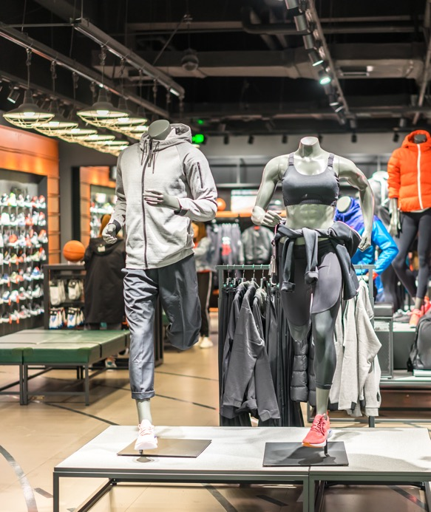




Drive smarter operations with RFID
Layer barcode and RFID data for more precise inventory tracking, smoother stock management, and reduced shrink
Use cases include
Accurate inventory tracking: Capture serialized item details like size, color, and serial number for precise inventory management
Consumer notifications: Use RFID data to alert customers about expiration dates or other alerts about scanned items
Loss prevention: Integrate with fixed readers at store exits to ensure items are purchased and prevent fraudulent returns
Comprehensive asset visibility: Complete store-wide visibility from inventory to point of sale with the Zebra RFID ecosystem
ZEBRA TECHNOLOGIES
19

Slide 20

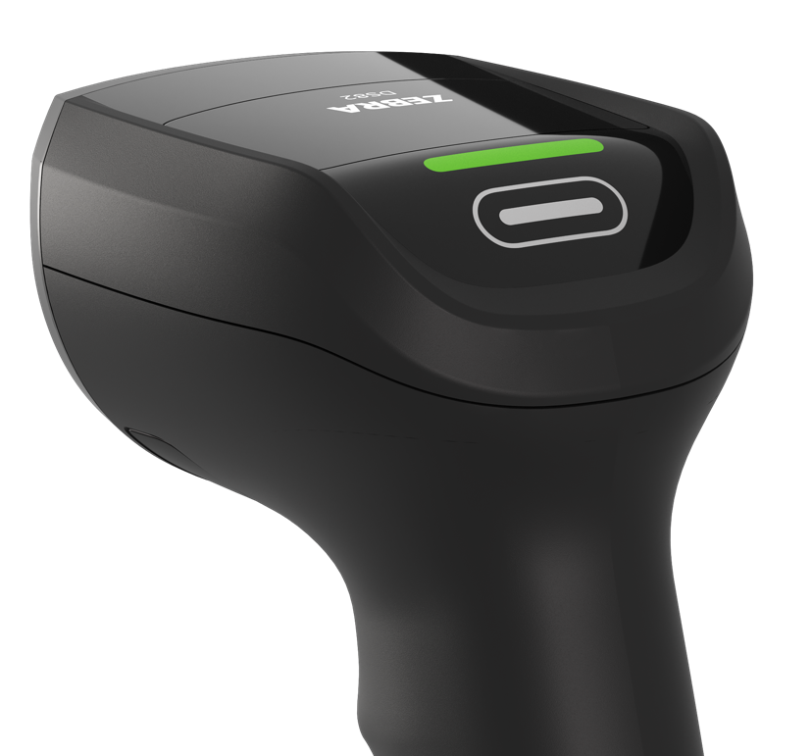
One button. Countless possibilities
Customize your workflows with a programmable multi-function button
Built for flexibility
Easily customizable to support complex workflows; meet two different workflows (e.g. inventory and POS) with the same scanner
Speed up your workflows
Use it as an RFID trigger (DS82 Series RFID models)
Use it for image capture/camera trigger
Use it as a “Page button” to locate the cradle
Toggle features such as Apple keypad
Define Advanced Data Formatting (ADF) rules for primary or secondary trigger
ZEBRA TECHNOLOGIES
20

Slide 21


Unleash productivity with better cordless technology
Cutting-edge features make it easier to use and manage cordless scanners
Maintenance-free contactless charging Wirelessly charge your scanners with inductive technology, making it
easier to clean, reducing wear and tear, and extending the lifespan
of both the device
and cradle.
100,000
Scans on a single charge with the PowerPrecision+ battery–25% more than closest competitor
8x
more supercapacitor power than the competition
ZEBRA TECHNOLOGIES
21

Slide 22
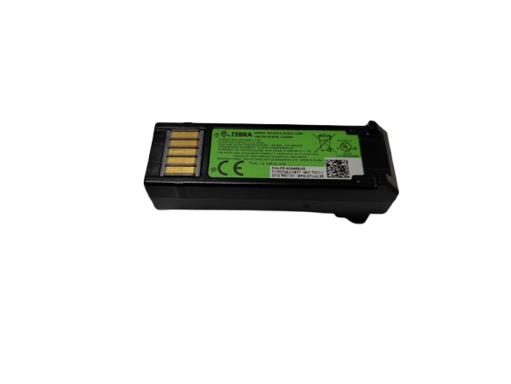
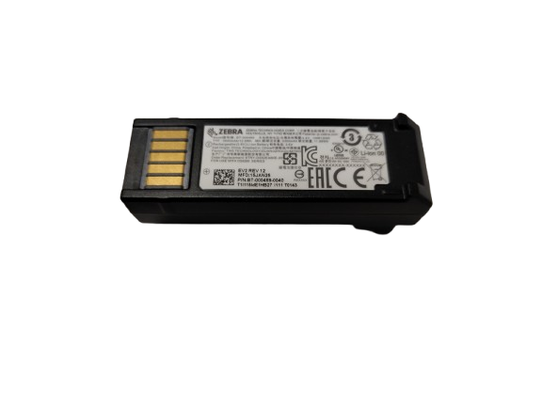
Swappable power sources
Two interchangeable power options make it easy to choose the right power solution for your workflows – and switch any time your needs change
PowerPrecision+ battery
Over three full days of 24x7 scanning (100,000 scans)
Up to 25% longer battery life than the closest competitor
A wealth of battery metrics for better management ⎯ and optional battery maintenance services
Gives users the flexibility to be away from a charging cradle
for extended periods
PowerCap™ supercapacitor
Greener alternative; designed for longevity so there are no batteries to manage or dispose of
Up to 6,000 scans per charge, 8x more than competing models
Ultra-fast charging minimizes downtime: ready for 100 scans in just 35 seconds
Capable of holding a charge for several hours
ZEBRA TECHNOLOGIES
22

Slide 23
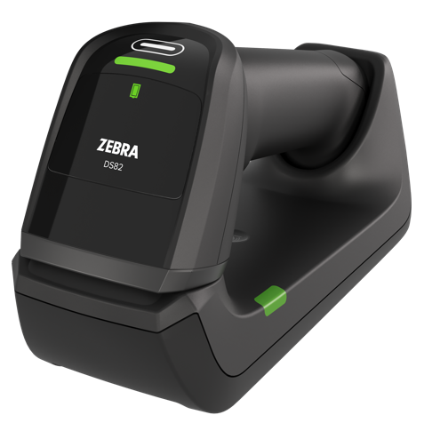
Smarter cordless by design ⎯ down to the details
Intelligent extras, fine-tuned for real-world use
Dedicated power gauge
See at-a-glance if the battery or PowerCap supercapacitor are sufficiently charged to reduce downtime
Choice of cradles
Compact Presentation Cradle for hands-free scanning; Standard Cradle sits on a desktop or
can be mounted on a wall
Contactless charging
Available for both the battery and
PowerCap supercapacitor
Wi-Fi Friendly mode
Bluetooth scanners won’t interfere with
your Wi-Fi network
AutoConfig cradle
Switch workflows and host apps by simply pairing to a different cradle
Paging button
Missing a scanner? Press the cradle’s paging button to instantly locate it
FIPS security
Government-grade security safeguards sensitive data
Virtual tether
Keep cordless scanners where they belong; If a scanner is taken out of range or left out of the cradle too long, both the scanner and cradle emit alerts
ZEBRA TECHNOLOGIES
23

Slide 24

Future-ready to support vision applications
Third-party vision applications can leverage the exclusive 2 MP sensor to enhance functionality
Get the flexibility to support new use cases
with vision applications, such as…
Enhanced loss prevention
Detect mismatches between items and scanned barcodes
Flag suspicious transactions in real time
Smoother checkouts
Recognize products in real time with computer vision
Future-ready flexibility
Supports emerging vision applications, making it a smart investment for forward-thinking retailers
ZEBRA TECHNOLOGIES
24

Slide 25
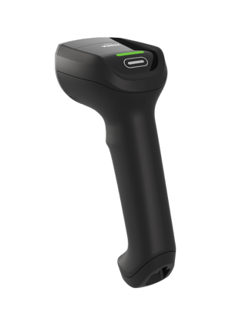
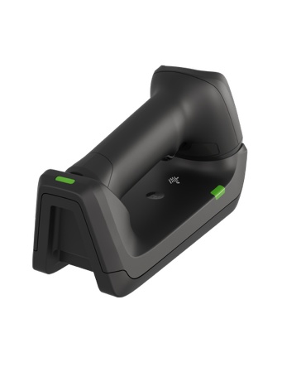
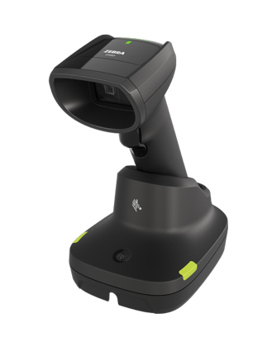
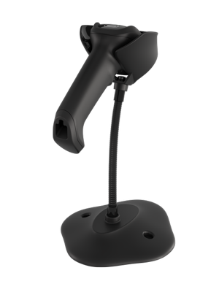
Optimized for hands-free and handheld efficiency
Scan with ease, whether you choose corded or cordless, hands-free or handheld
All-day comfort in handheld mode
The updated ergonomic design is sleek, lightweight, and well-balanced—reducing fatigue and delivering maximum comfort, even in the most scan-intensive environments.
Keep cordless scanners charged and in use
The Presentation Cradle charges cordless scanners while in hands-free mode and automatically switches to manual scanning when the device is picked up.
Switch between handheld, hands-free on the fly
Simply place the corded scanner in the optional Intellistand to automatically switch to hands-free mode; pick up the scanner for handheld mode—no
change of settings is required.
ZEBRA TECHNOLOGIES
25

Slide 26
Designed to withstand
real-world demands
Sealed against dust and spills
IP52 sealing protects against spills on the checkout counter
Less downtime. Fewer replacements. Lower total cost of ownership
Built tough
10 ft. (3 m) Mil Spec drop
50 x 6 ft. (1.8 m) drops to concrete
across the temperature range
2,000 tumbles in punishing tumble test
Recessed scan window
Protects against scratches, smudges, and dirt build up that can impact performance
ZEBRA TECHNOLOGIES
26

Slide 27
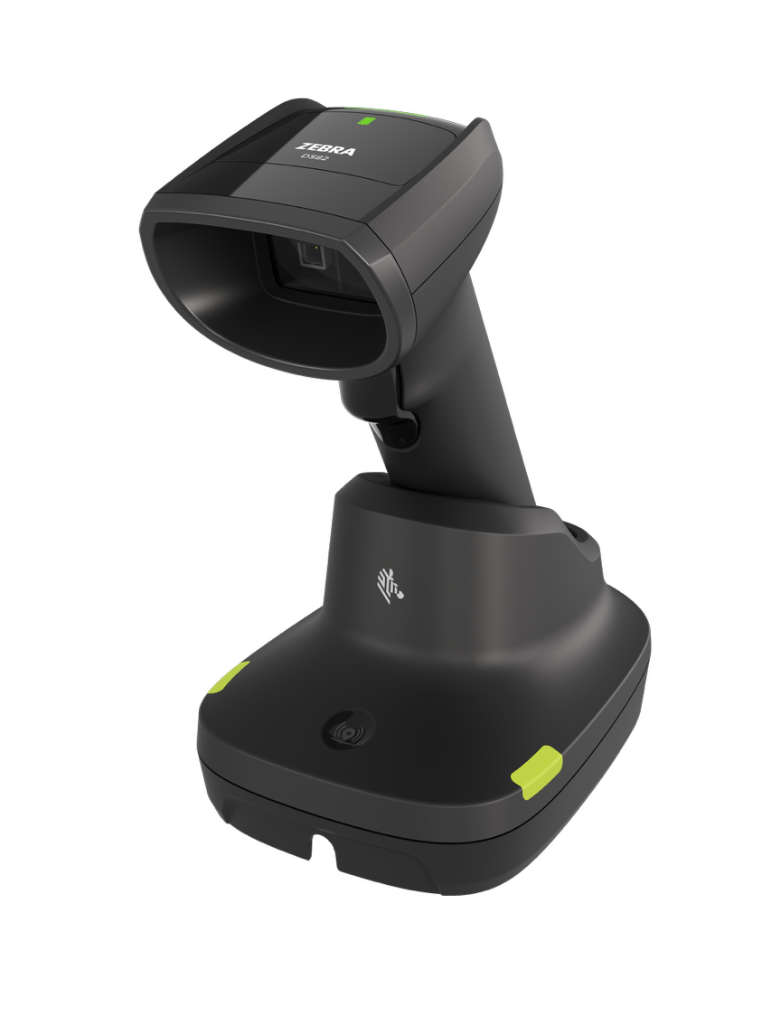
Product tour

Slide 28
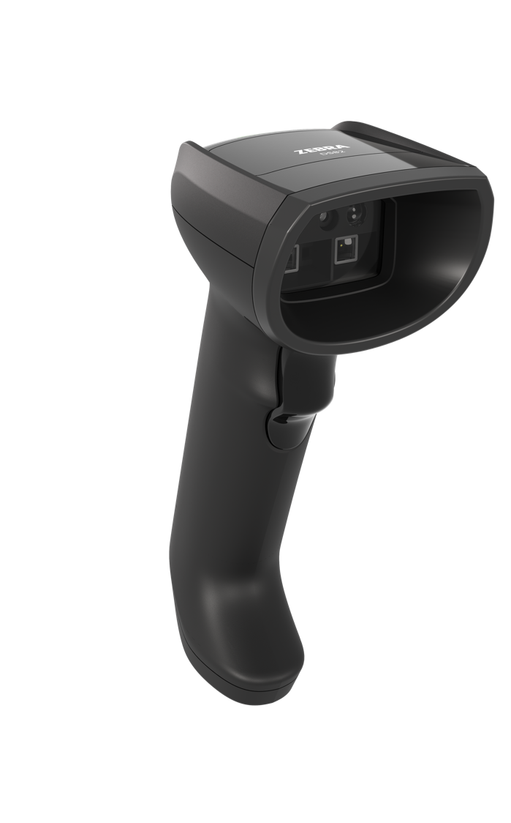

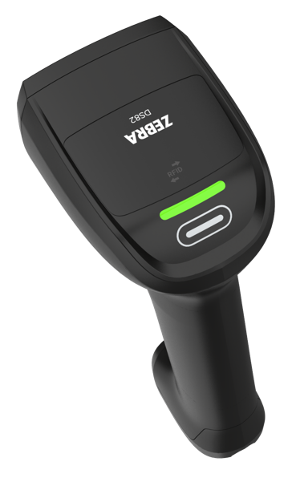
Product tour: DS8208 Corded
RIDGED CANOPY
Protects internal components for enhanced durability
MULTI-FUNCTION KEY
Programmable, use it as a second trigger, interface with a different host app
2 MP SENSOR
Enhanced scan performance and ready for third-party vision applications
DEEPLY RECESSED SCAN WINDOW
Protects against scratches and other damage
EASY TO GRIP HANDLE
Ergonomic design, well-balanced to reduce fatigue
GOOD DECODE LED
Easy to see
HAPTIC FEEDBACK
Ideal for noisy or sound-sensitive environments
ZEBRA TECHNOLOGIES
28

Slide 29
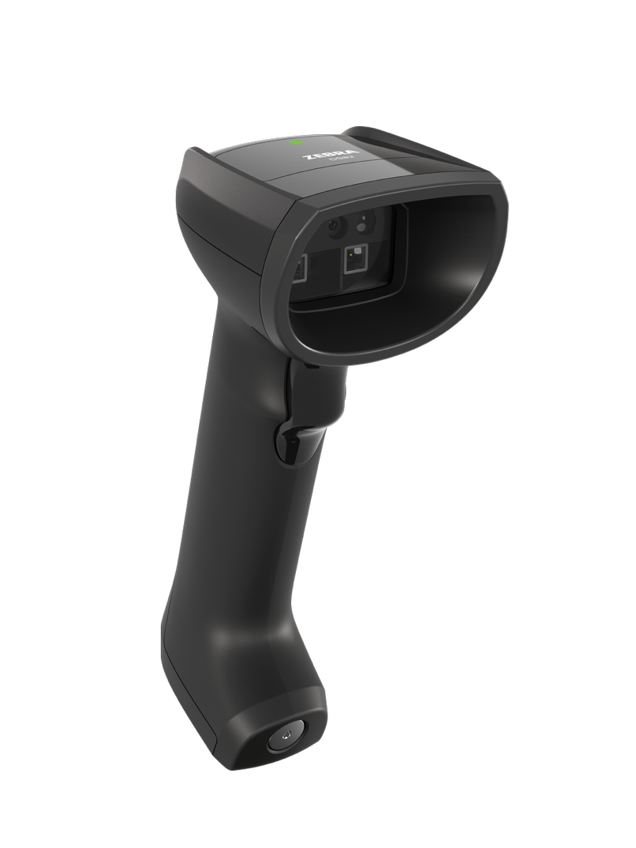
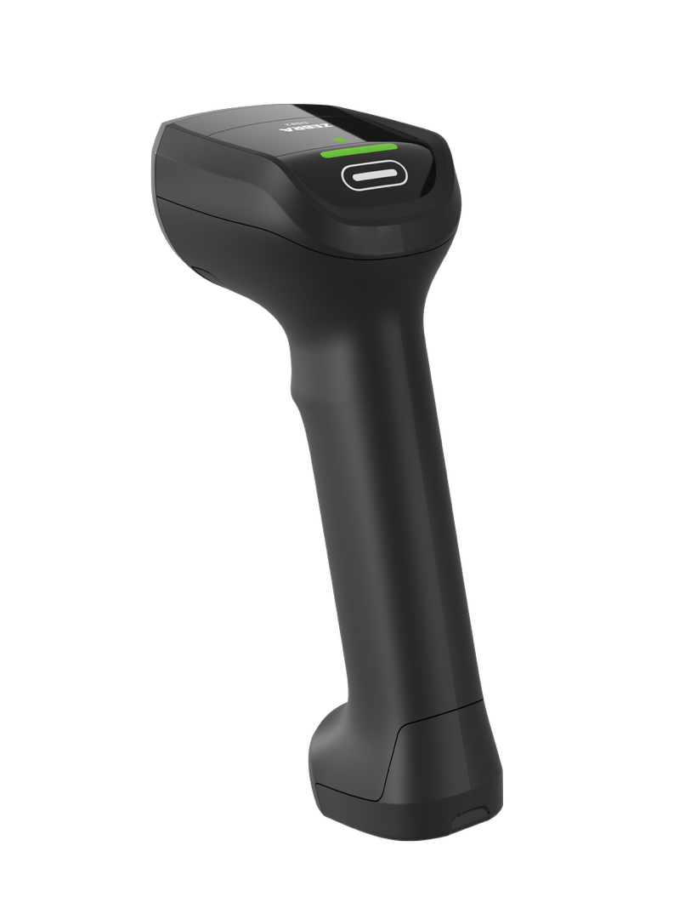
Product tour: DS8288 Cordless
RIDGED CANOPY
Protects internal components for enhanced durability
MULTI-FUNCTION KEY
Programmable, use it as a second trigger, interface with a different host app
2 MP SENSOR
Enhanced scan performance and ready for third-party vision applications
DEEPLY RECESSED SCAN WINDOW
Protects against scratches and other damage
HAPTIC FEEDBACK
Ideal for noisy or sound-sensitive environments
EASY TO GRIP HANDLE
Ergonomic design, well-balanced to reduce fatigue
GOOD DECODE LED
Easy to see
INTERCHANGEABLE
POWER OPTIONS
3500 mAh smart Li-Ion battery
or 1000F supercapacitor
ZEBRA TECHNOLOGIES
29

Slide 30
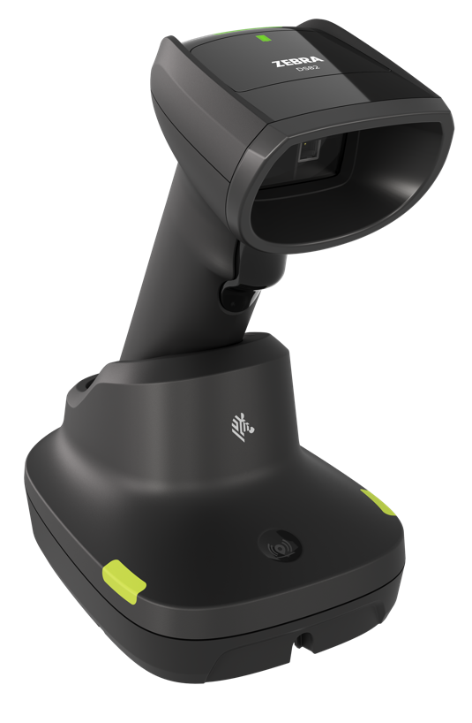
Product tour: Presentation Cradle
IR SENSOR
Wakes up illumination only when an object is present to reduce excess lighting and lower energy costs
HANDLE SCOOP
Provides additional stability
COMPACT FOOTPRINT
75mm x 125mm x 94mm
PAGER BUTTON
Track down a misplaced scanner
DUAL-SIDED LEDs
Easy to see
CABLE MANAGEMENT
1 front cable exit, 2 rear cable exits
ZEBRA TECHNOLOGIES
30

Slide 31
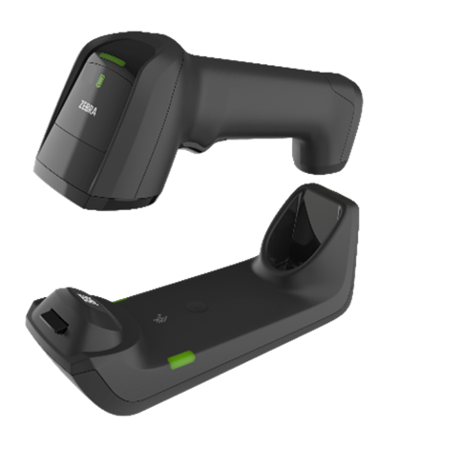
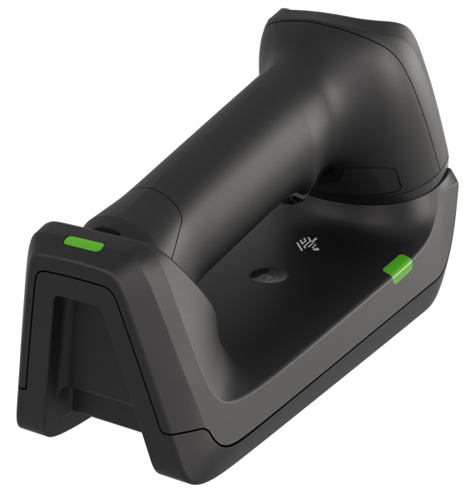
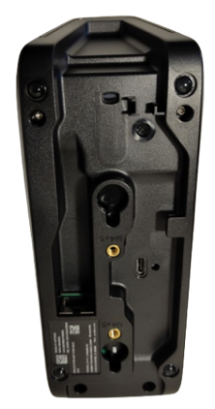
Product tour: Standard/Desktop Cradle
CONTACTLESS CHARGING
Easy to clean, reduces wear and tear and maintenance
DUAL-SIDED LEDs
Easy to see
PAGER BUTTON
Track down a
misplaced scanner
USB-C
Can be used for power in conjunction with Mod Jack
SECURE FOOT POCKET
Taller foot pocket holds the foot in place more securely
ADDITIONAL LED
Easy viewing inside a cubby
MOD JACK
MOUNTING HOLES
Matches DS8178 cradle
ZEBRA TECHNOLOGIES
31

Slide 32
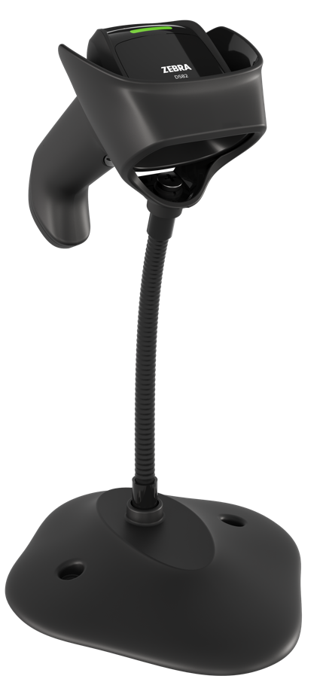
Zebra DNA
Set Up. Secure. Manage. Optimize.

Slide 33
Empower your workforce.
Drive results.
Intelligence made simple
in every Zebra device.
ZEBRA TECHNOLOGIES
33

Slide 34

Zebra DNA for Scanners
Simplify your scanning journey
123Scan
Simplify scanner setup and deployment
with intuitive configuration wizard that delivers time-saving features
and functionality.
IoT Connector
Collect enterprise data and route to your preferred
IoT endpoint to analyze and act to make data-driven decisions in
real time.
DataWedge for Scanners
Seamlessly handle multiple workflows in real time, automatically formatting captured data for the designated screen and host application.
Virtual Tether
Receive alerts when a scanner is taken beyond its Bluetooth range or left off the charger for a predefined length
of time.
Label Parse+
Capture up to 10+ barcodes on a single label. Data is captured, parsed, properly formatted, and sent to your application in under a second.
Zebra DNA empowers your
scanners with unmatched
visibility, uptime, and adaptability.
ZEBRA TECHNOLOGIES
34

Slide 35



















Zebra DNA for Scanners
Make the most of every stage of your scanning journey from deployment to optimization. Zebra DNA lets you keep devices current and adapt them to your business needs for a stronger ROI across the full lifecycle
Set Up
Secure and Manage
Optimize
DataWedge: Easily capture data and send to
your host applications without programming
IoT Connector: Collect enterprise data and route to your preferred IoT endpoint to analyze and act to make data-driven decisions in real time..
PowerPrecision+: Gain easy access to fleetwide metrics and get visual feedback of charge status and battery state of health.
Virtual Tether: Keep track of your cordless scanners
and prevent workflow interruptions caused by a misplaced device.
123Scan: Configure your scanner using a wizard to program electronically or via a printed 2D barcode. Simultaneously stage up to 10 scanners locally.
Remote Diagnostics: Troubleshoot without traveling to sites and resolve issues faster.​
Remotely access asset information, health and statistics, configuration settings and barcode data.
Remote Management: Configure scanners remotely with two options: Scanner Management Service (SMS) or Windows Management Instrumentation (WMI).
PRZM Intelligent Imaging: Farther, faster, smarter imaging that can heighten productivity.
Multi-Code Data Formatting: Scan multiple barcodes with a single trigger pull.
Advanced Data Formatting: Automate workflow decisions for front-line workers
to improve productivity and data accuracy.
Scanner Control Application: Control Zebra cordless scanners from a phone or tablet.​
Intelligent Document Capture: Capture an image and automatically optimize its appearance.​
Preferred Symbol: Prioritize
one barcode while excluding others without having to
cover unwanted barcodes.
Scan-to-Connect: Rapidly connect scanners to a Bluetooth-enabled phone, tablet or PC in one step.
DataWedge for Scanners: One scanner seamlessly works with multiple applications.
Label Parse+: Instantly capture all the barcodes on
a GS1 label.
Wi-Fi Friendly Mode: Ensure Bluetooth scanners don’t interfere with your Wi-Fi network.
UDI Scan+: Capture and parse UDI data in the right order to the right fields, in one trigger pull.
Scanner Software Development Kit (SDK):
Easily create fully featured applications for Windows, Linux, Android, iOS and Chrome.
Blood Bag Parse+: With one trigger pull, instantly capture, parse and transmit data to your app.
ZEBRA TECHNOLOGIES
35

Slide 36
Zebra Services

Slide 37

Zebra OneCare™: the industry standard in enterprise support
Unexpected failures that interrupt your workflows aren’t an option. Zebra OneCare maintenance plans keep devices running at peak performance and ready for whatever your job demands
Eliminates unpredictable repair-related costs. With Zebra OneCare, there are no limits—if something is broken, we fix it
End-to-end
coverage
Reduce the cost of battery replacement over a device’s lifespan and ensure workers have a healthy, fully charged battery for every shift
Optional
battery
plans*
Included in every plan; your users get support they can count on—fully trained technical professionals are available** to answer questions and address issues
Technical
support
Optional
VisibilityIQ
Foresight™
Cloud-based dashboard to view device insights; address potential issues before they impact your business, uncover opportunities for cost-cutting, right-sizing inventory, and reducing lost assets
* Available for batteries only **Hours of availability is plan dependent
ZEBRA TECHNOLOGIES
37

Slide 38
Zebra OneCare™ Maintenance Plans
Feature | Zebra OneCare Essential | Zebra OneCare Select
Live-agent support | Mon–Fri, 8–5 local time | 24/7
Repair turnaround time | 3-day repair turnaround* | ‘Like-new” replacement device ships for next business day delivery
Accidental damage coverage
Automatic application of engineering changes
Cloud-based visibility into repair, case reports and more with VisibilityIQ™ OneCare
Battery service enhancement | Option to include Battery Maintenance
Commissioning service enhancement | Option to include Standard Commissioning | Standard Commissioning
Benefits
Genuine Zebra expertise and parts to maximize device uptime
Years of investment protection—all for less than the cost of a single repair
Cloud-based visibility to repairs and more, with detailed insights into contracts, case and lifecycle reports
True service from the source–no one knows Zebra devices and its software better than Zebra, and Zebra Certified Repair Partners
ZEBRA TECHNOLOGIES
* Based on when device arrives to repair depot
38

Slide 39
Why Zebra

Slide 40
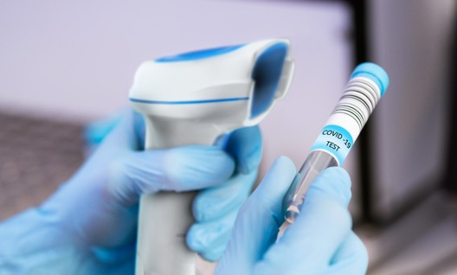

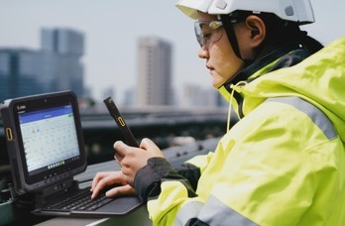

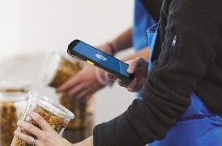
Globally recognized leader in powering the frontline
1
#
BARCODE
SCANNING
RETAIL TASK
MANAGEMENT SOFTWARE
RUGGED MOBILE COMPUTING
THERMAL
PRINTING
RFID
READERS
ZEBRA TECHNOLOGIES
40
Sources: VDC Research and Zebra analysis (#1 market share),

Slide 41

Powering organizations across the globe
$5.0B
~9,900
80%⁺
in global sales (2024)
employees in 55 countries across 120 offices
of Fortune 500 companies are Zebra customers
10,000⁺
~7,150
~10%
Channel partners in over 190 countries
US & Int’l patents issued and pending
of sales to R&D
ZEBRA TECHNOLOGIES
41

Slide 42
Thank You!
ZEBRA and the stylized Zebra head are trademarks of Zebra Technologies Corp., registered in many jurisdictions worldwide. All other trademarks are the property of their respective owners. ©2025 Zebra Technologies Corp. and/or its affiliates. 11/06/2025

